Slide 1
Supporting Strategic Decision-Making with Open Cost Data: Insights from OpenAIRE and PathOS openCost Conference 2024
Ioanna Grypari
Natalia Manola

Slide 2
Introduction
Importance of Market Dynamics
Understanding how costs influence funding decisions is essential for strategic decision-making in Open Science.
This Talk
Examine the role of OpenAIRE and PathOS in providing insights into the economic impact of Open Access publishing.
Highlight the significance of APCs in the Open Science landscape.
Showcase insights from an APC extrapolation exercise.

Slide 3
The Impact of Open Science

Slide 4

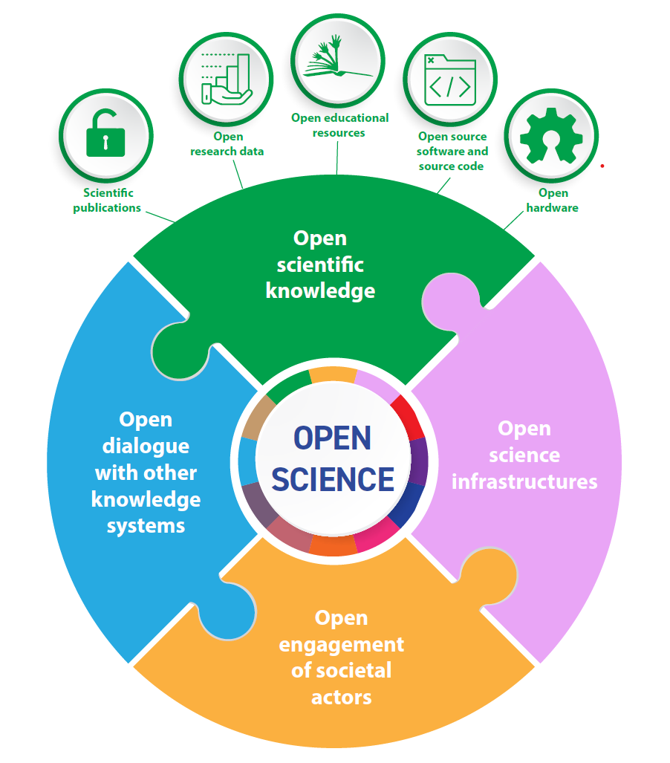
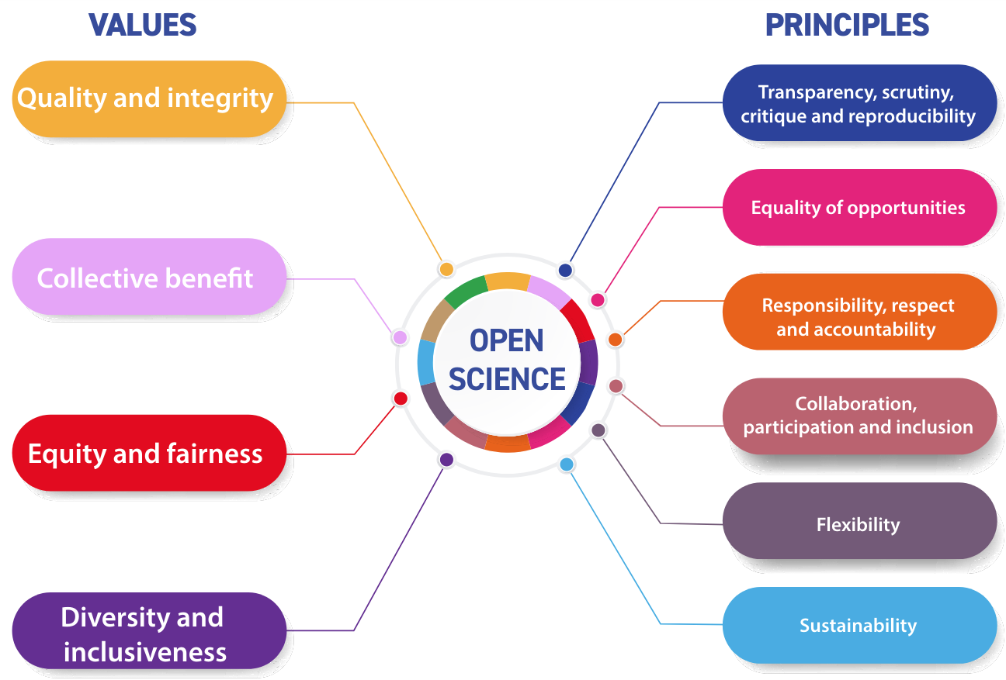
Images from UNESCO Recommendation, CC-BY-SA
Open Science is a diverse bunch of practices and principles

Slide 5

Are our plans working?
Image : Envato Elements
What are the longer-term consequences of not only making things Οpen, but the ways we are going about it?
Are there unintended consequences and “grimpact”?
Notes:
Paul Benneworth & Gemma Derrik: Grimpact – Time to acknowledge the dark side of the impact agenda. LSE Impact Blog. https://blogs.lse.ac.uk/impactofsocialsciences/2019/05/28/grimpact-time-to-acknowledge-the-dark-side-of-the-impact-agenda/

Slide 6


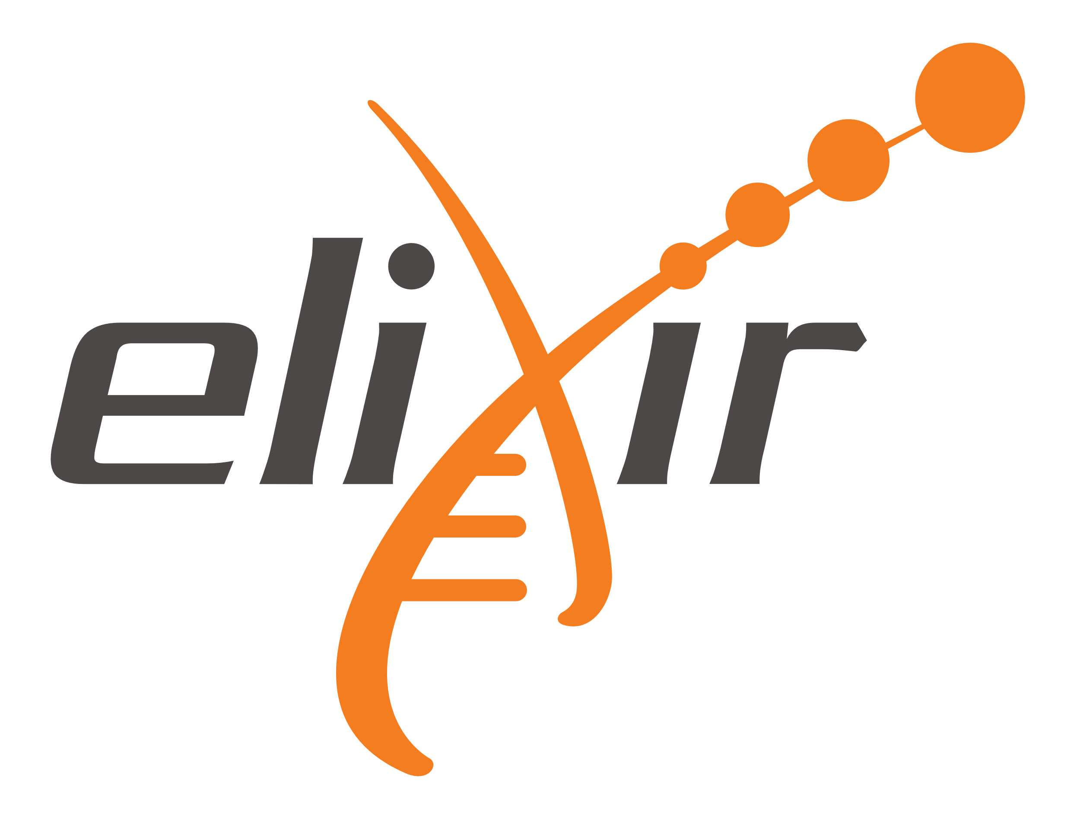
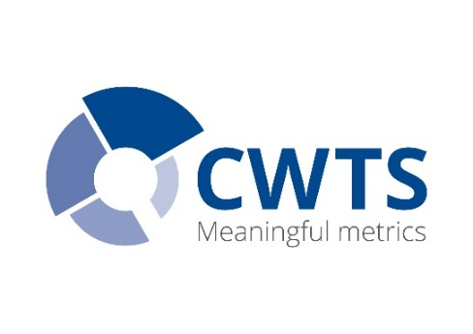

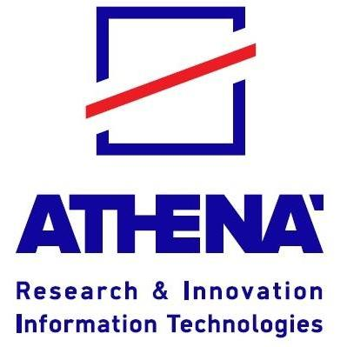
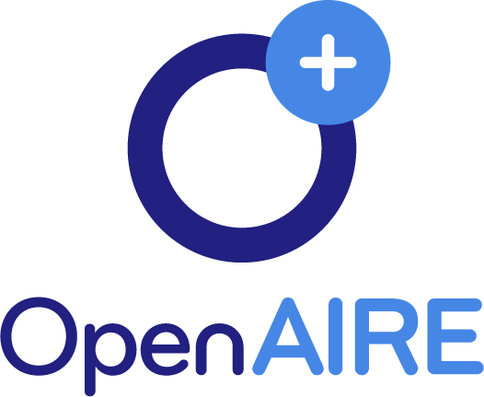

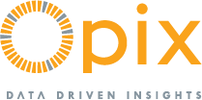

Programme: Horizon Europe
Call: HORIZON-WIDERA-2021-ERA-01
Type of Action: Research and Innovation
Topic: Modelling & quantifying the impacts of Open Science practice
Grant Agreement No.: 101058728
Duration: Sep 2022 – Aug 2025

Slide 7
PathOS Primary Objective
Identify and quantify the Key Impact Pathways of Open Science across academia, society, and the economy to enhance understanding and drive informed policy-making.
Beyond state of the art
  Map the Causal Pathways for Open Science, and design and estimate OS Impact Indicators for chosen case studies through a data-driven, AI-assisted approach.
  Formulate a Cost-Benefit Analysis framework tailored to Open Science practices and implement it in selected case studies.

Slide 8
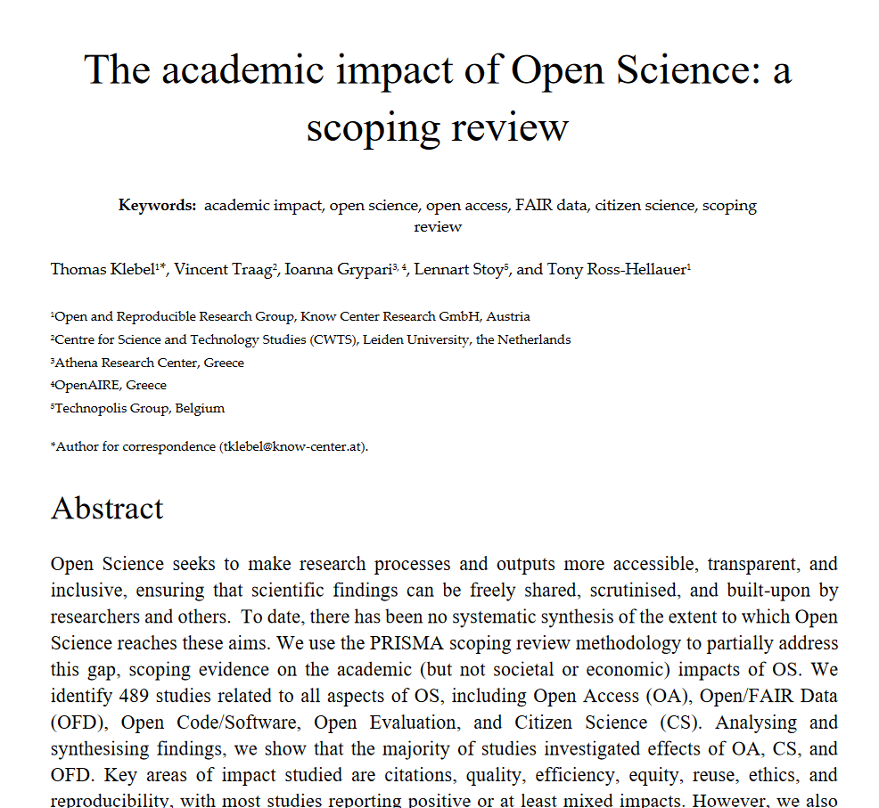
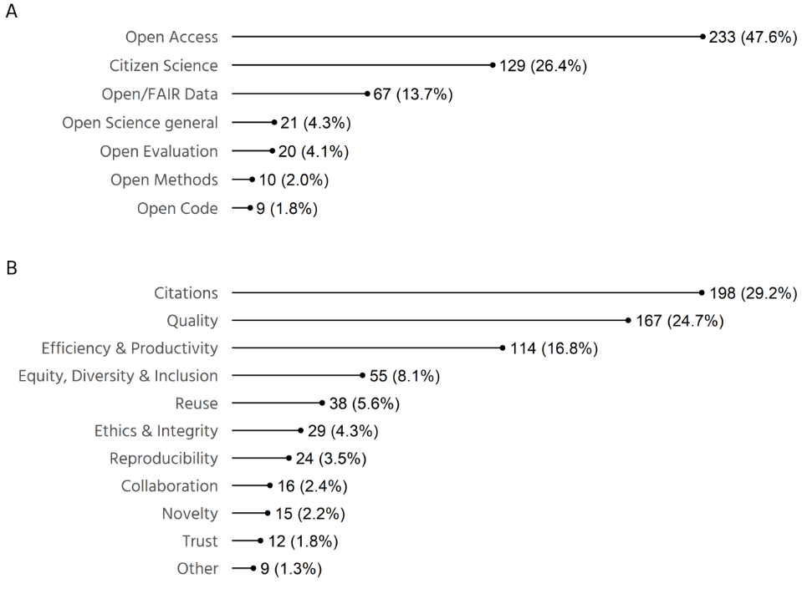
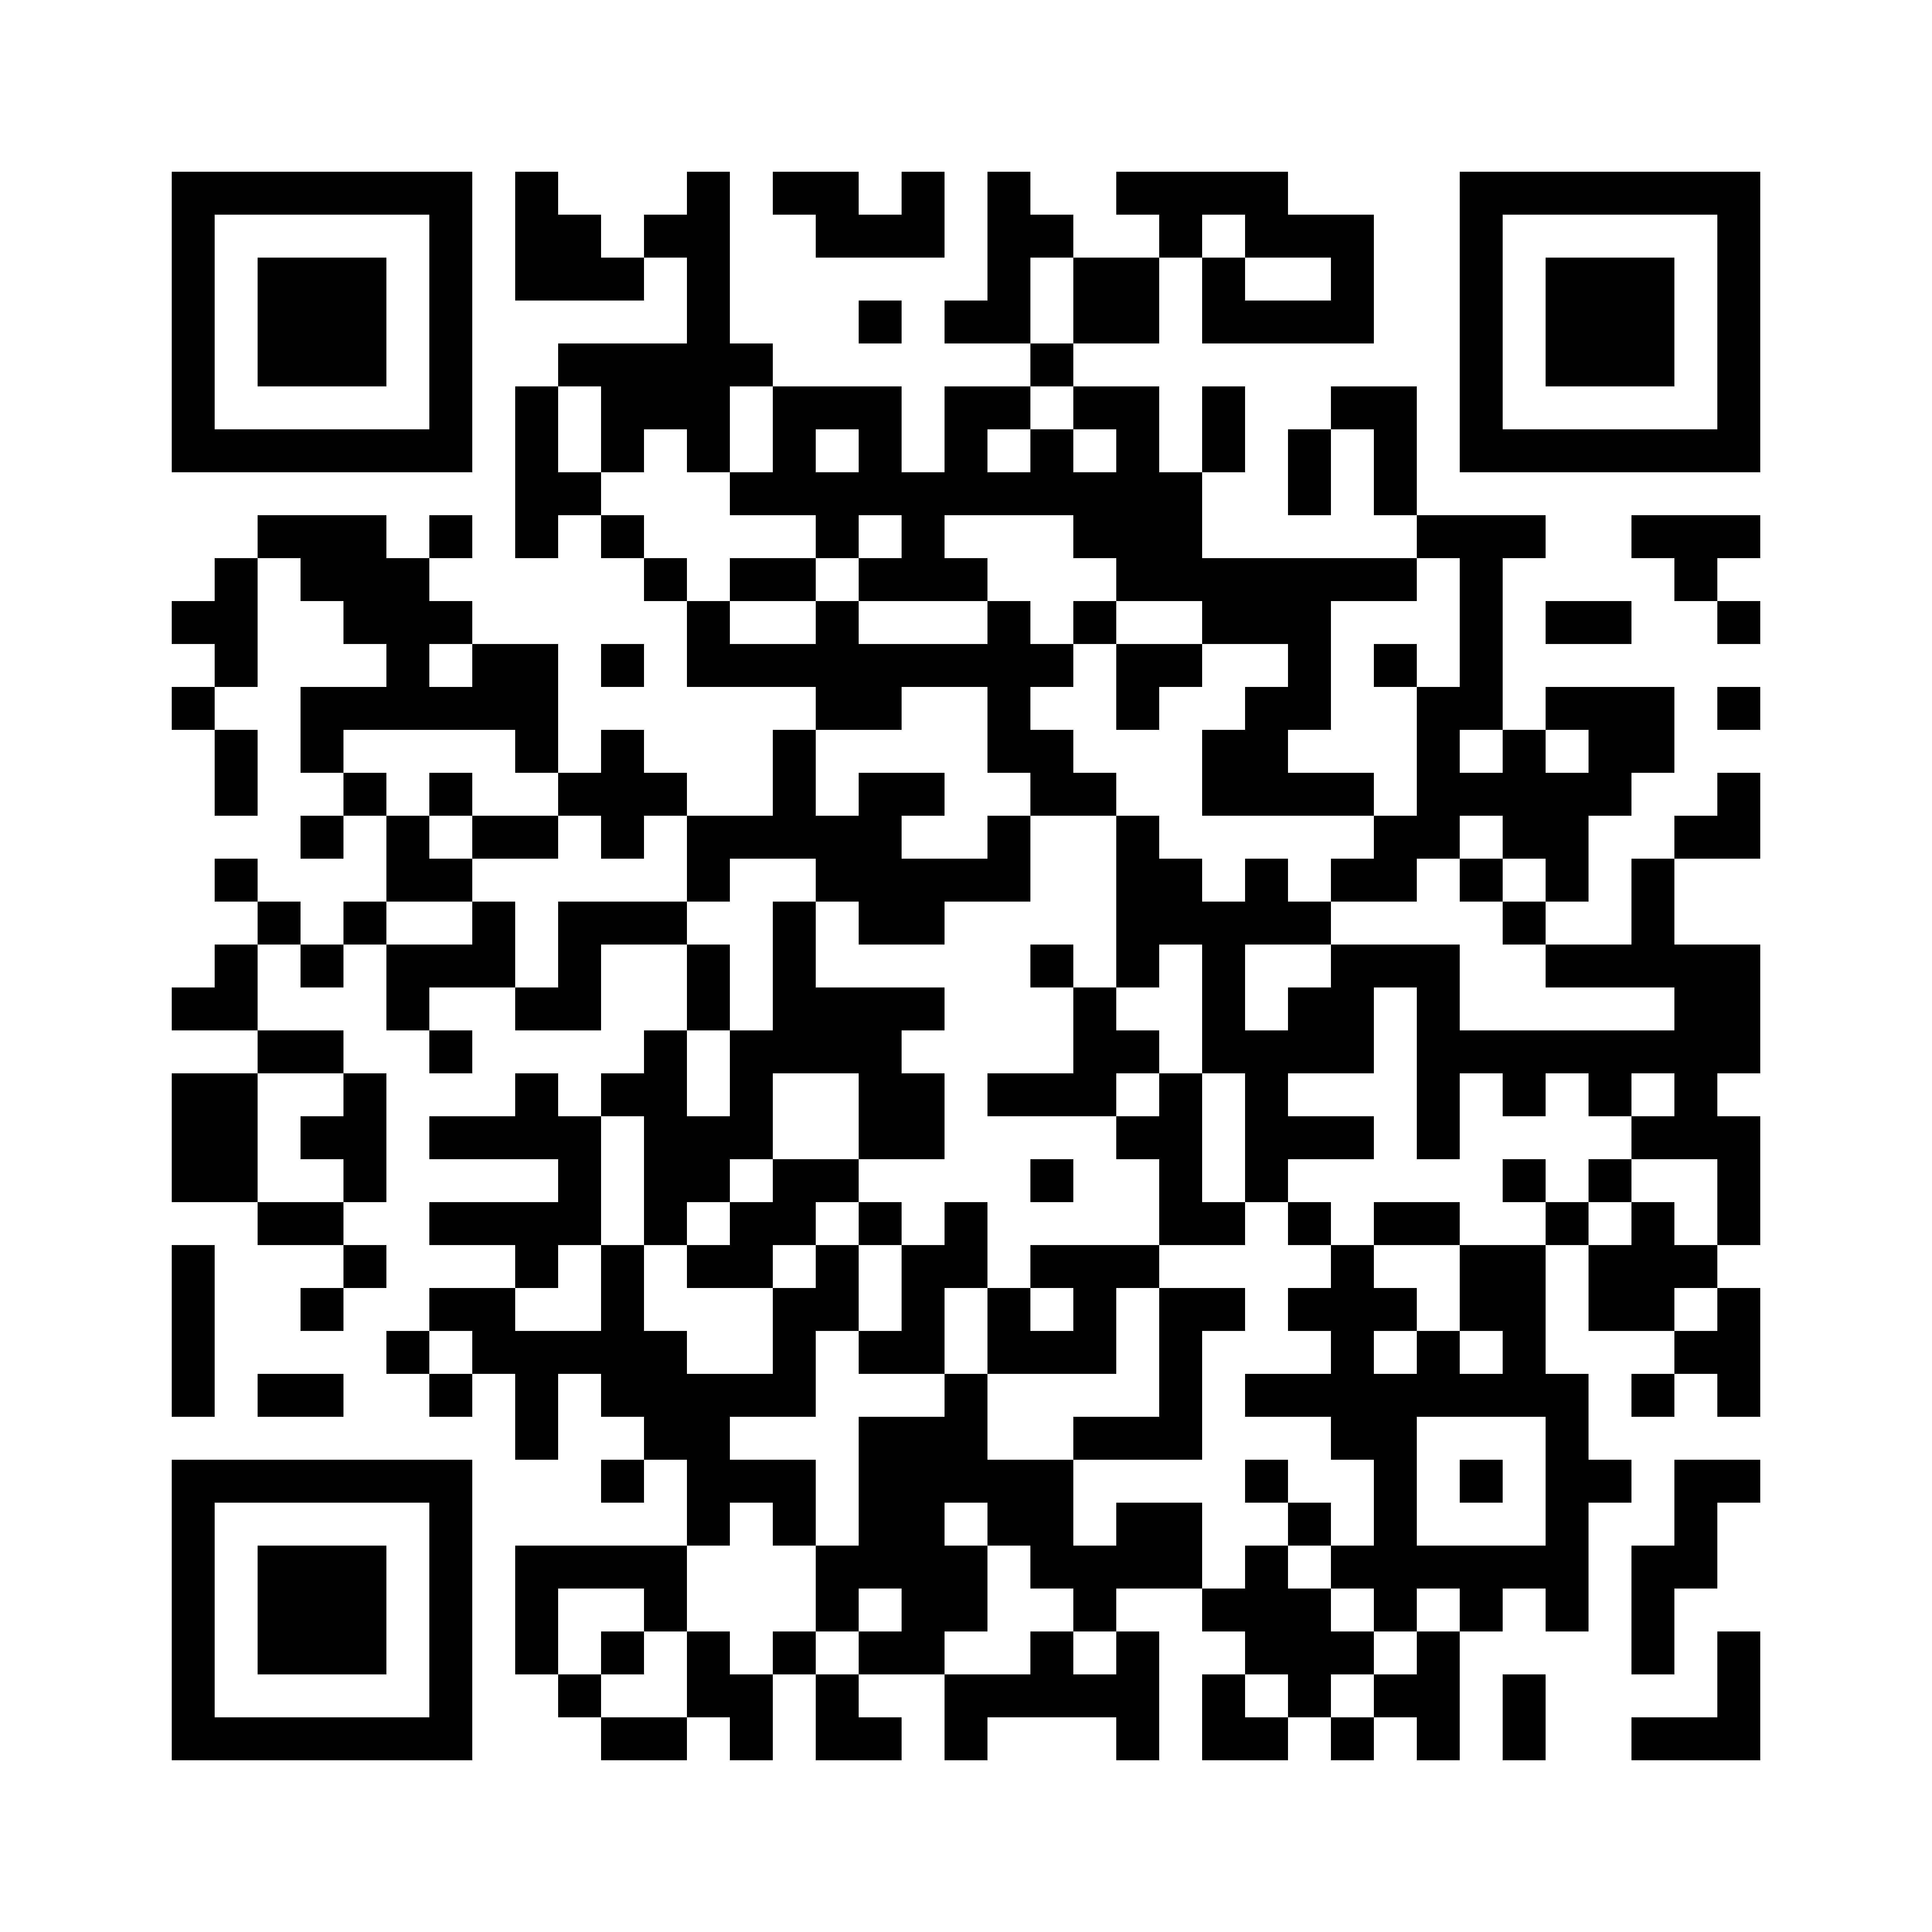
Academic impact: 489 included studies
Preprint available at https://doi.org/10.31235/osf.io/ptjub

Slide 9
Academic impact: Main findings
Citations
  Small to moderate increase from OA, Open/FAIR Data, and Open Evaluation
  Unclear effects from Open Code, no effect from OS badges
Quality
  Neutral to moderate positive effects from Open Peer Review
  Conflicting evidence from OA, Citizen Science neutral effect on quality given sufficient training
Efficiency & productivity
  Positive effects from Citizen Science, OA, and Open Science in general
  Unclear effect of Open Evaluation
  Wasted time from predatory publisher emails (OA)
Equity, diversity and inclusion
  OA leads to more diverse citations and international collaboration
  Marginalization of those with fewer resources (OA-APC, Open/FAIR Data) or lower status (Open Evaluation)
  Citizen Science activities focused in the Global North
Reuse
  Positive effect of Open/FAIR data
Reproducibility
  Positive effects of preregistrations and registered reports
  No effects of Open/FAIR Data or Open Methods
Novelty
  Potentially positive effect of OS practices on rate of true discoveries
Ethics & Integrity
  Unclear impact of Open Evaluation on integrity of reviews
  Open/FAIR data has risk of re-identifying participants
Trust
  Positive effect of OS badges on trust in results by scientists.

Slide 10
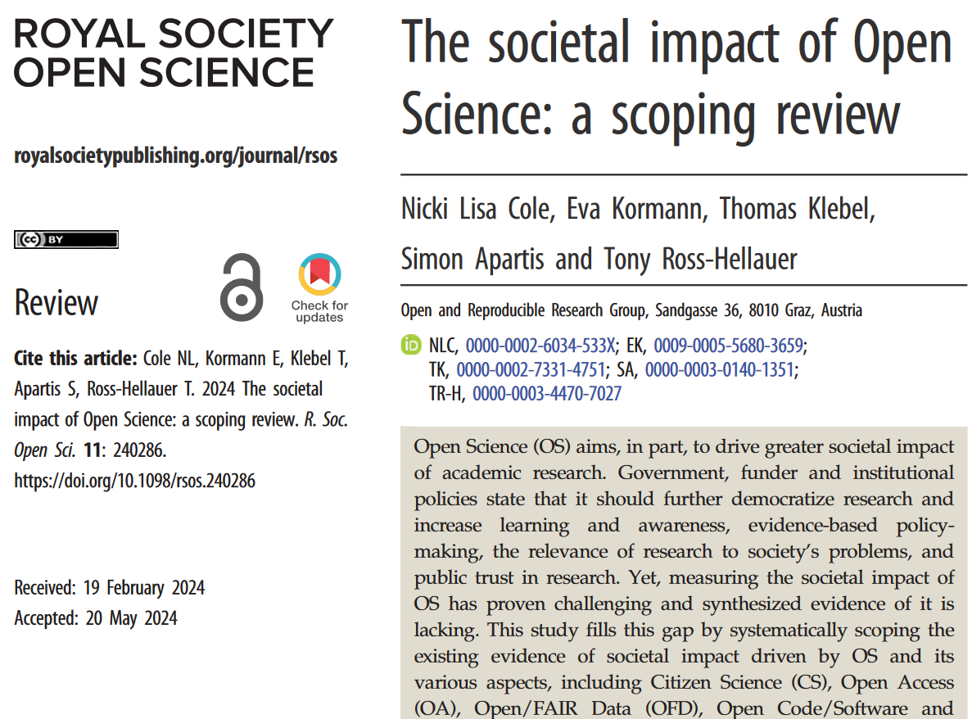
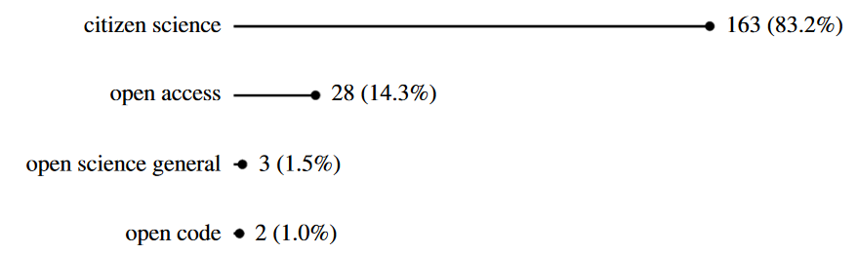
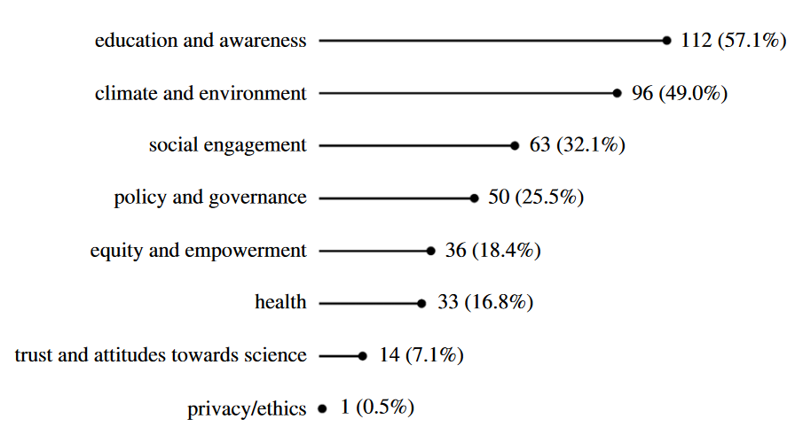

Societal impact: 196 included studies
Notes:
Main findings
Majority of evidence pertains to Citizen Science (83.2% of papers), with some from Open Access (14.3%) and limited evidence from other OS aspects
Evidence shows impact in terms of education and awareness (57.1% of papers), climate and environment (49%), and engagement (32.1%) -- these are driven by Citizen Science
Education
Strong evidence of positive impact of CS on participant awareness, knowledge and scientific skills
Impacts extend through social networks and communities
Climate & environment
Awareness, attitudes and values and behavior change
Impacts in conservation, biodiversity, pollution, and resource monitoring and management
Social engagement
Fostering engagement between project stakeholders, government and policymakers, and wider community
Participants more likely to further engage in the community
Fosters stronger ties to place and community identity
Increases social capital among participants
Other areas of impact: Policy and governance (25.5%), equity and empowerment (18.4%), and health (16.8%)
Open Access evidence is largely driven by altmetrics data and analysis, which is questionable for its ability to demonstrate societal impact – demonstrates readership but who reads is sometimes an open question
Evidence of OA Altmetric Advantage
Greater evidence of engagement with publisher promotion when an article is OA
OA books have larger and more geographically diverse readership
Evidence that OA has more presence in news outlets
Some evidence of preference for OA in policy documents

Slide 11
Economic impact (work in progress)
Literature
  Scarce company data
  Many theoretical papers on expected gains, but few with real evidence
  Most papers on Open Science, Open Access and Open Data, few on Citizen Science, Open Source or Open Code
  Most evidence comes from the medical and biotech sector
Challenges/evidence gaps
  Great difficulties in identifying either business (turnover/profits) or macroeconomic impacts
  A lot more case studies and broader assessments are needed to allow for meta-analyses
Notes:
Content of the literature
Quantitative evidence for assessing economic impact depends very much on the willingness of companies to disclose internal profitability data; they are obviously reluctant to do so, hence most papers measuring economic impact comes from research organisations.
There are many theoretical papers, describing how the authors expect economics gains to be achieved, but much less offering real evidence.
The methods most commonly used are case studies, surveys and interviews, less so patenting indicators and macro-economic modelling
Papers refer to Open Science, Open Access and Open Data, there are hardly any papers on Citizen Science , Open Source or Open Code
Main results
Some evidence of cost savings (faster access to knowledge and avoiding duplication) as a direct economic impact
In sectoral terms contribution is manifested most in medical and biotech research
Few papers on macro-modelling suggest a considerable contribution to Gross Domestic Product
Challenges/evidence gaps
Great difficulties in identifying either business (turnover/profits) or macroeconomic impacts (productivity increases/employment; Lack of sufficient evidence for comparing similar cases; lack of transparency in internal accounting)
No standardised metrics to measure results on a project-by-project basis in companies
Limited interest/evidence on causation of economic impacts in public research
A lot more case studies and broader assessments are needed to allow for meta-analyses

Slide 12
Implications
Significant knowledge gaps - particularly wrt economic implications
Areas with strong evidence may lack policy support (e.g. Citizen Science)
Key challenges in measuring causal relationships and a lack of standardized definitions
Future monitoring relies on Open Data and should focus on impact, employing mixed methods to identify causal pathways.

Slide 13
Monitoring

Slide 14
Monitoring
Monitoring uptake provides insights into participation levels. Monitoring impact assesses the effectiveness and outcomes of Open Science.
Essential to differentiate between correlation and causation.
Financial implications are critical for decision-making. Accurate cost assessments support effective budgeting and resource allocation. Cost changes can distort the market.
Continuous monitoring helps identify and mitigate these distortions.
Data-driven insights enable informed policy and funding decisions, enhance transparency and accountability in Open Science investments.

Slide 15


THE MISSION
Shift scholarly communication towards openness and transparency, mobilising R&I actors to co-develop, co-invest and assume co-ownership of an open scholarly communication ecosystem.
WHAT WE DO
A Scholarly Communication e-Infrastructure that brings together human capital and advanced ICT services.
  Aligning policies
  Operating services
  Offering training

Slide 16
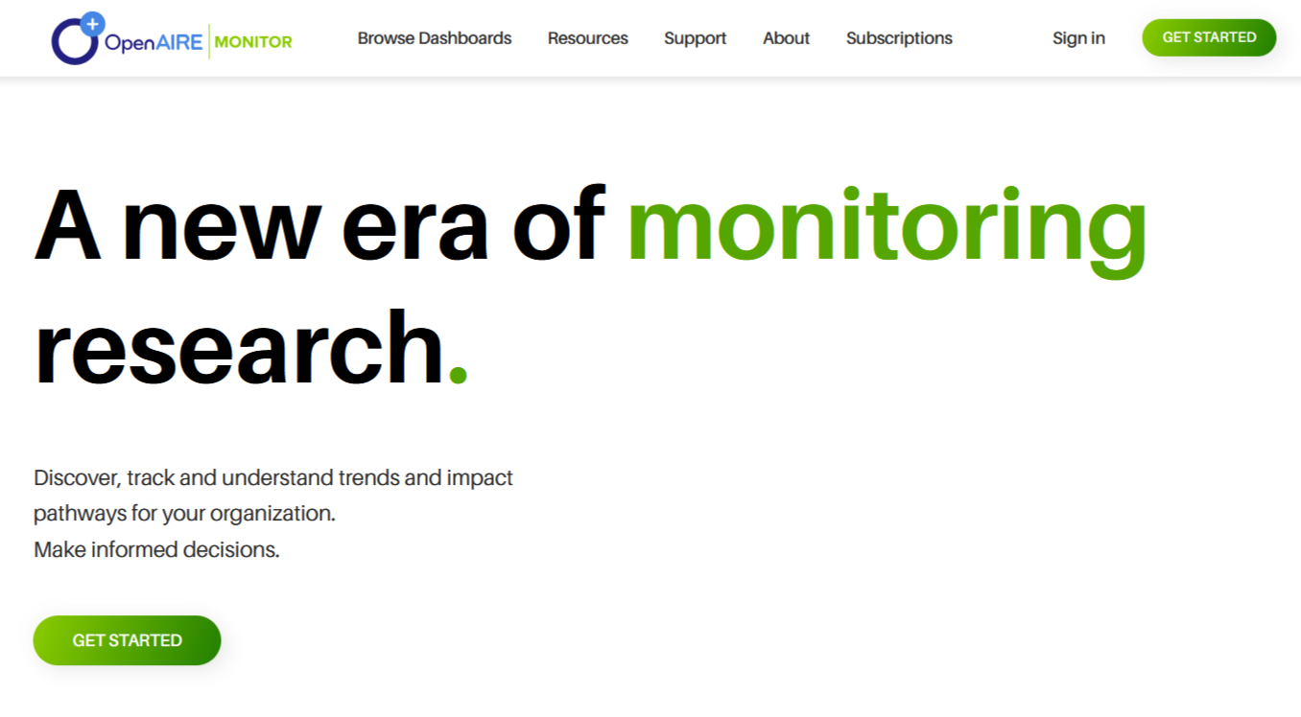
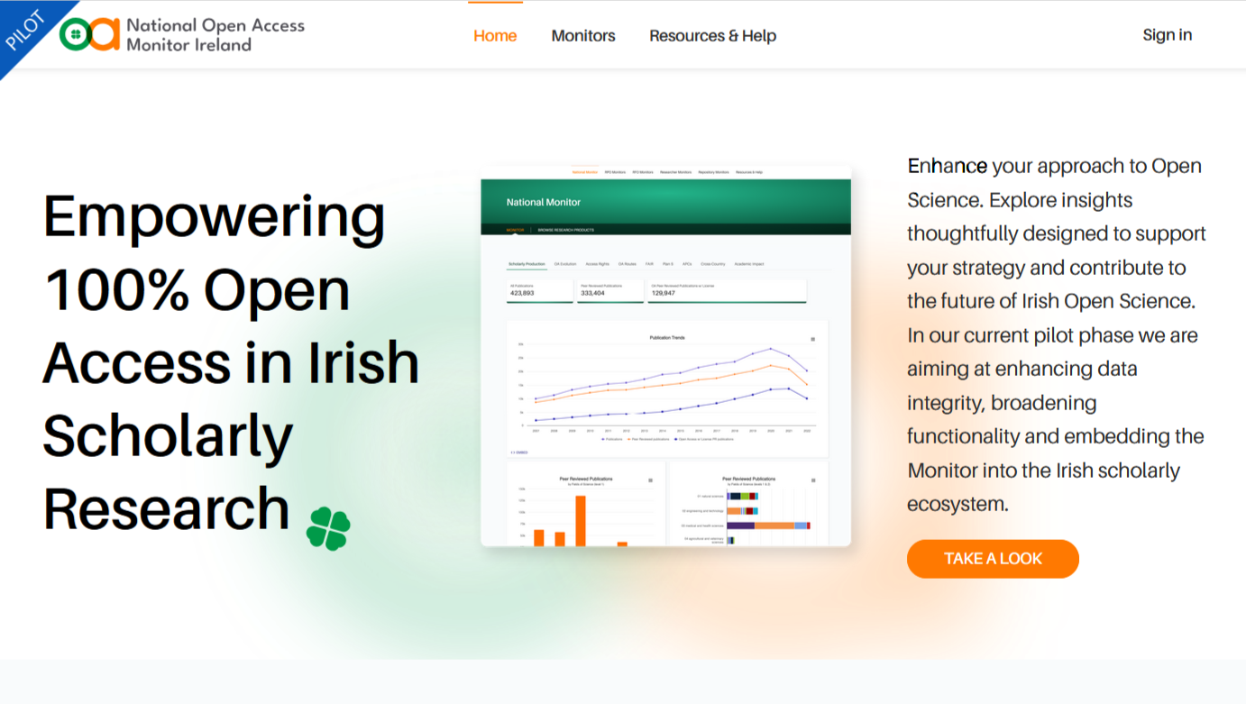
OpenAIRE Monitor
National Open Access Monitor, Ireland
https://monitor.openaire.eu/
https://oamonitor.ireland.openaire.eu/

Slide 17






EOSC Track in a nutshell
EOSC Steering Board Survey
Annual surveys
Policy-Infrastructure-Impact
360º view of Open Science in Europe
EOSC-A Survey
Annual surveys of members
Country Narratives
Information from key experts
European Open Science Observatory
OpenAIRE Open Science Observatory
Analysis based on OpenAIRE Graph
Policy Intelligence Tool
External data
Eurostat, National Monitoring Platforms, Stories, News
Policy & related resources Registry
OECD STIP Compass, Zenodo, Repositories

Slide 18
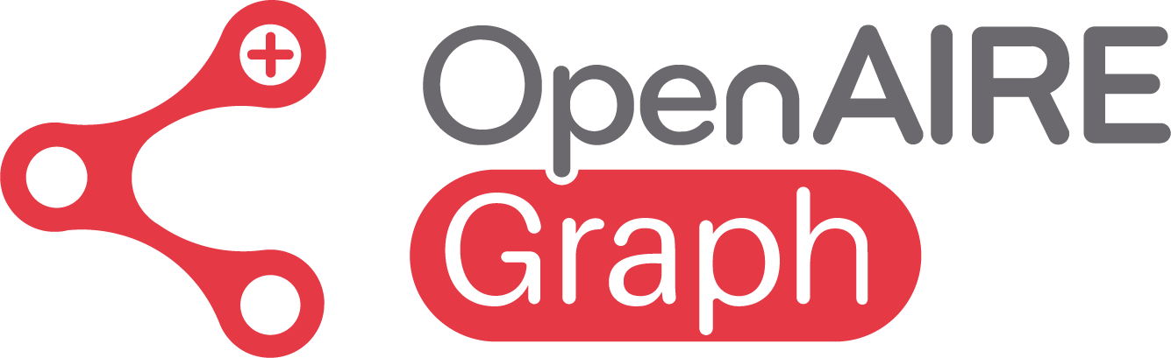
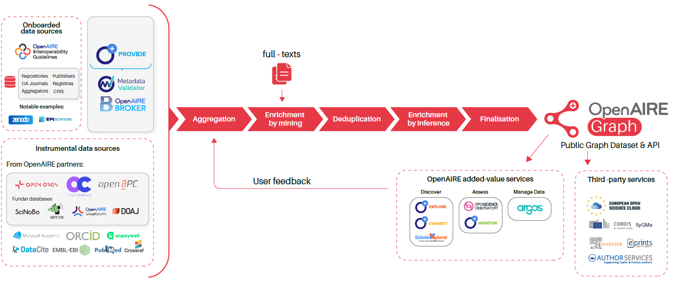
Data Backbone: The OpenAIRE Graph
graph.openaire.eu
A Scientific Knowledge Graph with timely and comprehensive coverage of research outputs (140K data sources, 280M research outputs, monthly updates)
Precision, Depth & Processing
Robustness, Openness & Transparency

Slide 19
APCs
In the OpenAIRE Graph: OpenAPC
Bruns and Taubert (2021): Over 50% of APC payments for participating universities are missing from current datasets - average payments for non-covered APCs are higher than those reported
Schönfelder (2020): Impact of missing data on accurately assessing APCs – recommendation for improved data collection practices across institutions to enhance transparency.
Budzinski et al. (2020): Market power of publishers significantly affects APC pricing - higher market concentration among publishers correlates with increased APC levels.

Slide 20
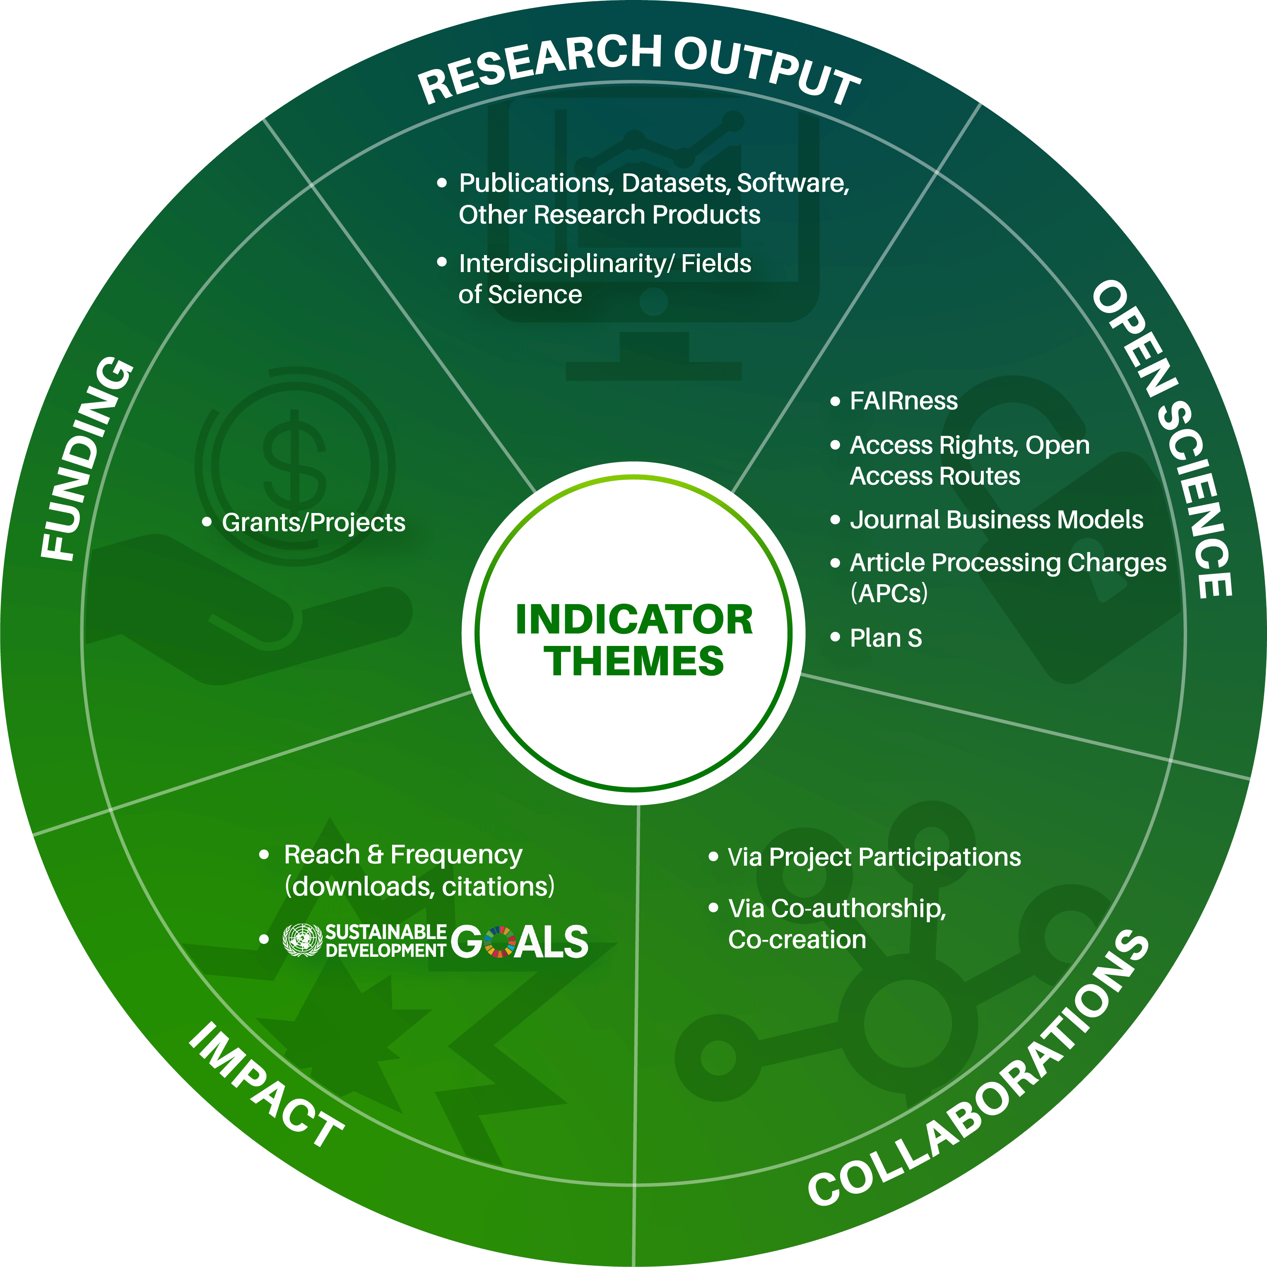
Indicators

Slide 21
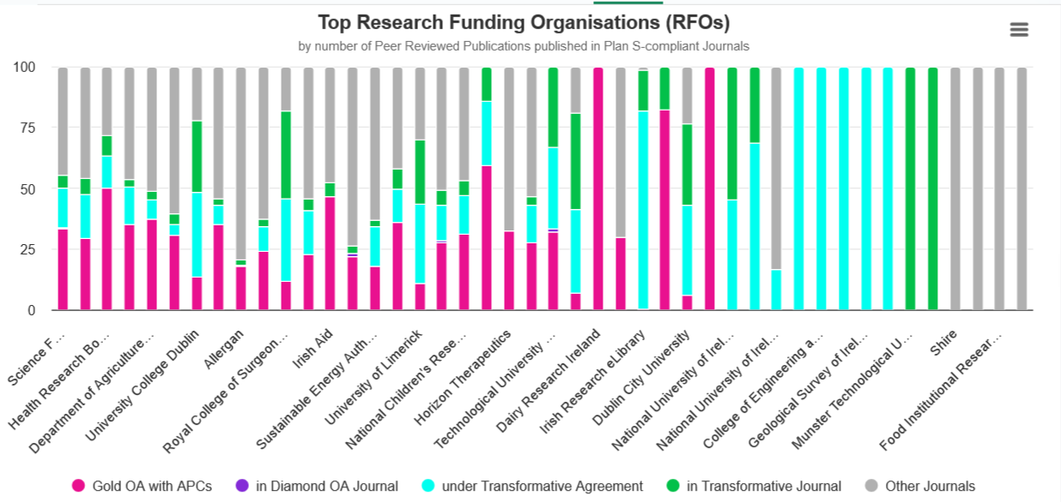
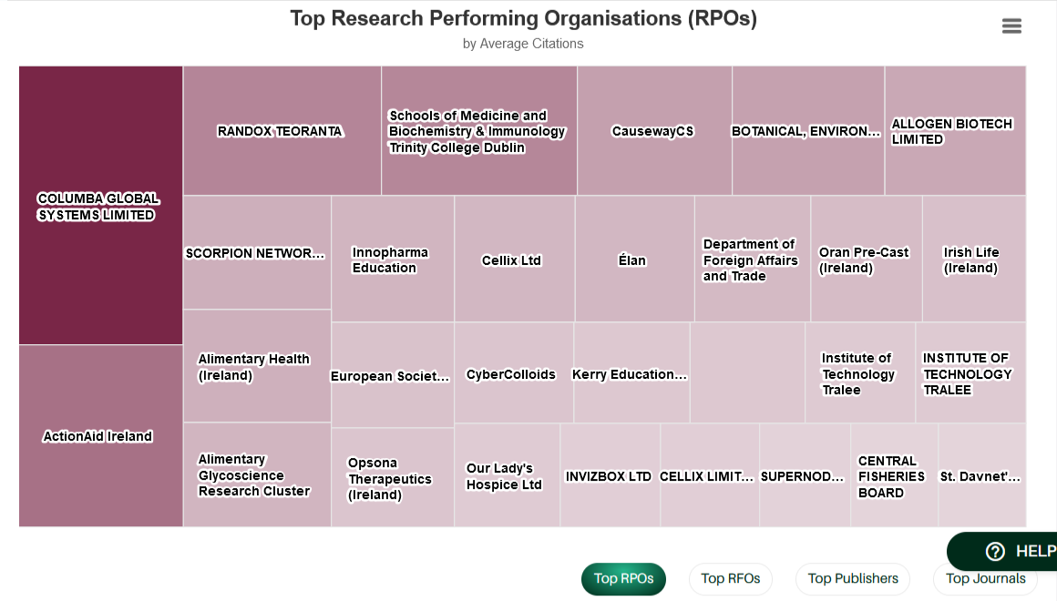
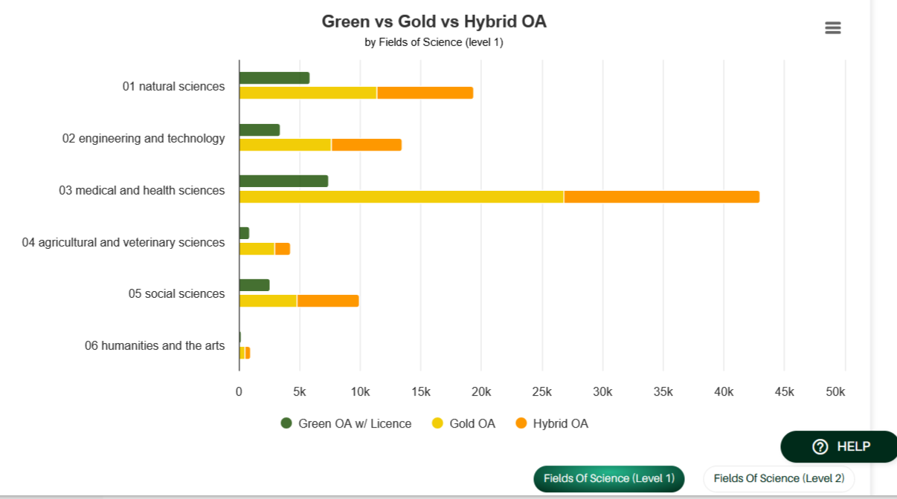
Monitoring

Slide 22
PathOS
Pathways, Indicators, and Evaluation
Impact Pathways: Impact pathways are crucial for understanding how OS strategies translate into practical applications and their subsequent effects on the society.
  Tracing complex, interconnected pathways that influence diverse effects (feedback loops).
OS Impact Indicators: Measures to assess strategy compliance and efficacy.
  Suggesting indicators that capture the multifaceted nature of Open Science including developing robust methodologies.
Cost-Benefit Analysis (CBA): Informing the allocation of resources and strategy prioritization.
  Consistently comparing costs and benefits, including non-market effects, using suitable metrics
Operationalization in Case Studies: Testing strategies in real-world scenarios to assess practical impacts.
  Adapting evaluation tools to different disciplinary and contextual nuances.

Slide 23
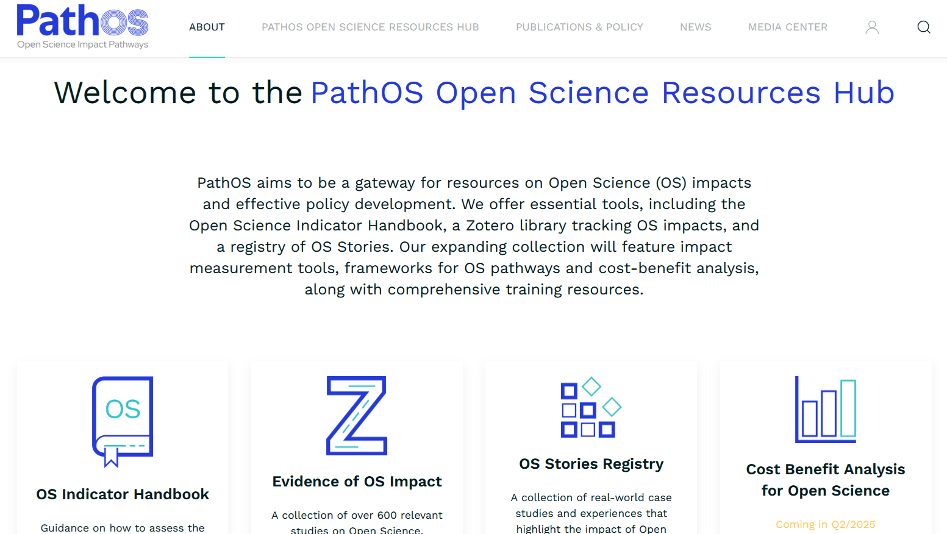
Key Outputs
Frameworks
  OS Impact Pathways
  Cost-Benefit Analysis for OS
Case Study Deep Dives
  OS impact assessments, Causality focus
  Cost-Benefit evaluations (select case studies)
https://pathos-project.eu/
Handbook of OS Indicators
  Indicator "Recipes"
  Tools and datasets
Training & Engagement
  Engagement programme
  Training for policy-makers & research administrators
Literature Insights & Registry
  Lit Review on OS impacts
  Online registry of OS stories
Recommendations
  Guidelines and best practices
  Project-derived insights

Slide 24
APC EXTRAPOLATION

Slide 25
A Simple APC Extrapolation Exercise
Based on Schönfelder (2020), analyzing APC pricing using data from OpenAPC.
Quintile of the SNIP score (CWTS, 2024): We used the SNIP for each journal and year of publication, then separated the distribution of SNIP scores for Irish peer-reviewed publications into quintiles .
Publication route: Gold or Hybrid OA.
Year of publication
Notes:
Source normalized impact per paper: (SNIP) Ratio of a journal’ raw impact per paper (RIP) and the relative database citation potential (RDCP) in the subject field covered by the journal.

Slide 26
Coverage and Averages after Extrapolation
Peer-Reviewed Publications | Gold OA | Hybrid OA | Gold & Hybrid OA
Incurred an APC | 74,277 | 42,403 | 116,680
Have an APC from OpenAPC | 1,100 (1.48%) | 553 (1.3%) | 1653 (1.42%)
Average APC from OpenAPC | EUR 1769,44 | EUR 2694.97 | EUR 2105.79
Have an APC after Extrapolation Exercise | 50,161 (67,5%) | 29,838 (70,37%) | 79,999 (68.56%)
Average Extrapolated APC | EUR 1617,55 | EUR 2527.71 | EUR 1948,31

Slide 27
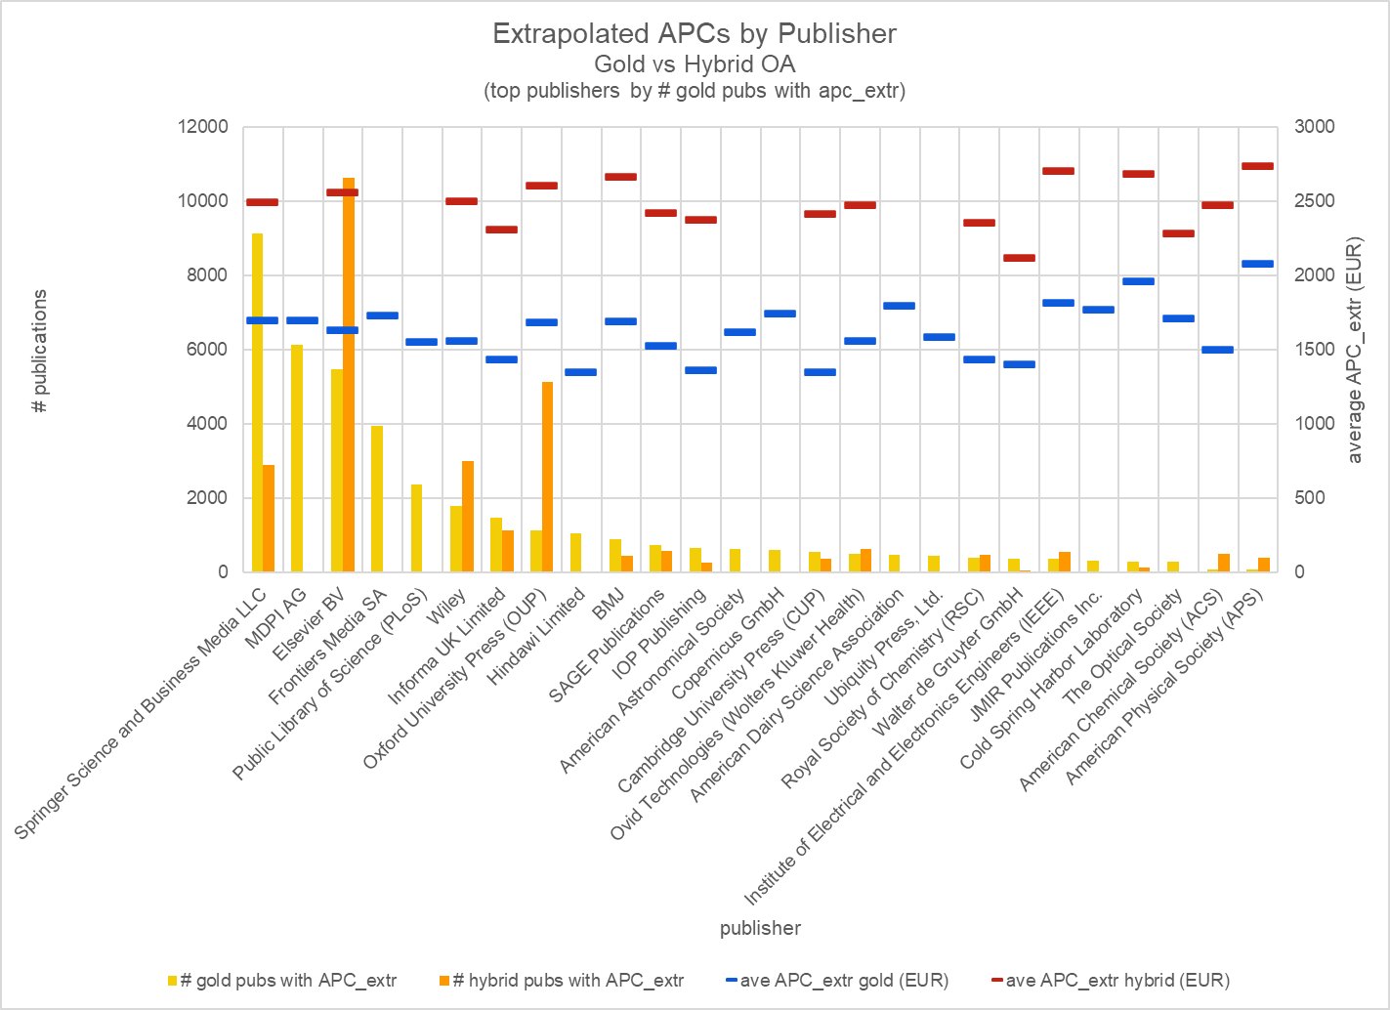
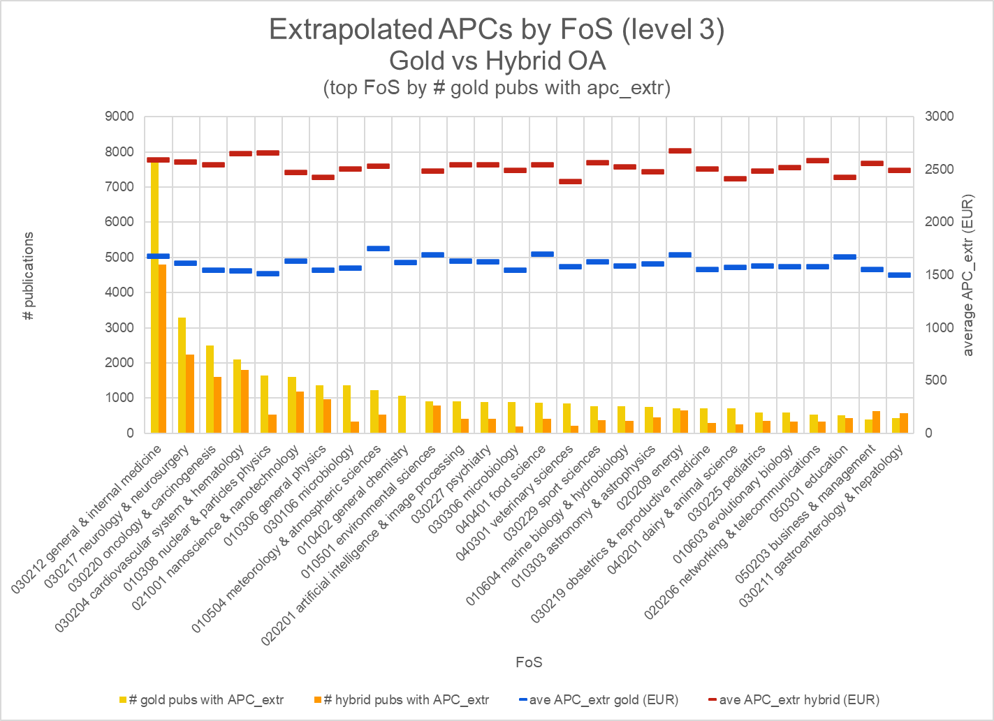
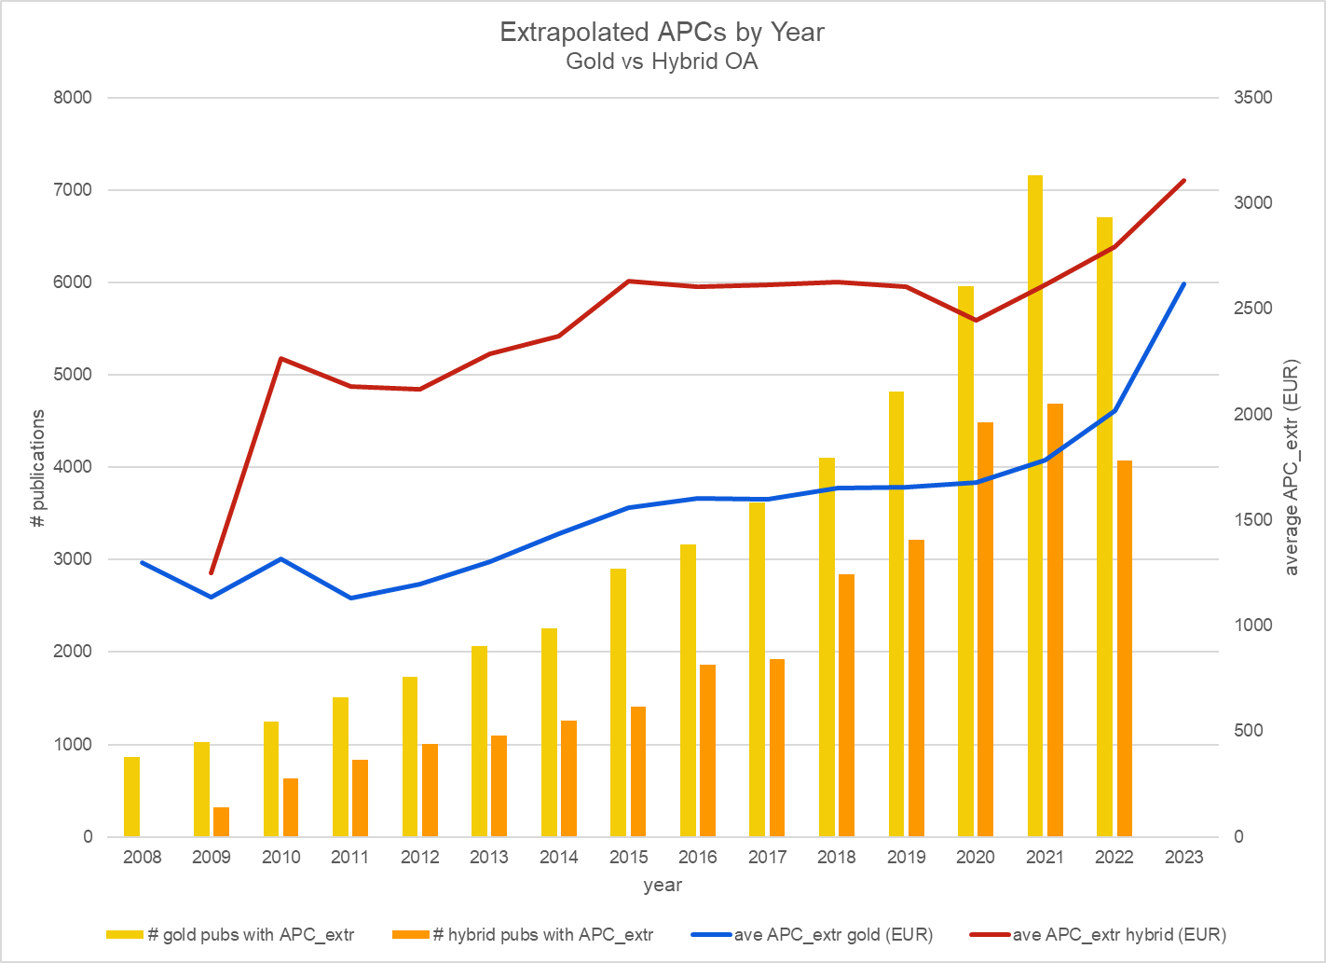
A Simple APC Extrapolation Exercise

Slide 28
A Simple APC Extrapolation Exercise
Effectiveness of Extrapolation
  Expands the dataset significantly, offering a more comprehensive view of the APC landscape.
Essential to recognize potential inaccuracies
  Validity of underlying assumptions is critical.
  Representative grouping is necessary for meaningful results.
Addressing Data Gaps
  Many areas exhibit insufficient APC reporting, leading to incomplete insights.
  Collaboration can enhance data quality and comprehensiveness.
  Increased contributions lead to more reliable extrapolation.

Slide 29
Conclusion

Slide 30
Conclusion
Monitoring Impact: Essential for informed decision-making.
Limited Evidence: There is insufficient data on the economic impact and overall outcomes of Open Science.
Available Resources: Frameworks from PathOS and data from the OpenAIRE Graph can help navigate these complexities. Tech and infrastructure is available.
Data Gaps: Current data is inadequate for a comprehensive analysis of APCs and market dynamics.
APC Extrapolation: The variability observed after extrapolation needs validation to ensure accuracy.
Collaboration Needs: Prioritizing APC cost-sharing across disciplines, countries, and publishers is essential.
Focus on Causality: Understanding causal relationships is crucial for effective analysis.

Slide 31
Thank you!
ioanna.grypari@openaire.eu

