Slide 1

Monitoring costs of scholarly publishing in Sweden
Read and publish agreements, APCs in the wild and subscriptions
openCost conference – University of Regensburg – 08/10/2024
Dr Johan Fröberg, Executive officer, Open Access/Open Science Research Collaboration Unit

Slide 2
Outline
Background on the National Library and our Open Science activities
Reporting on total costs of scholarly publishing
Focus on the process for OpenAPC
Selected results
Challenges and future developments

Slide 3
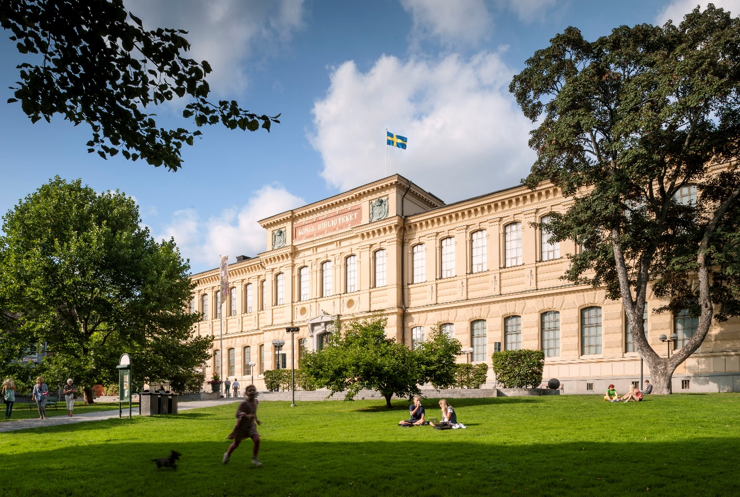
The National Library of Sweden
Government agency under the Ministry of Education and Research,
additional assignments from the Ministry of Culture
Collects, preserves, and provides access to Sweden's published cultural heritage so that researchers and the public may have access to it
Produces official library statistics
Runs KBlab – enables large-scale research on the collections, develops language models and AI solutions
Develops and promotes libraries for national minorities
Coordinates the library sector to meet the national library strategy
Coordinates activities in higher education sector towards open access
Source: Jens Östman/KB

Slide 4
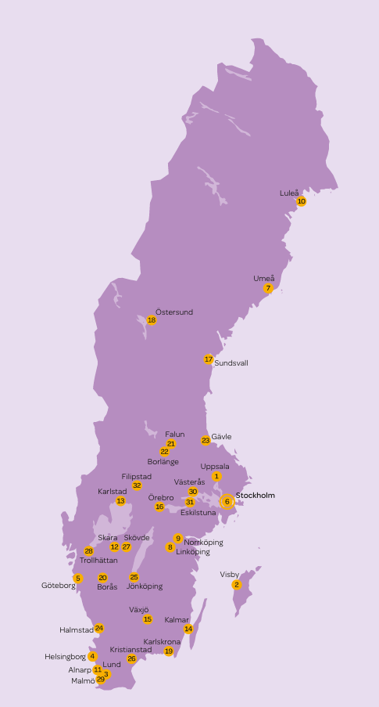
Framework
Goal for open access stated in research bills from 2016 and 2020
  All publications resulting from publicly funded research should be published with immediate open access by 2021
Swedish higher education institutions (HEIs)
  18 Universities
  12 University colleges
  5 Art, design and music academies
  14 Independent education providers
SUHF – Association of Swedish Higher Education Institutions
UKÄ – Universitetskanslersämbetet / Swedish Higher Education Authority
Bibsam – national consortium for license agreements for electronic information resources
Source: UKÄ

Slide 5
The National Library and Open Science
Government assignment to
  Coordinate, monitor and report on the national development in open access to scholarly publications annually since 2017
  Monitor and report on total costs of scholarly publishing annually since 2017
  Develop and maintain a publishing platform for Swedish open access journals, publicera.kb.se, launched in 2021
Administration of the Bibsam Consortium
  Signs transformative agreements and publishing agreements on behalf of the 90+ participating institutions (HEIs, government agencies & research institutes)
  Focus on transformation towards open access
Focus on transition to open access
  Active role in the national open access community since 2006
  Five studies on different aspects of open access to scholarly publications presented in 2019
  Studies on Open Educational Resources and Citizen Science presented in 2022 and 2023, respectively
  National Guidelines for Open Science presented in January 2024

Slide 6
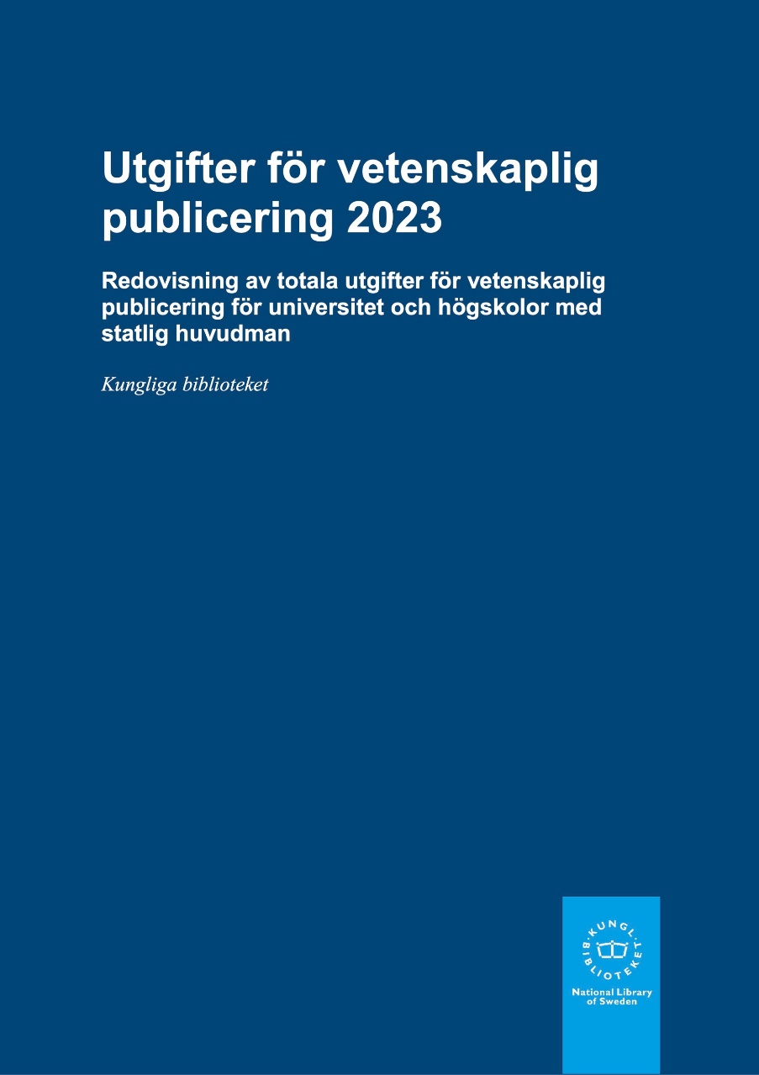
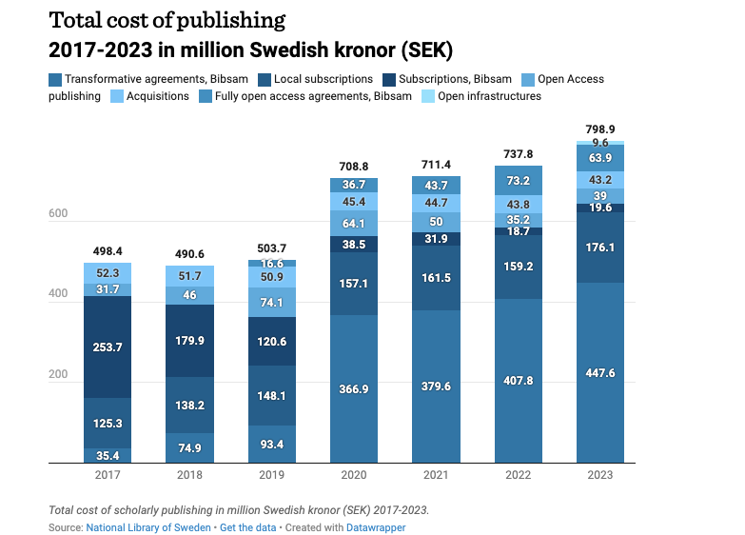
Total costs of scholarly publishing
Recommendation in one of the five studies from 2019
  That ”…one or more relevant authority(ies) be given responsibility for continuous monitoring and analysis of national publishing costs in the transition to an open access publishing system with the aim of restricting scholarly publishing costs.”
Assignment to the National Library since 2019
Annual report in Swedish since 2017
First report also in English
  Covers methodology and terminology
Results presented on www.kb.se

Slide 7
Compilation of total costs
Type of costs included:
  Subscriptions, Bibsam
  Local subscriptions
  Transformative agreements, Bibsam
  Fully open access agreements, Bibsam
  Open access publishing
  Acquisitions
  Open infrastructures (first included in 2024)
Administrative expenditures (FTE estimates)
All Bibsam-related expenditures compiled from information in-house
Local expenditures collected via
  Questionnaire sent to university libraries, open March–April each year
  Official national library statistics
Separate process for open access publishing - OpenAPC

Slide 8
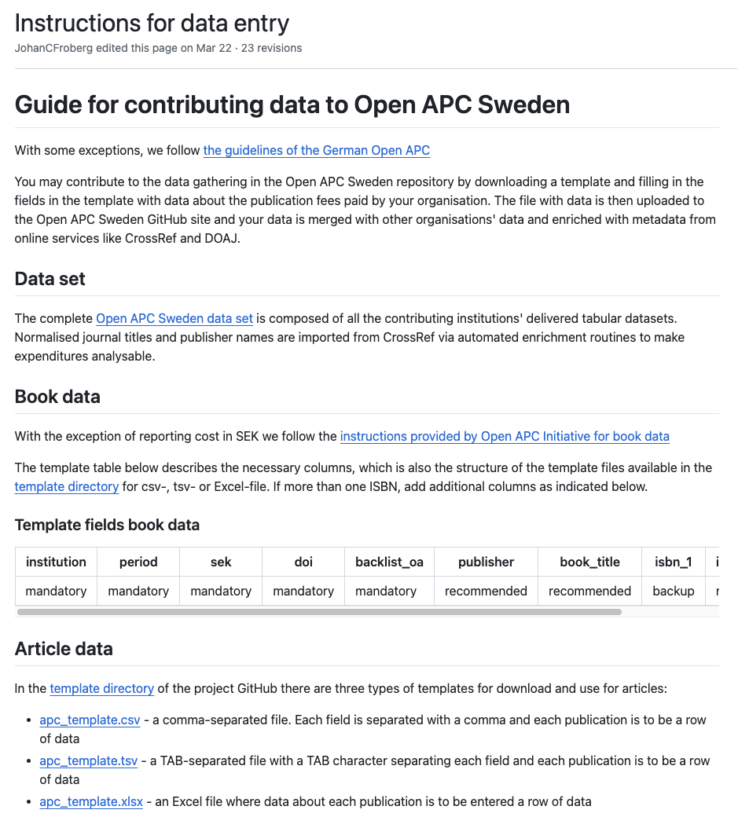
”APCs in the wild” – Open APC
National Library initiated OpenAPC Sweden in 2016
Part of OpenAPC Initiative since 2017
Started as a project with five HEIs
25 HEIs reported in 2024
  Those who do not provide estimates in the questionnaire
Dedicated account in HEIs’ economic systems
  Decision by the SUHF board
Collects APCs and BPCs (starting a few years back)
GitHub used for data and code (primarily R, previously Python)

Slide 9
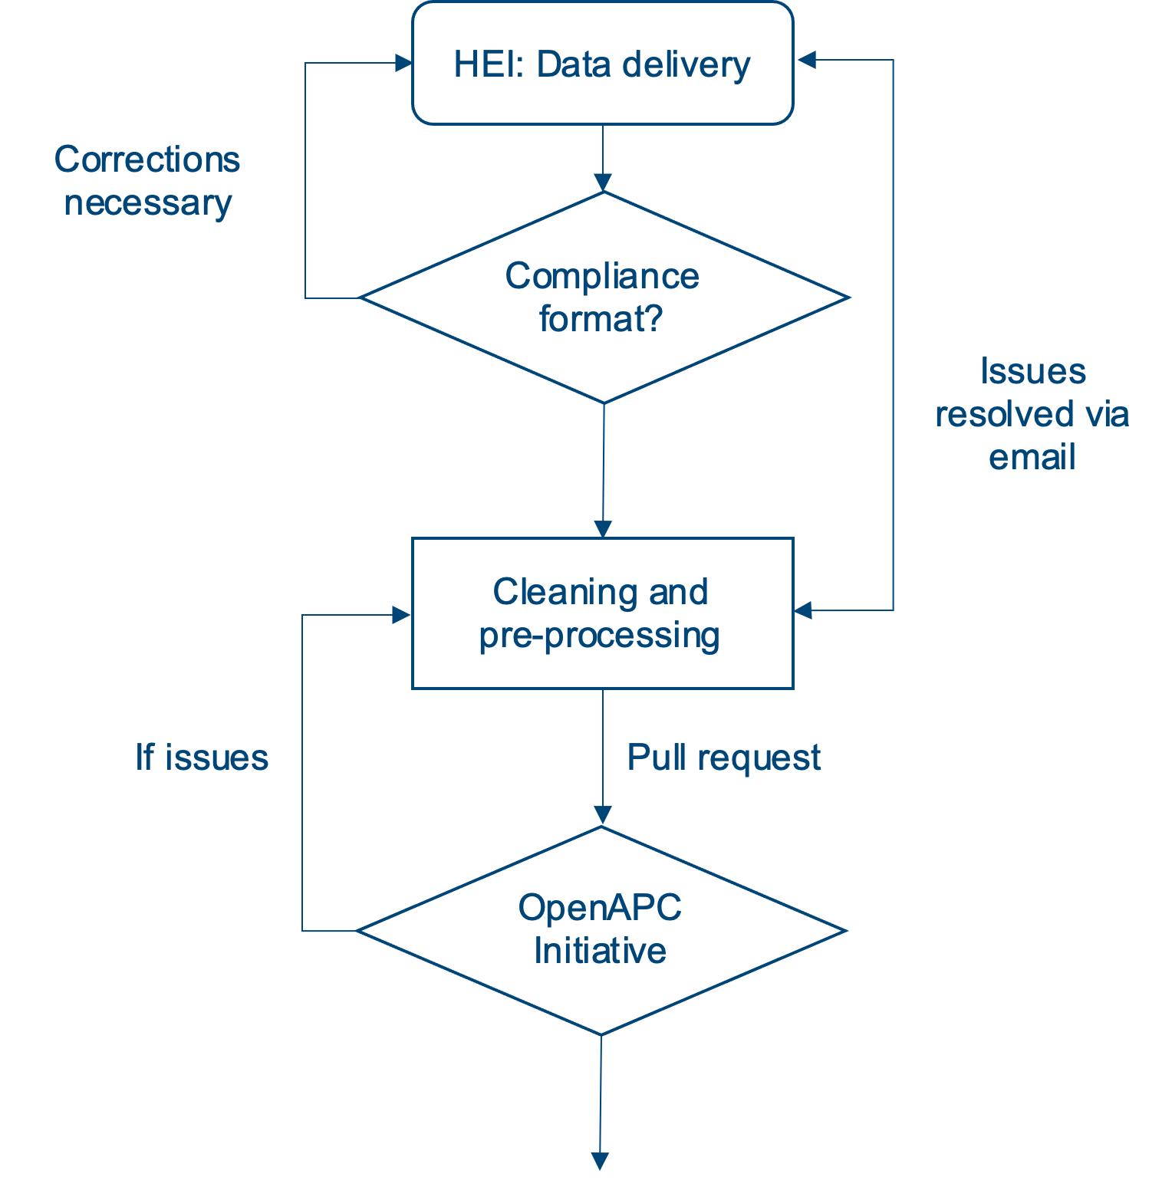
Open APC process
Reporting first quarter each year for the previous year
HEIs send Excel/csv-files to the National Library – deadline March 31
National Library
  Checks compliance with format requirements
  Checks for overlap with OpenAPC Initative and
  publications covered by publishing agreements
  Cleans and pre-processes data
  Sends pull requests to OpenAPC Initiative
  Follows up on any data problems, often in dialogue with HEIs
Compiles results for total costs report – deadline early May
Annual OpenAPC workshop in the fall
  Discussion of results and trends
  Sharing experiences and knowledge
  Planning next year’s reporting

Slide 10
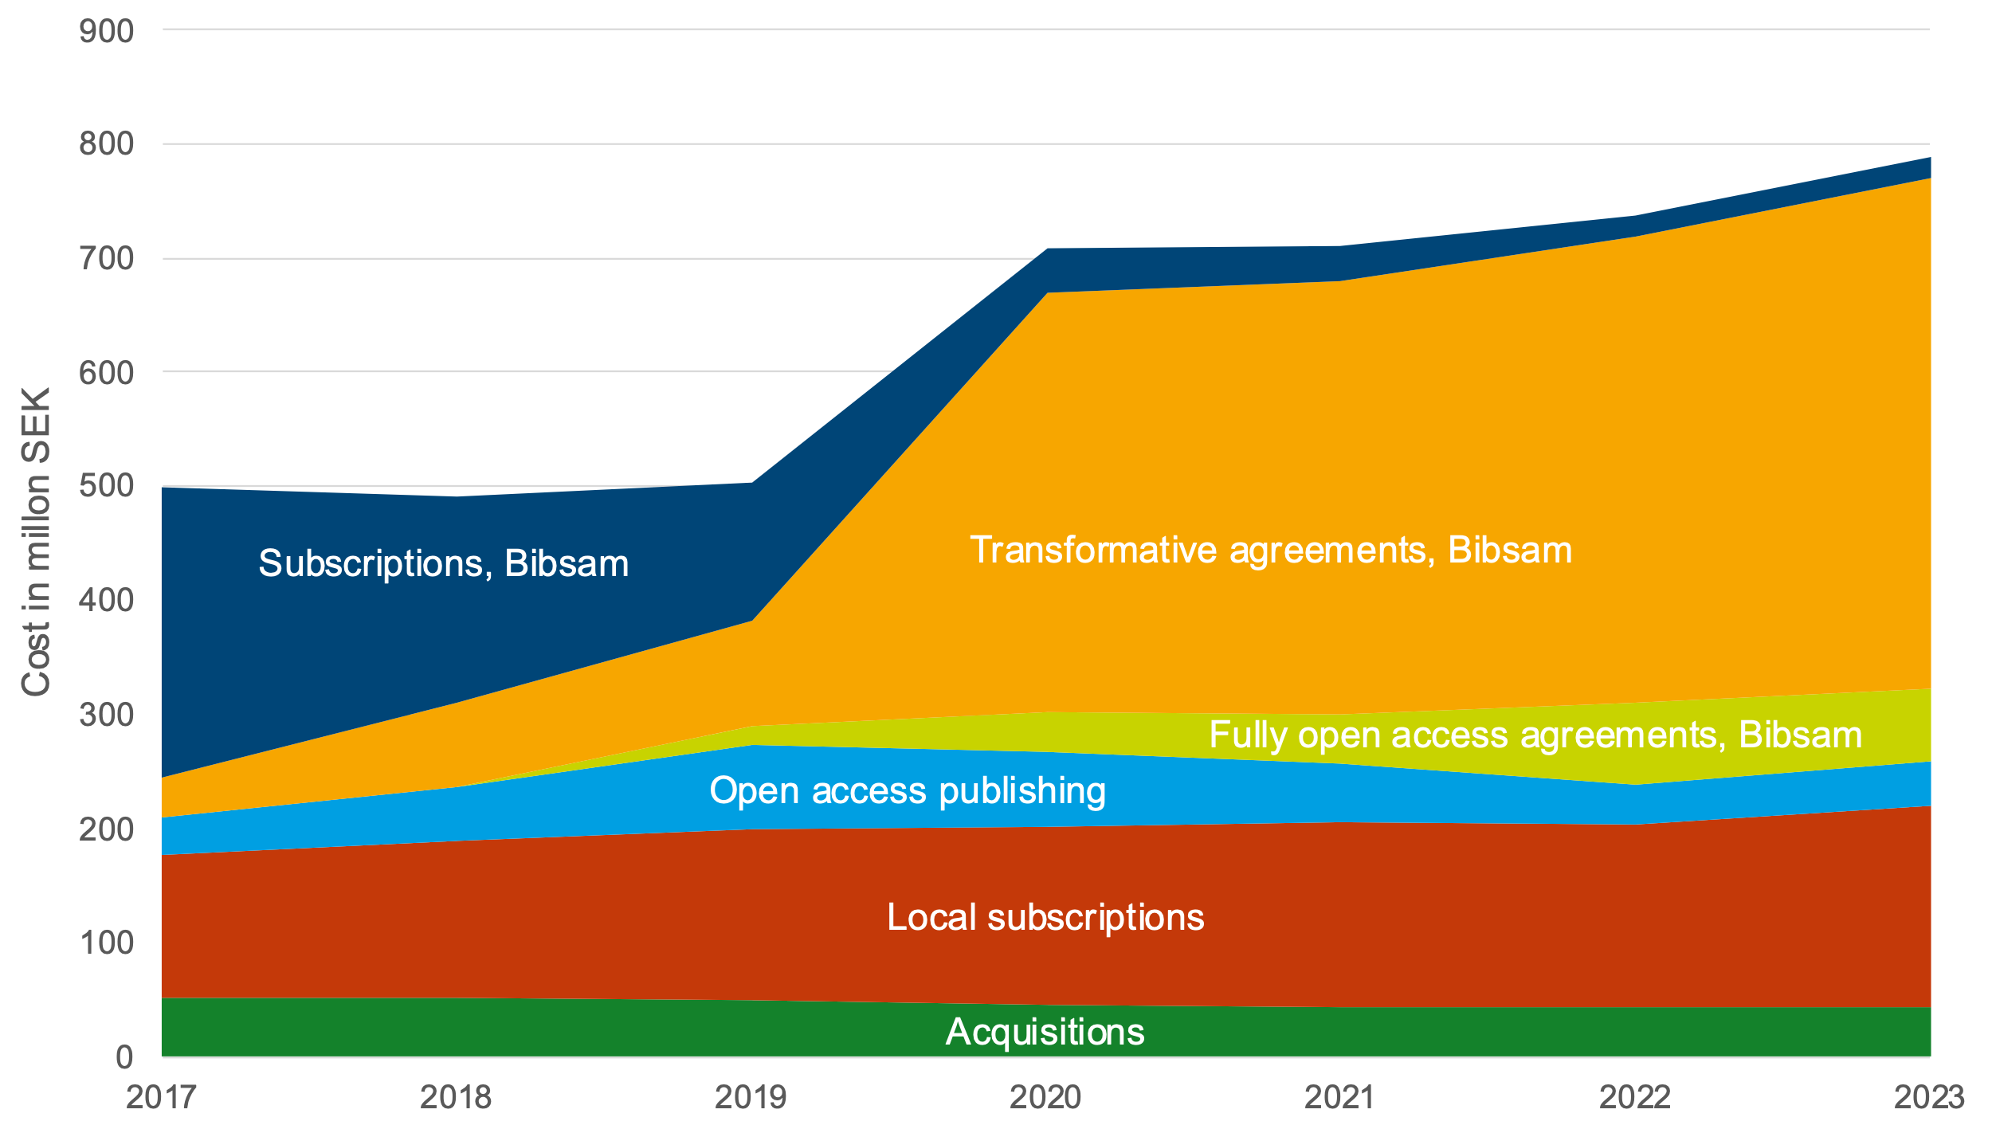
Costs of scholarly publishing
1 € = ~11 SEK

Slide 11
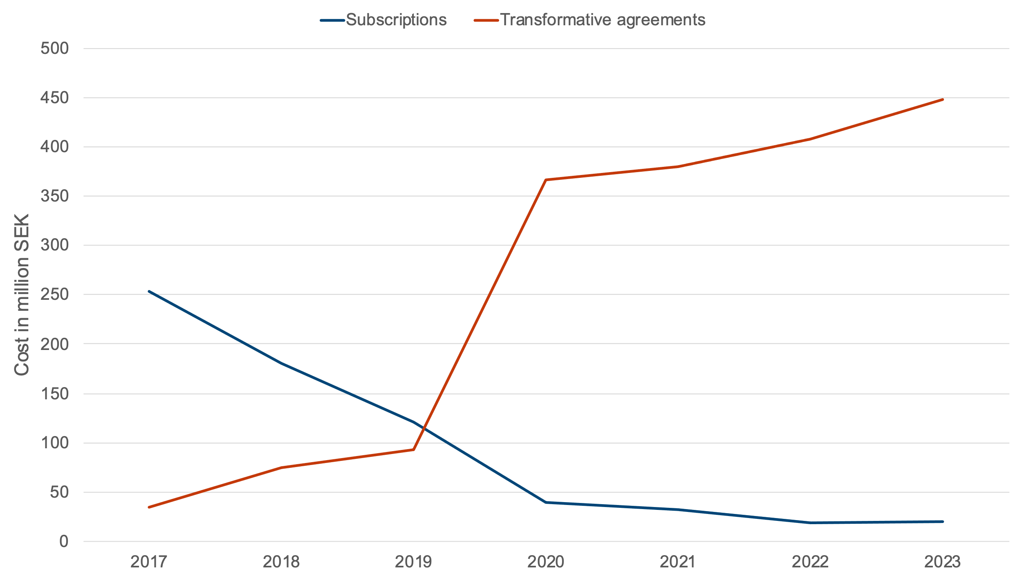
Bibsam: From paying for reading to paying for reading and publishing

Slide 12
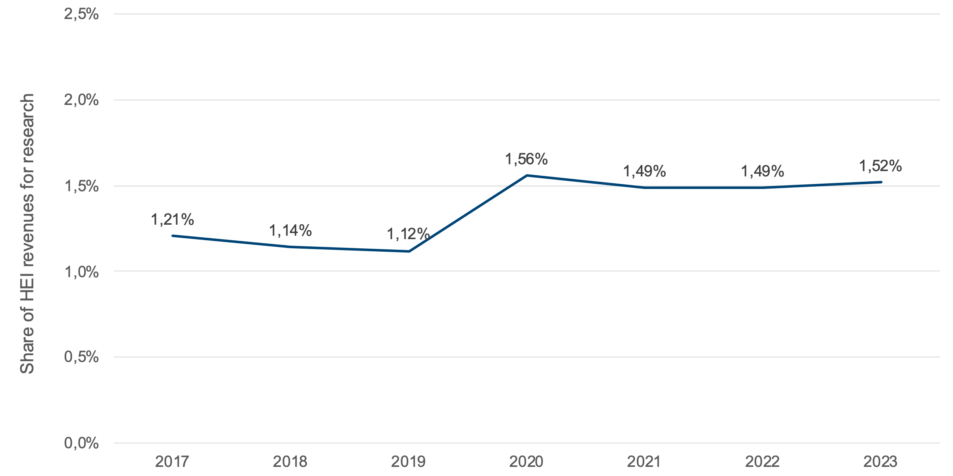
Total costs in relation to HEI research funding
Source: Costs of scholarly publishing, National Library
Revenues for research and third-cycle education, Swedish Higher Education Authority

Slide 13
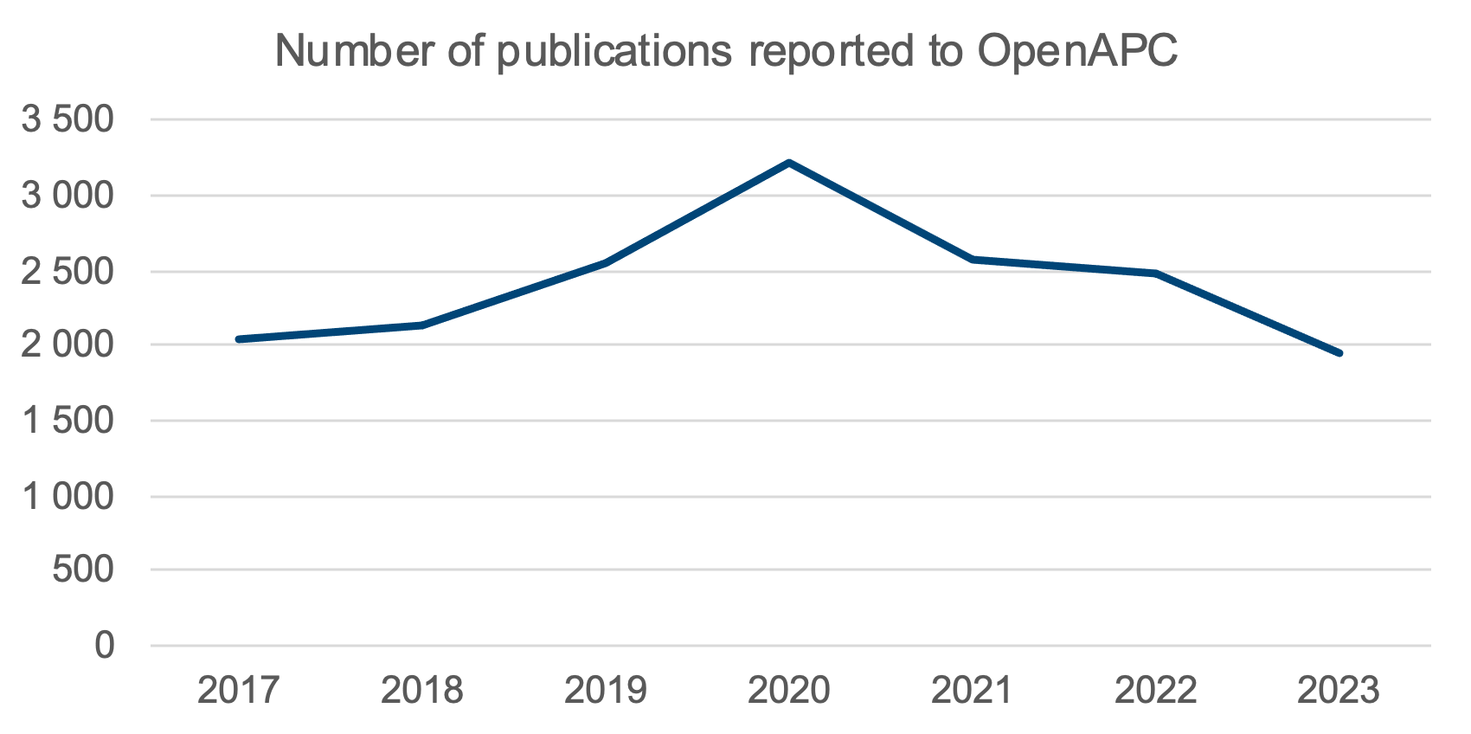
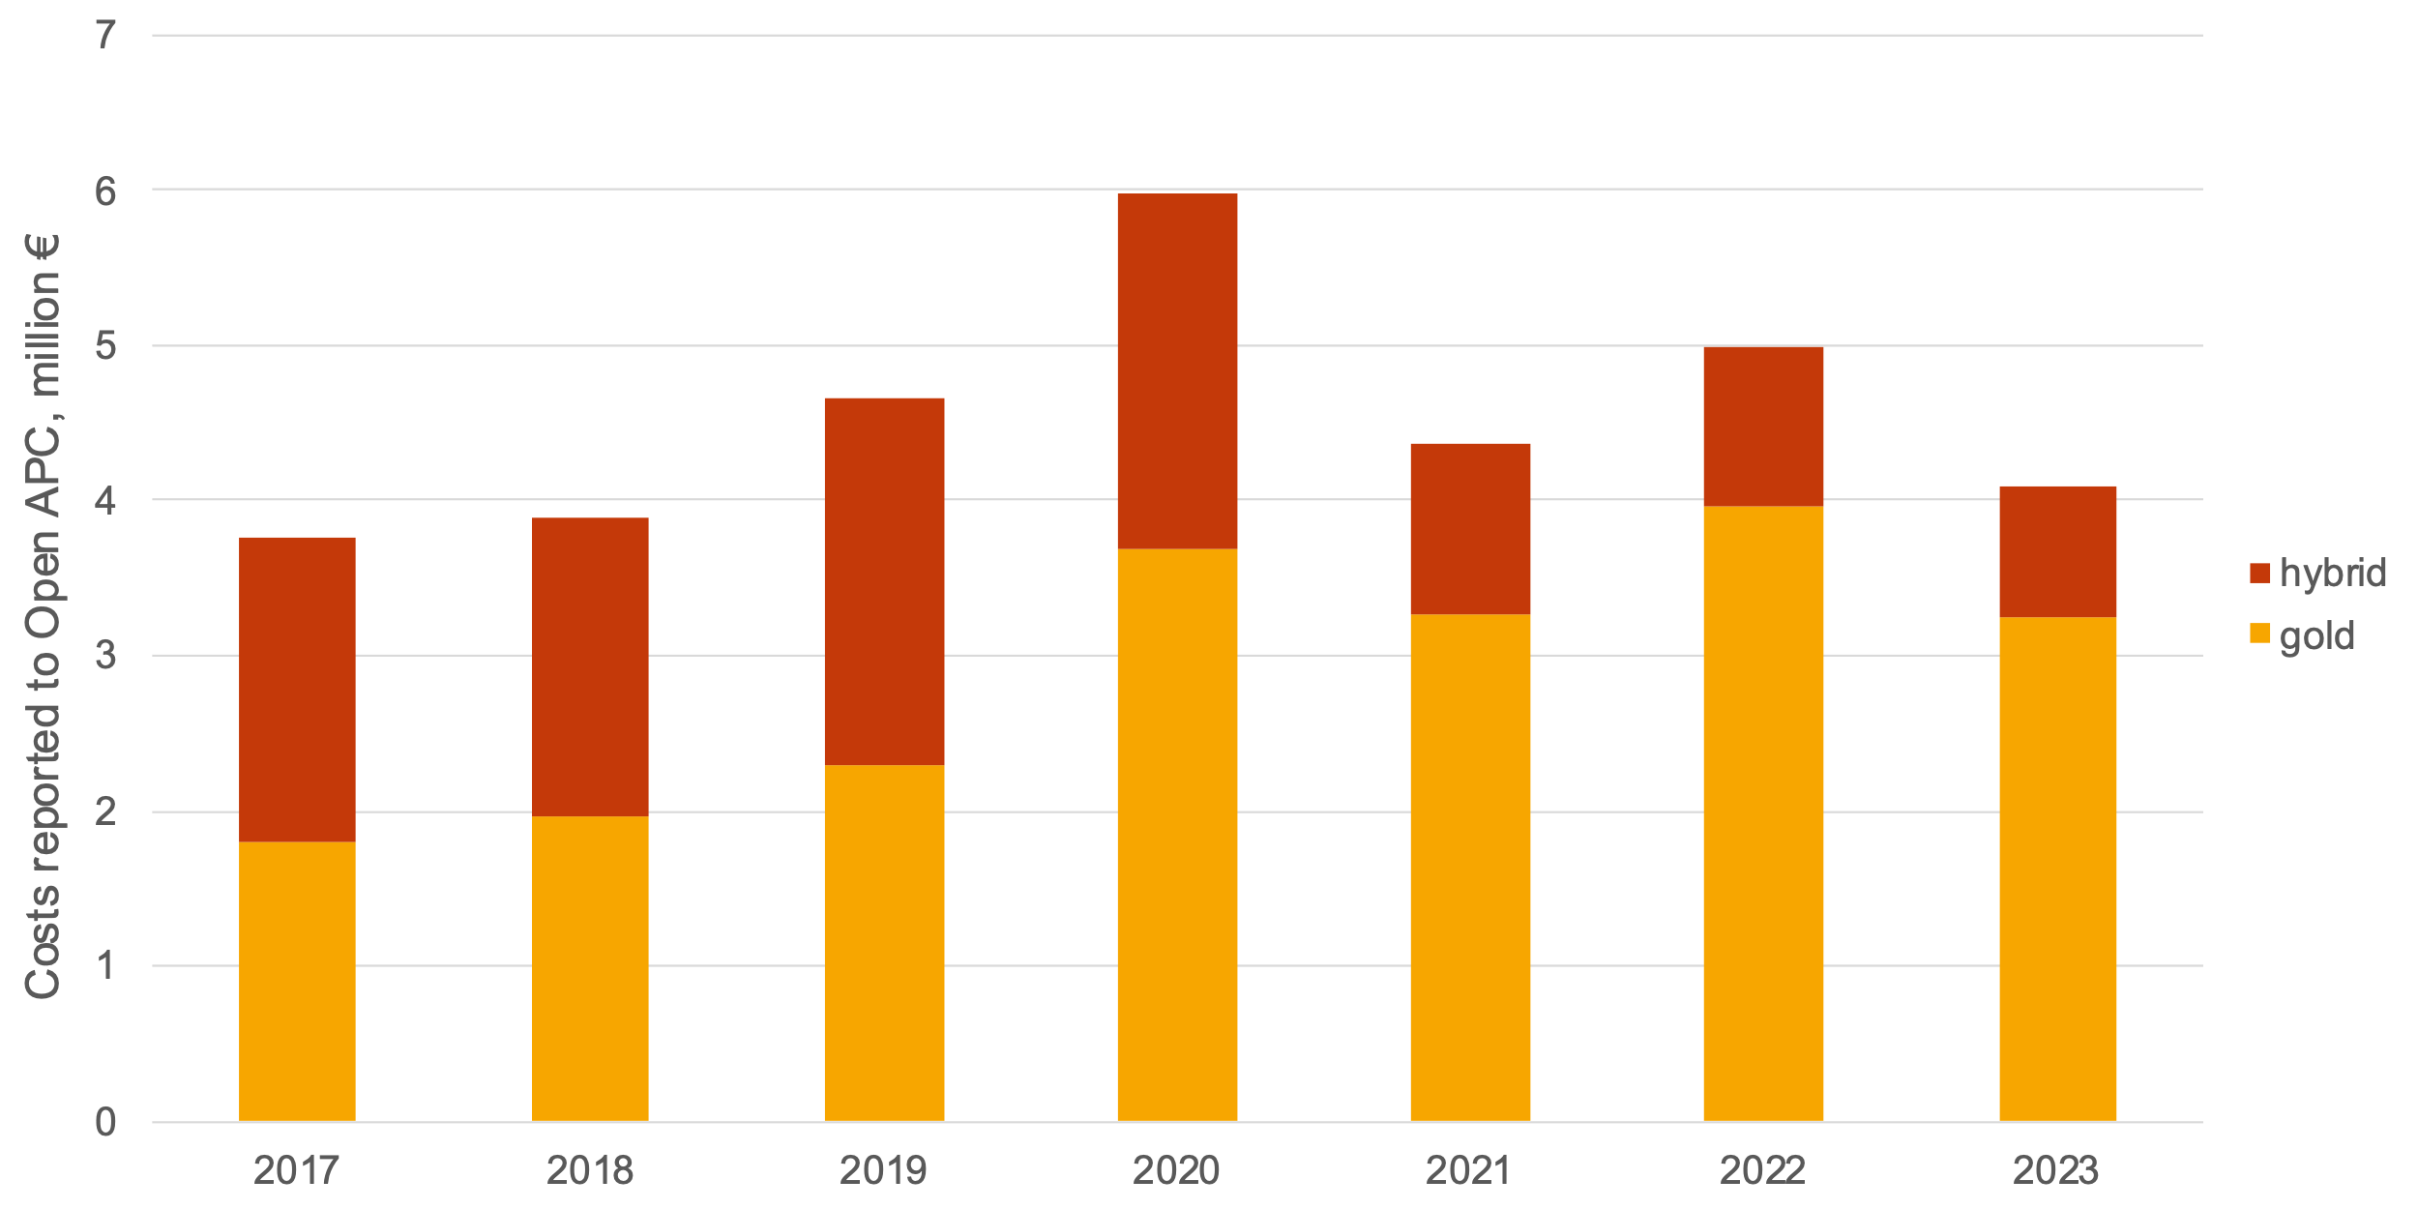
Reported APCs to OpenAPC Initiative

Slide 14
Challenges and future development
How to define open infrastructures?
Administrative expenditures
Conference publications not covered in reporting to OpenAPC
Publishing charges for books and book chapters increasing in numbers
How to get all HEIs to report to OpenAPC?

Slide 15
Questions?

