Slide 1

openCost: the road to publication cost transparency
Expert Workshop
Yvonne Campfens, Executive Director Stichting OA Switchboard
Hamburg, 7 October 2022
Notes:
OA Switchboard - central metadata exchange hub
The OA Switchboard is a mission-driven, community led initiative designed to simplify the sharing of information between stakeholders about open access publications throughout the whole publication journey.
for research institutions, libraries and consortia
who want to: connect with their research and simplify their workflows
for academic publishers
who want to: support a smooth and compliant author journey and report on OA publication output
for research funders
who want to: demonstrate the extent and impact of their research funding and deliver on their commitment to OA

Slide 2
Agenda
What is OA Switchboard?
How does OA Switchboard support publication cost transparency?
→ 3 Scenarios
How to deal with the myriad of dashboards, systems and processes?

Slide 3
1. What is OA Switchboard?

Slide 4
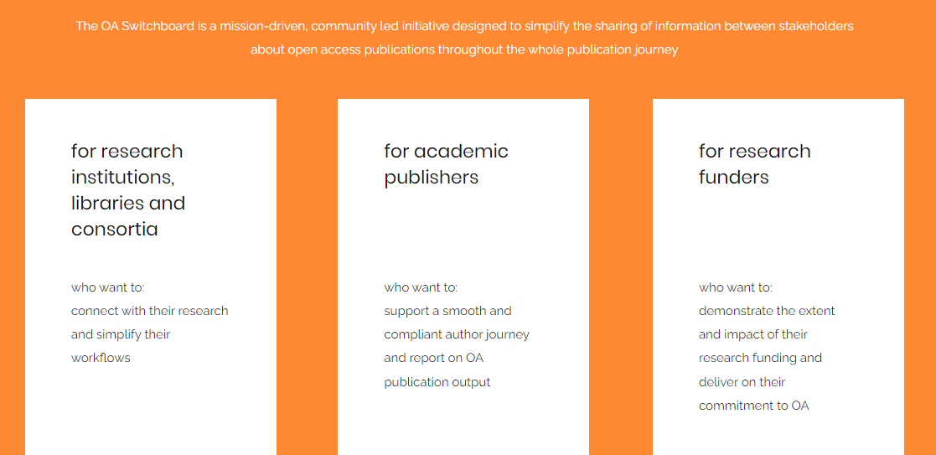

Slide 5
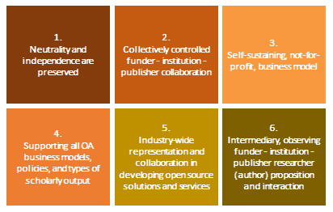

OA Switchboard at a glance
Initial meeting of key stakeholders in 2018
2019-2020 Project delivers MVP and key principles
Stichting (‘foundation’) OA Switchboard founded (Oct ‘20)
Live as operational solution since 1 January 2021
Mission-driven community
Practical tool

Slide 6


Central metadata exchange hub
Standardised messaging protocol and shared infrastructure
Sending a message
Relaying the message
Stakeholder 1
OA
Switchboard
(Message hub)
Stakeholder 2
Relaying the response message
Sending a response message

Slide 7
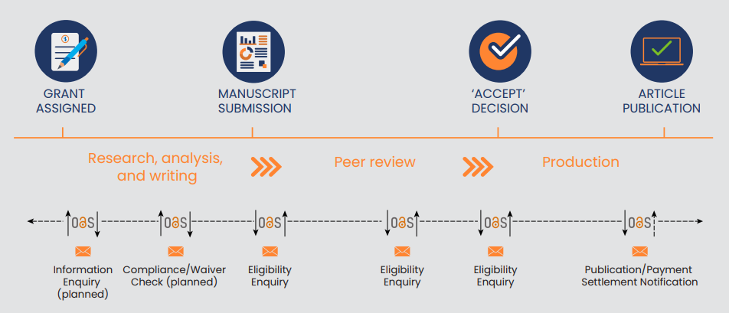
Supports many use cases
Can be integrated with stakeholders’ systems

Slide 8


We currently support two Use Cases:
1. Reporting Made Easy & 2. Matching Publication Costs with Publication Funds
Eligibility
Enquiry
Eligibility
Enquiry
Eligibility
Enquiry
Publication/
Payment
Settlement
Notification

Slide 9
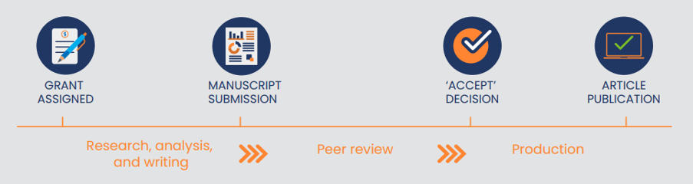
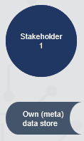
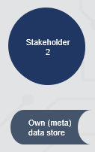
When it comes to ‘improving scholarly publishing metadata’,
we’ve learned a thing or two
See our latest blog:
www.oaswitchboard.org/
blog-post-29-september-2022
Principles:
Authoritative data from source
Time-specific metadata values
Keeping your own data secure

Slide 10
USE CASE 1: Publication notification and reporting
Current set-up for most OA Switchboard publishers
Sending a message
Relaying the message
Publisher
OA
Switchboard
(Message hub)
Institution
or
Funder
custom connector with private datastore

Slide 11
Keeping your data secure… This is what we see shaping
Sending a message
Relaying the message
Publisher
OA
Switchboard
(Message hub)
Institution
or
Funder
custom connector with private datastore
Own (meta)
data store
Own (meta)
data store

Slide 12
2. How does OA Switchboard support publication cost transparency?
Scenario 1: OA Switchboard P1-messages
Scenario 2: Chase APC in the wild information from own researchers
Scenario 3: Eligibility Enquiries (E1-E2 messages)

Slide 13
2. How does OA Switchboard support publication cost transparency?
Scenario 1: OA Switchboard P1-messages
Scenario 2: Chase APC in the wild information from own researchers
Scenario 3: Eligibility Enquiries (E1-E2 messages)

Slide 14
Ambition and intention of the P1-messages
The basic idea is that a P1-message is sent by the publisher upon VoR publication to the institution (or research funder) who picks up the publication charges.
This ‘picking up the charges’ can be via:
  a prior agreement (with or without information on article-level charges being relevant), or
  via an individual article-level charge (i.c. an APC)

Slide 15
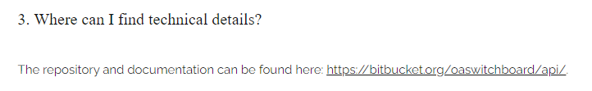
OA Switchboard schema / protocol
Label in online form (UI)
Field in JSON scheme
Type
Mandatory Y/N
Description
Find this file and more via our FAQ
on www.oaswitchboard.org/faq

Slide 19
Challenges we ran into...
Two scenarios, different challenges, and how we deal with it:
Prior Agreement:
  A P1-message is sent by the publisher to the institution affiliated to the (relevant) author under whose deal the article is (most likely) charged.
  It could very well be that the final settlement on this is not (yet) available when the VoR is published.
  Therefore the P1-message contains additional information to indicate the certainty of the article being ‘charged to’ a prior agreement.

Slide 20
Challenges we ran into...
Two scenarios, different challenges, and how we deal with it:
No Prior Agreement:
  A P1-message is sent by the publisher to the institution affiliated to the (relevant) author who has (most likely) picked up the article-level charges.
  The article-level charges may have been invoiced to the author, or to the institution.
  In case the author was invoiced, it could still be that the invoice was passed on to somebody else (e.g. a co-author or their institution), or that the invoice payment was split between the authors.
  It could also be that the publisher’s system doesn’t have real-time or completed records on the invoicing when the VoR is published.
  Therefore the P1-message contains additional information to indicate the certainty of the article being ‘charged to’ the institution receiving the P1-message.

Slide 21
2. How does OA Switchboard support publication cost transparency?
Scenario 1: OA Switchboard P1-messages
Scenario 2: Chase APC in the wild information from own researchers
Scenario 3: Eligibility Enquiries (E1-E2 messages)

Slide 22
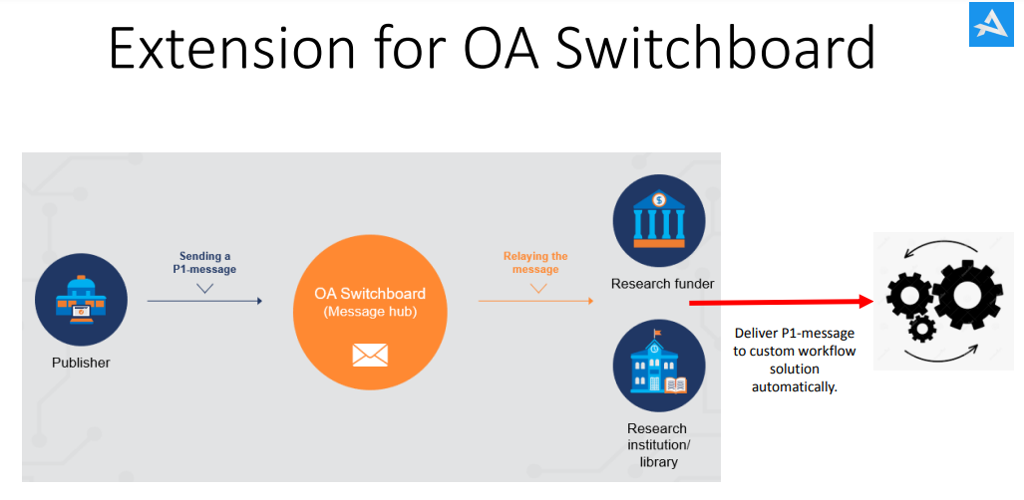
A wild idea we’ve explored with a few institutions in Germany:

Slide 23
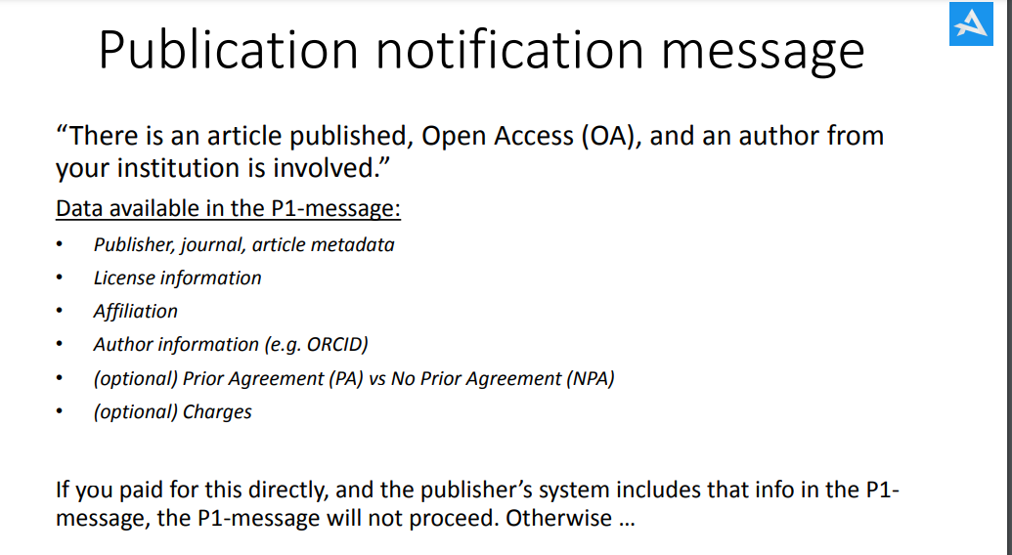

Slide 24
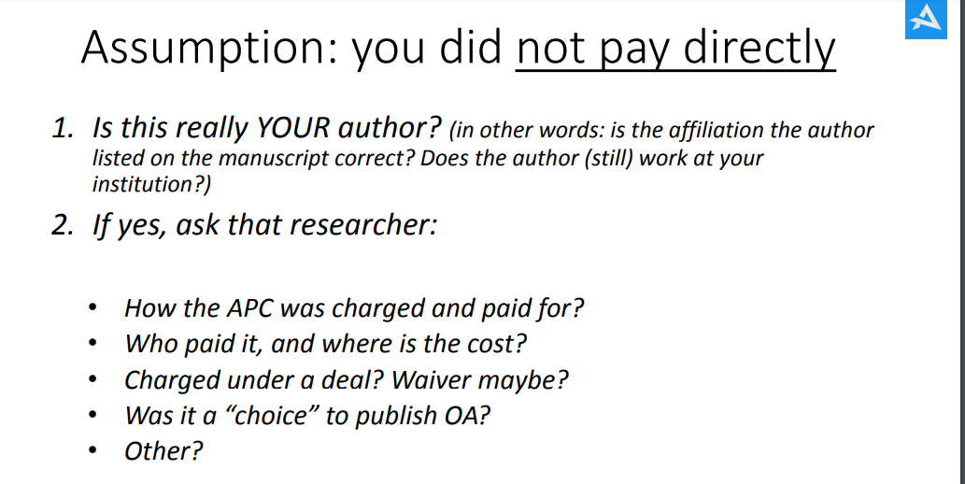

Slide 25
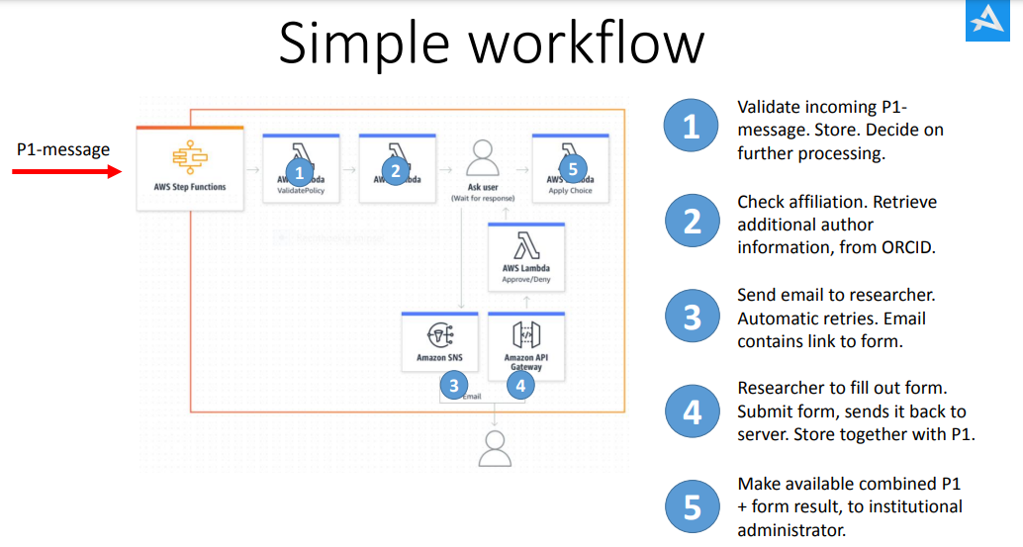

Slide 26
2. How does OA Switchboard support publication cost transparency?
Scenario 1: OA Switchboard P1-messages
Scenario 2: Chase APC in the wild information from own researchers
Scenario 3: Eligibility Enquiries (E1-E2 messages)

Slide 27
A more structural solution:
pre-publication eligibility enquiries (E1-E2 messages)
Check between the publisher and the (corresponding) author’s institution during the editorial process: “Are you able/willing to pick up the charges?”
Get the invoice to the institution directly, not to the author
(and have that information in the publisher billing system)
Build the P1-message (publication notification with VoR metadata) on this

Slide 28
A more structural solution:
pre-publication eligibility enquiries (E1-E2 messages)
Check between the publisher and the (corresponding) author’s institution during the editorial process: “Are you able/willing to pick up the charges?”
Get the invoice to the institution directly, not to the author
(and have that information in the publisher billing system)
Build the P1-message (publication notification with VoR metadata) on this
Benefits:
Relieve the author
Get the invoice done correctly first time around
Efficient payment process
Have correct and completer metadata in the P1-message → in the openCost database
Reduces the need to investigate APCs in the wild

Slide 29
3. How to deal with the myriad of dashboards, systems and processes?

Slide 30




USE CASE 1: PUBLICATION NOTIFICATION AND REPORTING
Institution to retrieve metadata and reports from multiple sources
Publishers
Portal
A
Publisher
B
OA Switchboard (Message hub)
Publisher
. . .
Portal
. . .
Research institution/library
. . .
Publisher
Publisher
Publishers without a portal or data feed

Slide 31

USE CASE 1: PUBLICATION NOTIFICATION AND REPORTING
Institution seeking to receive automated data feeds
Publishers
Structured data (JSON), pushed instantaneously upon publication, technically validated and automatically routed, via one API
Data feed (API)
A
Partner system or own data hub or system
Publisher
B
OA Switchboard (Message hub)
Data feed (API)
. . .
Publisher
. . .
Research institution/library
Data feed (API)
. . .
Publisher
Publishers without data feeds (API)

Slide 32


Thank you
Yvonne Campfens
yvonne.campfens@oaswitchboard.org
twitter.com/OASwitchboard
www.oaswitchboard.org
strategic partnership with

Slide 33
APPENDIX

Slide 34
Use Case 1: Reporting Made Easy
There is a wide variety on the ‘supply’ (publisher) side
 | Scenario to cover publication cost of a specific journal article
Type of publisher - What’s available & how | Prior Agreement | No Prior Agreement
1. Publishers with their own dashboard/portal Examples: Big legacy publishers Largest born OA publishers 30+ publishers working with CCC | The institution/consortium is expected to download VoR reports manually. This means multiple actions across multiple publishers. The file and data formats all differ, so curation and standardisation is needed before analysis, data visualisation and further reporting. | Is this Use Case supported?
2. Publishers with their own dashboard/portal AND/OR data feed option Examples: Via email: many Via API: ?? | Via email: Same as under 1. Via API: retrieval/delivery of VoR reports is automated, but multiple integrations across multiple publishers need to be set-up and maintained. Same challenges regarding file and data formats as under 1. | Is this Use Case supported?
3. Publishers with*) or without their own dashboard/portal AND participating in OA Switchboard Examples: see oaswitchboard.org/participants *) It is regarded a complementary service to their institutional/consortia clients and research funders to also report via OA Switchboard | The institution/consortium has the option to: Download VoR reports manually via the OA Switchboard dashboard/portal (UI) → One action across multiple publishers. → One standardised and structured file and data format across multiple publishers (JSON ‘messaging protocol’; output/exports in Excel or JSON). Delivery of VoR reports via API → One integration across multiple publishers. → One standardised and structured file and data format across multiple publishers (JSON ‘messaging protocol’; output/exports in Excel or JSON).

