Slide 1
Exploring the total cost of ownership
Amy Devenney
Licensing Intelligence Team

Slide 2



Jisc agreements in 2021
31,000
UK articles published immediately OA under Jisc agreements
287 million articles read by UK member organisations
£156 million
is spent on subscriptions and publishing of digital content by Jisc subscribing institutions

Slide 3
What is this session about?
Jisc APC/Total cost of ownership exercise
Insights from 2015/16 – 2020/21
Evolution of business models
Article-level metatdata collection
Evaluation of Transitional agreements
Look ahead

Slide 4
Who are we? What do we do?
Licensing intelligence team at Jisc
S
S
Senior Data Services Manager
New team (est. Jan 2021) who:
Collect data from content providers
Standardise and verify datasets
Combine this with additional datasets
Produce data in a usable format
Demonstrate value and impact
Data Managers
S
Data Analysts
S
Research Analyst

Slide 5
Who are we? What do we do?
Licensing intelligence team at Jisc
S
S
Senior Data Services Manager
Some of our team aims include:
Developing comprehensive quality assured data.
Provide flexible products and tools to support data access and reuse.
Develop strategic partnerships and engaged communities to support effective data access and reuse.
Establish common frameworks and a standards-based infrastructure to support interoperability.
Data Managers
S
Data Analysts
S
Research Analyst

Slide 6
Jisc APC/Total Cost of Ownership exercise
TCO exercise conducted annually for the last 6 years
Collected information on institutional expenditure on open access publishing
Provided oversight of the total cost of ownership
Enabled an understanding of the trends in open access publishing
Informed negotiation strategy to contain expenditure and negotiate TAs
Aligned with the financial year April - March

Slide 7
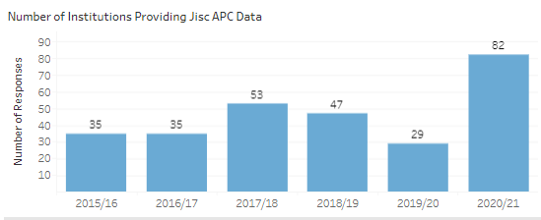
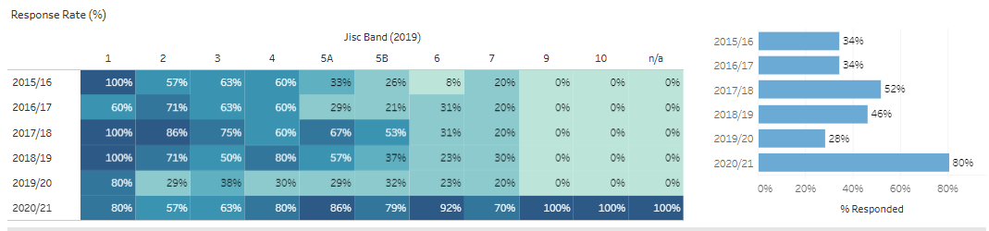
Insights 2015/2016 – 2020/2021

Slide 8
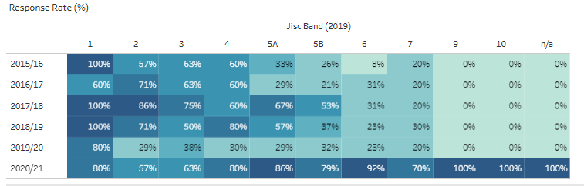
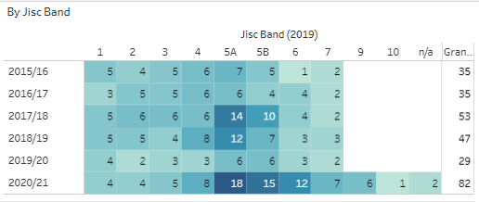
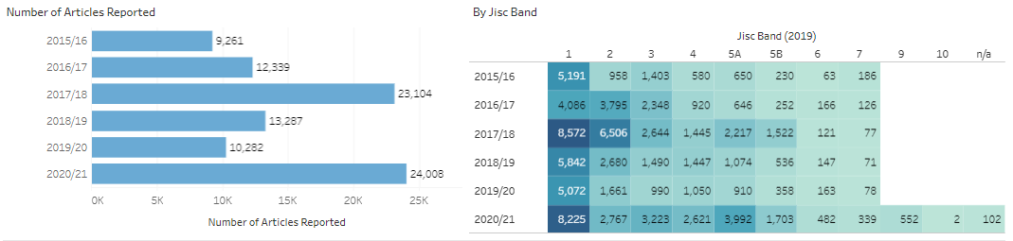
Data insights 2015/2016 – 2020/2021

Slide 9
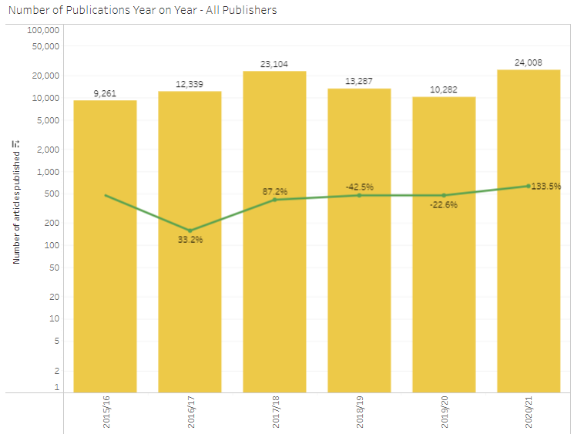
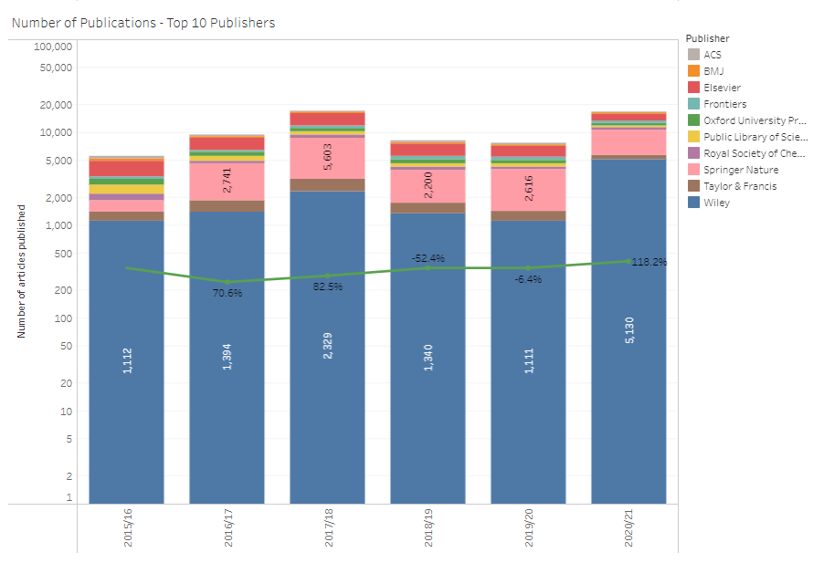
Data insights 2015/2016 – 2020/2021

Slide 10
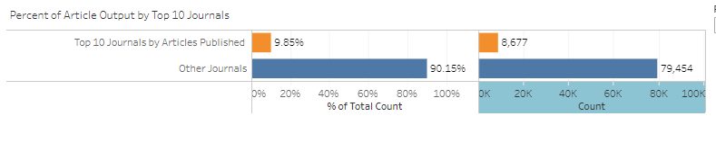
Data insights 2015/2016 – 2020/2021
BMJ Open | Cell Reports
Nature Communications | Frontiers in Immunology
Cell Reports | Scientific Reports
Optics Express | Nucleix Acid Research
PLOS One | Angewandte Chemie (International Edition)

Slide 11
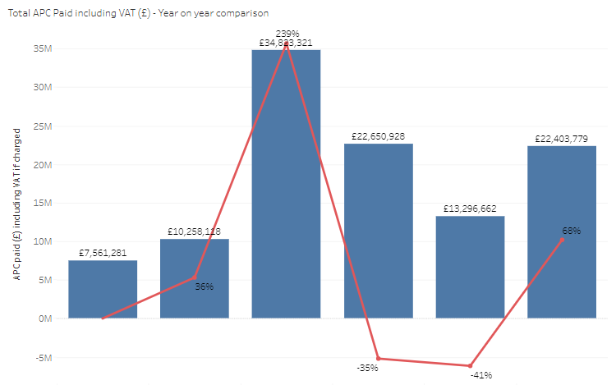
Data insights 2015/2016 – 2020/2021

Slide 12
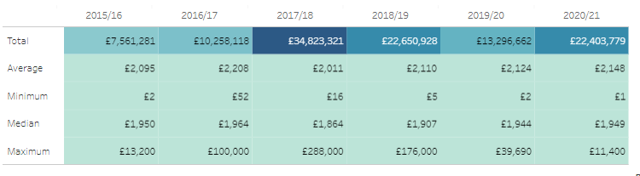
Data insights 2015/2016 – 2020/2021

Slide 13
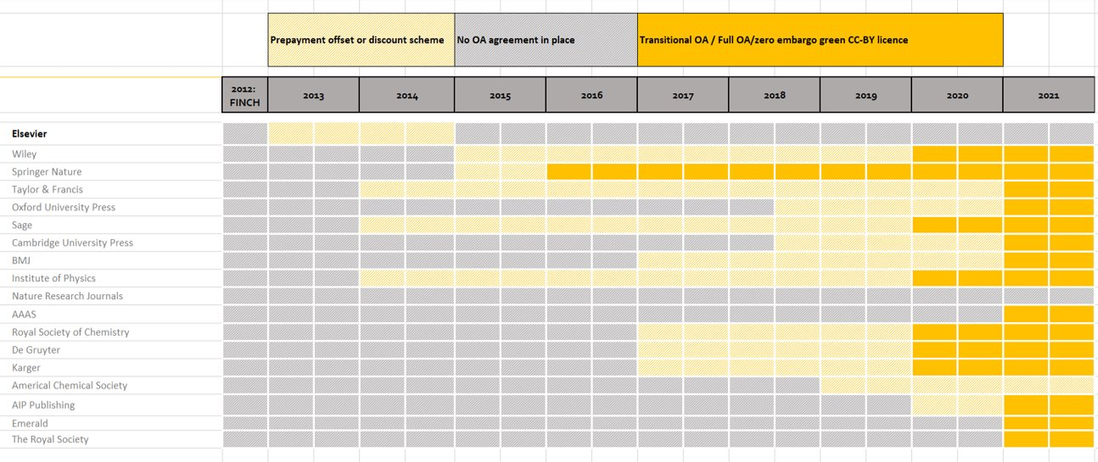
Changing Landscape

Slide 14
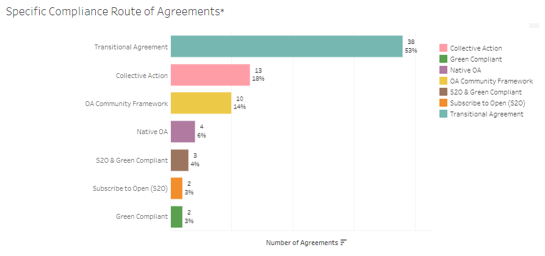
Changing Landscape

Slide 15
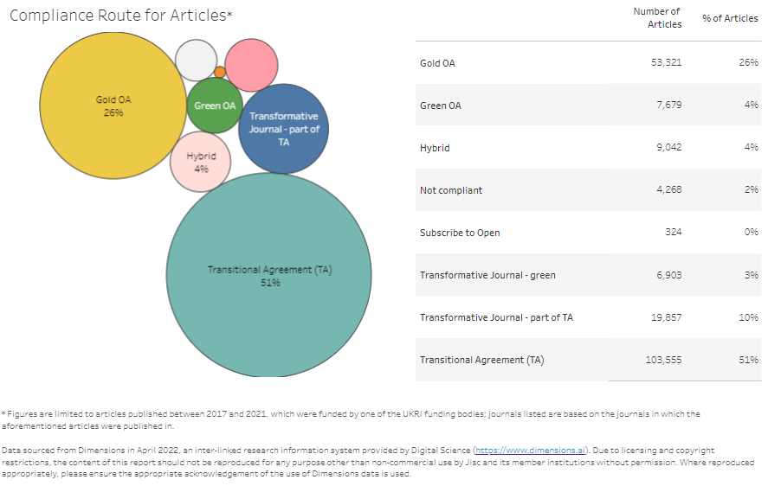
Changing landscape
93.5% of UKRI funded articles (2017-2021) are in journals that are covered by compliant agreements
Work is continuing on the negotiating compliant routes for the remaining 6.5% of output

Slide 16
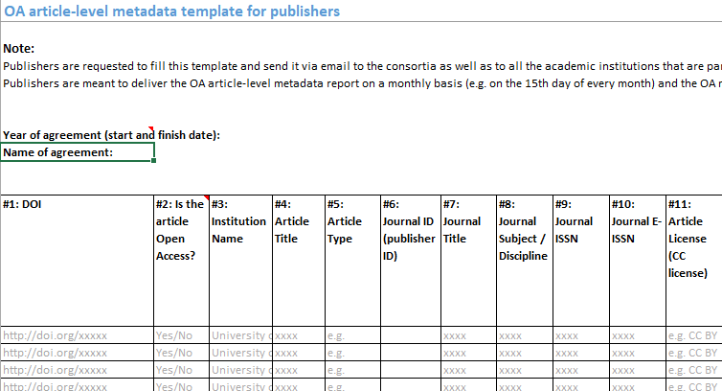
Data collection and Jisc
Data collection
Contact publisher with our article level metadata template (32 fields, 20 are mandatory) includes list price APC
Discussion with the publisher to establish:
    Details about the publisher's data workflows
    Answers to metadata queries
    Reporting schedule (monthly/quarterly)
    Receiving test data
Include data requirements, as agreed, into the license

Slide 17
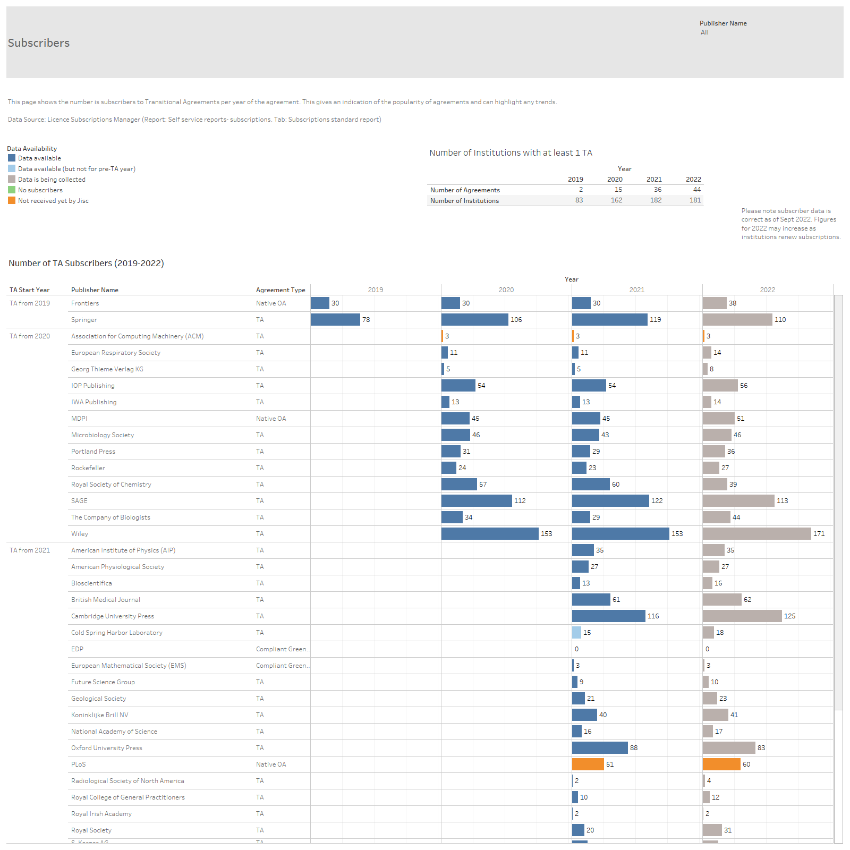
Data collection and Jisc
Data is being collected on a regular basis from 40/44 (90%) of the publishers with agreements
Actively working with the remaining 4 to establish processes
Working with OASB to use their reports wherever possible

Slide 18
Evaluation of Transitional Agreement
Financial value
Value of publishing (list price)
Cost avoidance (list price value – publish fee)
Actual cost saving (previous spend – TA spend
Investment per article
Cost per article

Slide 19
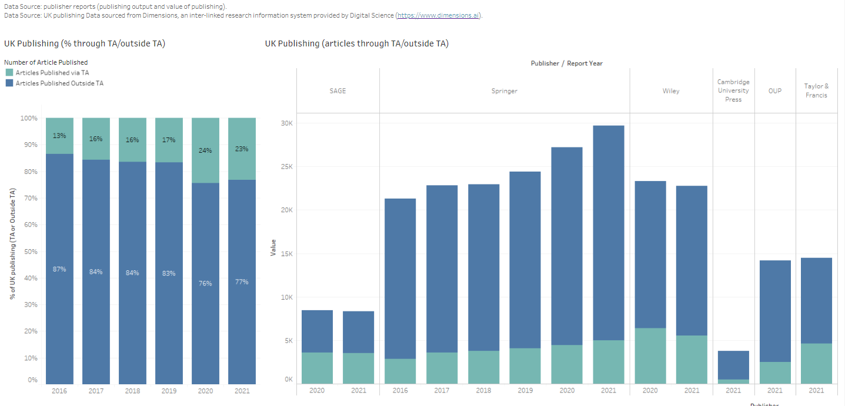
Looking ahead

Slide 20
Looking ahead
Use the ALM data to identify output through TAs but reduce the administration burden on members
Re-design the form to capture spend (funder/institutional) on APCs outside the agreements
Re-design the form to capture contributions to the TA costs
Work with funders to understand their reporting requirements
Understanding the UK expenditure on OA articles beyond our members

Slide 21
Thank you for attending.
amy.devenney@jisc.ac.uk

