Slide 1
Using the institutional repository to store data related to payments
Dr. Gernot Deinzer
University Library Regensburg
Dieses Werk ist lizenziert unter einer Creative Commons Namensnennung 4.0 International Lizenz.

Slide 2

Questions about
Open Access

Slide 3
General Open Access
How many publications at the University are Open Access?
Fees
How much spends the university for Open Access?
Why are publications Open Access?
How much is financed by the library?
Vissibility
How can data be reused?
Are the (most important) metadata set?
How about the qualtity of Open Access articles?

Slide 4
Open Access Situation
University of Regensburg

Slide 5






OA-Situation
Primary OA publications
DEAL und transformation Agreements
Support of community-based business models
Parallel publications
OLH/SciPost
DOAJ
Consultation
Central Funds for Gold Open Access
Agreements
Instiututionel Offers
Journals
Research Data/Software
SCOAP³
“University Press” / Primary publications (z. B.PhD thesis)
Hybrid Open Access

Slide 6
Central administration of publication charges
Obligatory steps
Invoice to central billing office
Assignation to library
Decision for payment together with researcher
Payment by Library
Fund for publications
Funding body
Own Research Money
Inventory = record in institutional repository

Slide 7
Data, Data, Data
What Data do we store in our repository?

Slide 8
What are (Meta-)Data of a publication?
DC
Title
Author
Pages
Funding
Acknowledgements
Rights
License
Internal Information
Faculty
Chair
Are we missing some data?
Account for payment
Part of agreement
How do we connect the data?
APC

Slide 9

Identifier of a publication
But how can I identify a publication, which has no or not yet a doi?
Manuscript number
Invoice number
Not publicly available

Slide 10
Data we collect
Bibliographic Data
Standard (Crossref)
Data related to rights
License
Cost data
Invoice (Document)
Fulltext
JATS
Amount, type
Right transfer
Related to institution
Chair/Working Group
Projects (UR/non UR)
Literature
Payments (Cost centre, transaction number)
IDs (Invoices. Manuscript)
Machine readale
“normal”
pdf
Listing in Datenbases
Identifier

Slide 11


Points for Orientation
Requirements for Open Access repositories
https://www.coalition-s.org/technical-guidance_and_requirements/
COAR Community Framework for Best Practices in Repositories
https://www.coar-repositories.org/news-updates/open-consultation-coar-community-framework-for-best-practices-in-repositories/

Slide 12

Data imported from external sources
Metadata: Crossref, Datacite, PubMed
Additional data (Literature, Projects not UR): Web of Science
Freely available versions: unpaywall
Payment information other institutions
Payment datas from central administration

Slide 13
Open Access Types
Gold OA with APCs
Gold OA with APC
Springer DEAL Hybrid
Springer DEAL Gold
Wiley DEAL Gold
„On“ OA
Green Open Access
Gold OA without APCs
Primary publication
„University Press“
OLH
Scipost
SCOAP³
OA-Journals without APCS
Wiley DEAL hybrid
Hybrid OA
Allianz/National licences
§ 38 Abs. 4 UrhG
Rights transfer -1994
Individuel contract
OA version in other repository
Other tranformative agreements

Slide 14
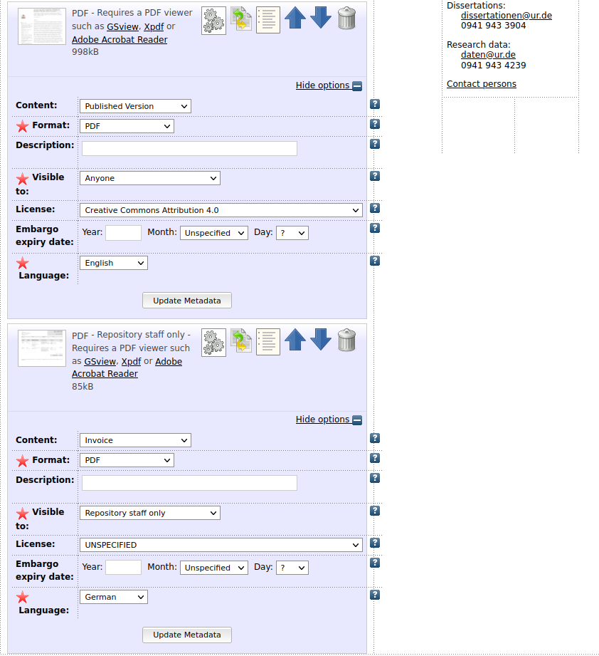
Documentation
Payment and legal basis

Slide 15
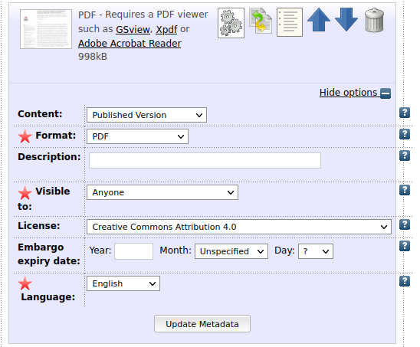
Documentation
Payment and legal basis
Fulltext article
Metadata
License
Free for everyone

Slide 16
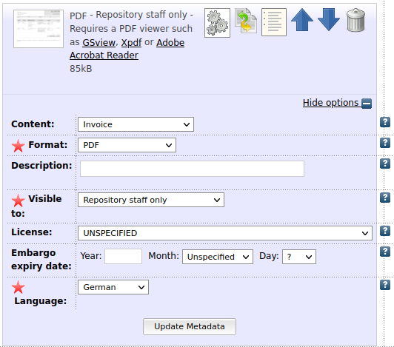
Documentation
Payment and legal basis
AdditionalFile:
Invoice
Legal basis
Visible just for staff
No effect on fulltext status

Slide 17
Fully automated Reports
How is the ratio between subsidy and full funding?
How much publications cost more than 2,000.- €?
How much OA publications have a free license?
How much publications were published with an DFG project involved?
How big is the part of funded publications listed in Web of Science?

Slide 18
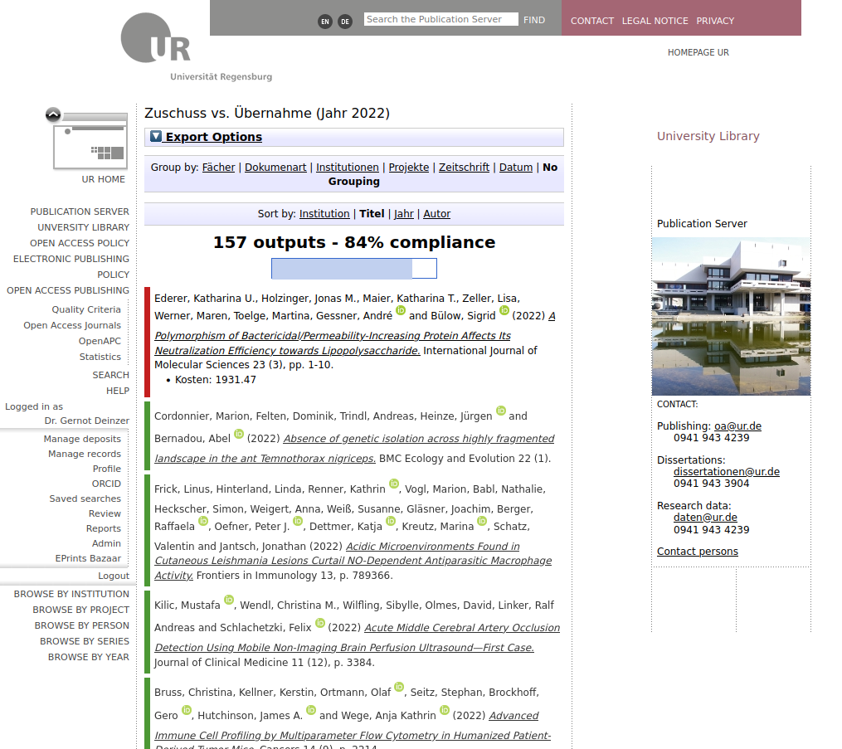

Slide 19
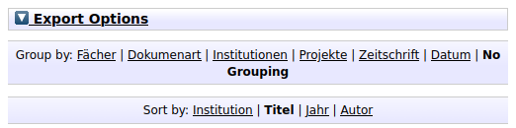
Possibility of export
CSV
HTML
JSON
Grouping
E.g. journals
E.g. subjects
Different sortings

Slide 20

Number of results
Fullfillment of condition in percent
e.g.
Paid Publications 2022
84 % Subsidy of 700.- €
Else: whole APC paid

Slide 21

Single Publications
Green: condition is fullfilled
Red: condition not fullfilled with information about costs

Slide 22
Statistics
Overview over payments (just German text)

Slide 23
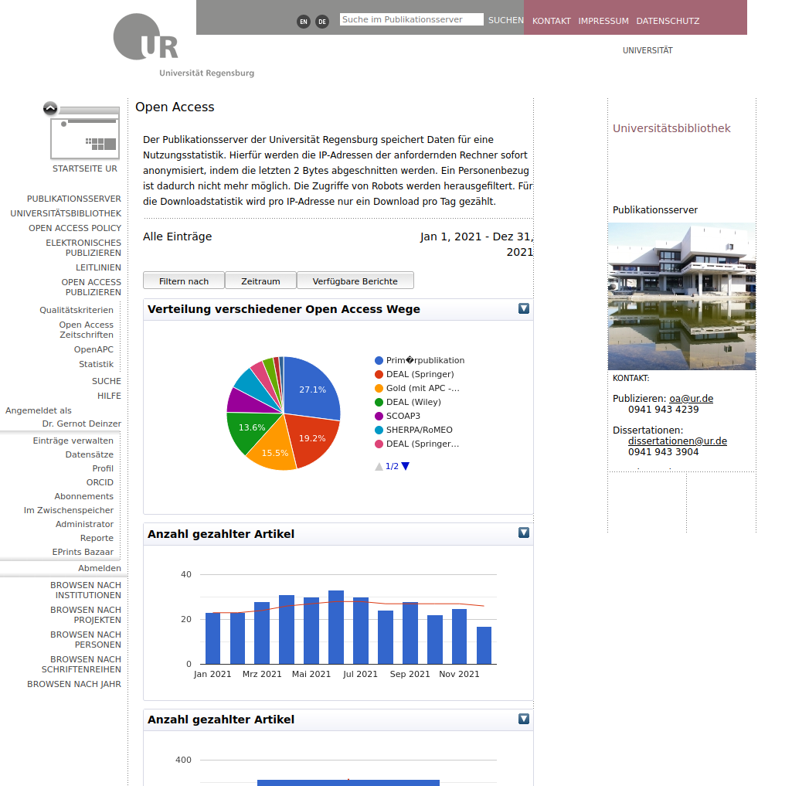

Slide 24
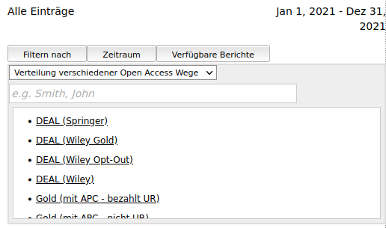
Filtering possible:
OA-Type
Institutions
Projects
Publication type
Publisher
Sries
Authors
…

Slide 25
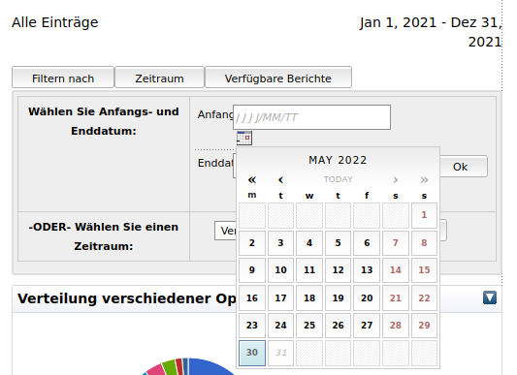
Selection of time period possible

Slide 26
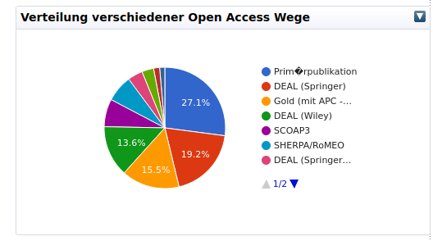
Distribution of different OA-Types
How mcuh publications is free due to?

Slide 27
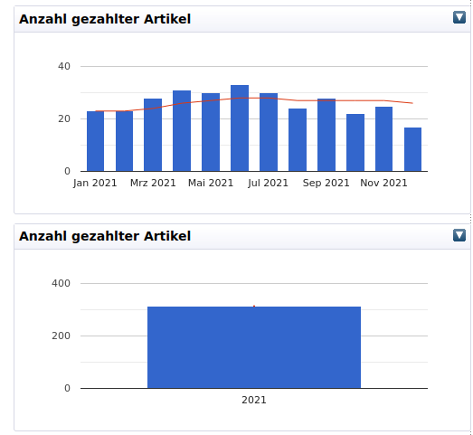
Number paid articles
Untill: 2020: paid by library
Since 2021: Whole University
Monthly and yearly numbers

Slide 28
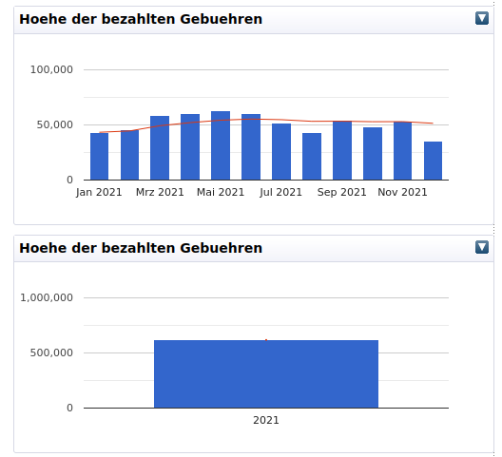
Amount of Payments
Untill 2020: paid by library
Since 2021 whole University

Slide 29
Interfaces
How do we get the data in other systems?

Slide 30
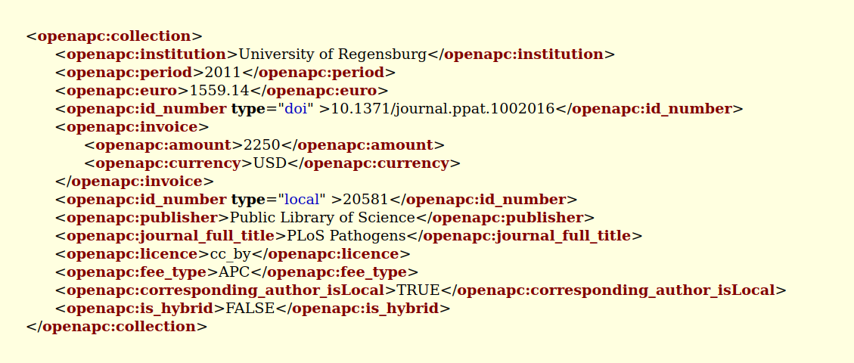
OAI-Interface for data related to payments
https://epub.uni-regensburg.de/cgi/oai2?verb=ListRecords&metadataPrefix=OpenAPC&set=6F615F747970653D676F6C645F70616964

Slide 31




Application:
Harvesting

Slide 32

Conclusion
Need standards for all OA publications
including costs, transformative agreements, memberships, community models …

