Slide 1
HV-CMOS
Ivan Peric
for ATLAS and CLIC HVCMOS R&D and Mu3e Collaborations

Slide 2
HVCMOS introduction
Ideas:
Use the standard (HV)CMOS technologies to implement particle detectors
Use a high voltage to deplete the sensor volume – charge collection by drift
The standard implementation: CMOS electronics inside the deep n-well-collecting electrode
“Smart diode”
Partial depletion from the top, no backside electrode needed
PMOS
NMOS
Shallow-n-well
Shallow-p-well
Deep-n-well
N-Well
~60V
P-Substrate

Slide 3
HVCMOS introduction
Some drawbacks:
The standard substrates are relatively low resistive (~20 Ωcm)
The depleted region is up to ~15 µm thick – MIP signals are relatively weak ~ 1800 e
The collection electrode is, at the same time, the PMOS bulk – there is a strong capacitive crosstalk from PMOS transistors to the detector input.
General drawback of monolithic sensors: Complex in-pixel electronics leads to increased detector capacitance or to decreased electrode-/pixel-size ratio
PMOS
NMOS
Shallow-n-well
Shallow-p-well
Deep-n-well
N-Well
~60V
P-Substrate

Slide 4
HVCMOS detector types
We investigate two detector structures:
A) Hybrid detector with a “smart” HVCMOS sensor and the capacitive signal transmission to the readout ASIC (capacitively coupled pixel sensor - CCPD)
B) Monolithic pixel detector with digital signal processing on the chip periphery
+
B)
CSA
A)
Pixel contains a charge sensitive amplifier
One RO cell
/pixel

Slide 5
HVCMOS detector types
CCPD
ATLAS-pixel “style”: the digital outputs of three pixels are multiplexed to one pixel readout cell
HVCMOS pixel contains an amplifier and a comparator
CLIC “style”: every HVCMOS pixel has its own readout cell
HVCMOS pixel contains only an amplifier
Size: 50 µm x 250 µm
Size: 25 µm x 25 µm
Readout pixel
Readout pixel
TOT = sub pixel address
Different logic 1 levels
+
Size: 33 µm x 125 µm
Size: 25 µm x 25 µm

Slide 6
Monolithic HVCMOS pixel sensor for Mu3e experiment

Slide 7
Monolithic HVCMOS pixel sensor for Mu3e experiment
Concept: Every pixel has its own readout cell, placed on the chip periphery
CSA
Hit flag
Priority scan logic
Comparator
RAM/ROM
Pixel contains a charge sensitive amplifier
Comparator
and Thr tune DAC
Read
Time stamp
Data bus
Readout cell function – time stamp is stored when hit arrives
Hit data are stored until the readout
Priority logic controls the readout order
RO cell size in 0.18 µm AMS technology ~ 7 µm x 40 µm
(with comparator and threshold-tune DAC)
One RO cell
/pixel
Row/Col Addr + TS

Slide 8
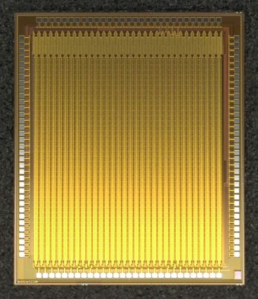
Monolithic HVCMOS pixel sensor for Mu3e experiment
One pixel
3 mm
92µm
Readout cell

Slide 9
MuPixel (readout-cell)
46 µm
Comparator
Address ROM
TS DRAM
7µm
DAC and SRAM
Coupling capacitor
CMOS digital part

Slide 10
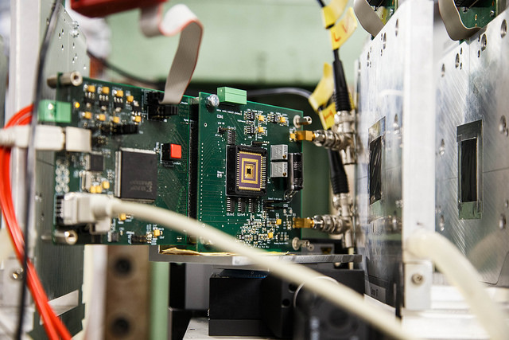
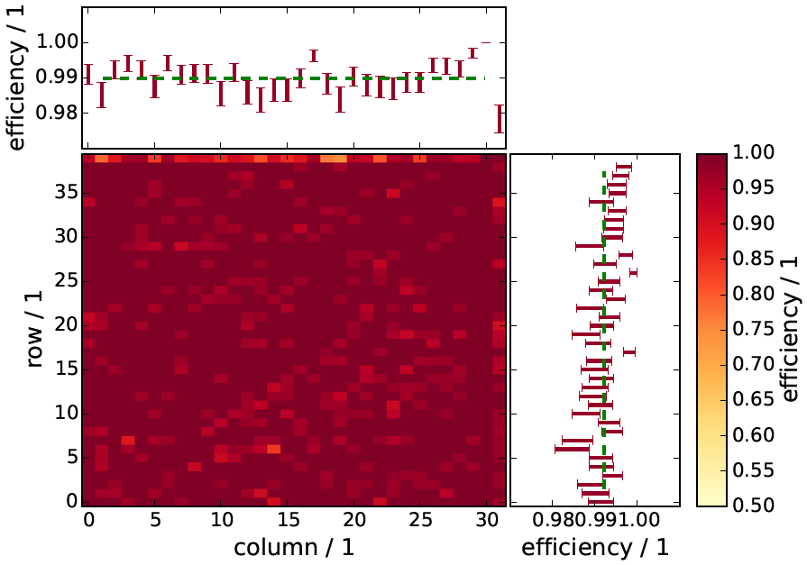
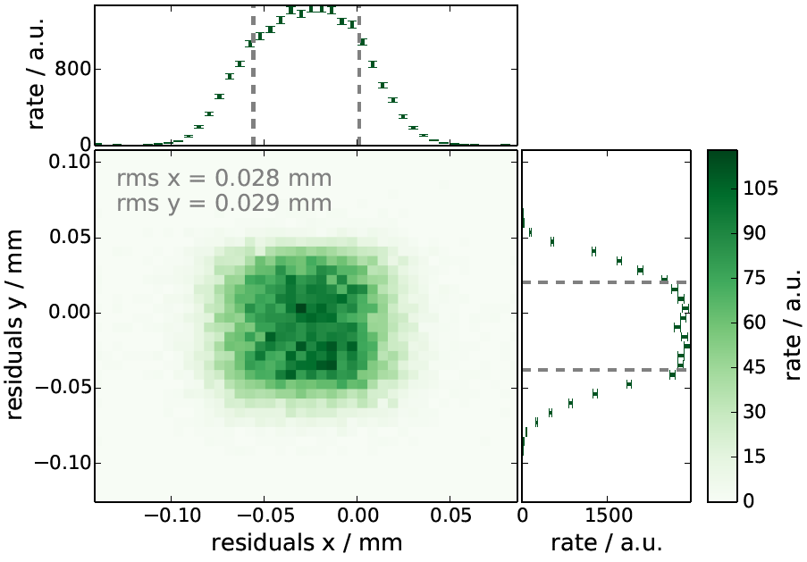
MuPixel test beam
Test-beam measurement February 2014 DESY
Performed by our colleagues from Institute for Physics in Heidelberg
Result analysis: Moritz Kiehn, Niklaus Berger, et al.

Slide 11
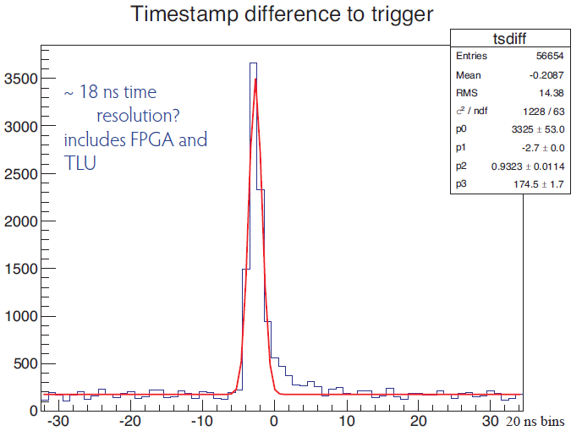
MuPixel test beam
Test-beam measurement February 2014 DESY
Performed by our colleagues from Institute for Physics in Heidelberg
Result analysis: Moritz Kiehn, Niklaus Berger, et al.
80ns
Probably caused by indirect hits

Slide 12
Periphery area estimation for triggered readout
Concept: Every pixel has its own readout cell, placed on the chip periphery
Triggered hit flag
CSA
Comparator
Hit flag
RAM/ROM
Priority scan logic
Pixel contains a charge sensitive amplifier and a discriminator with threshold tune DAC
Time stamp
Delayed TS and trigger
Read
Data bus
One RO cell
/pixel
Readout cell function – time stamp is stored when hit arrives
The stored time stamp is compared with the current time stamp
If trigger arrives with the correct latency, the triggered hit flag is set
Priority logic controls the readout order
Estimated cell size in 0.18 µm AMS technology without comparator ~ 7 µm x 50 µm
Example: Pixel size 50 µm x 250 µm
Chip size: ~ 2 cm x 2 cm
Number of pixels: 400 x 80
Size of periphery without comparator:
2 cm x 560 µm (~ 2.5%)
Global readout
Periphery size ~ 2.5 %

Slide 13
HVCMOS pixel sensor for ATLAS

Slide 14
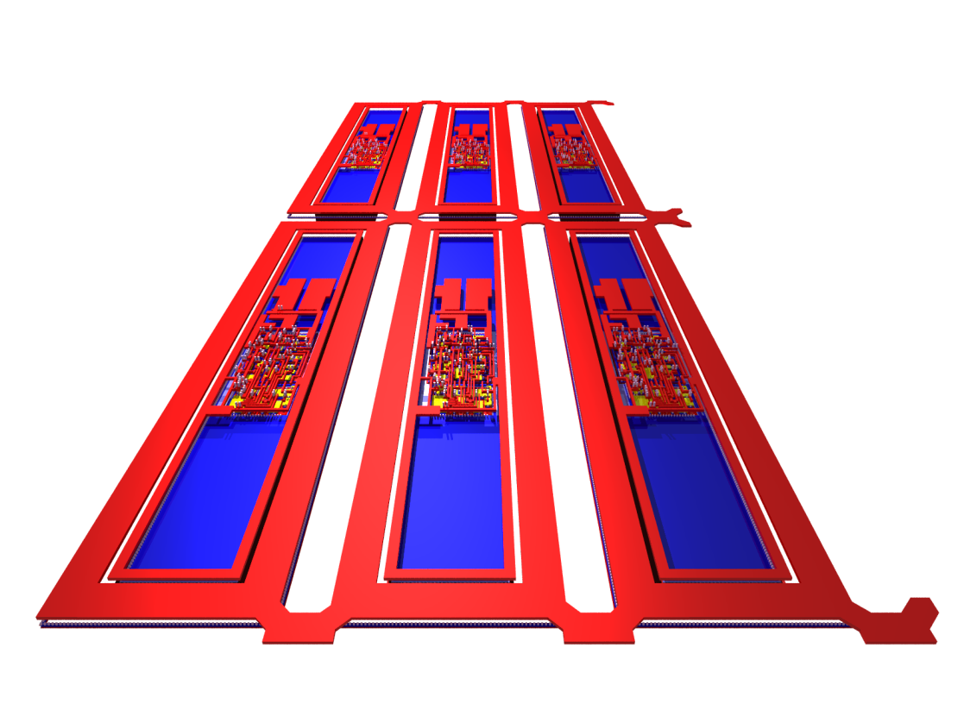
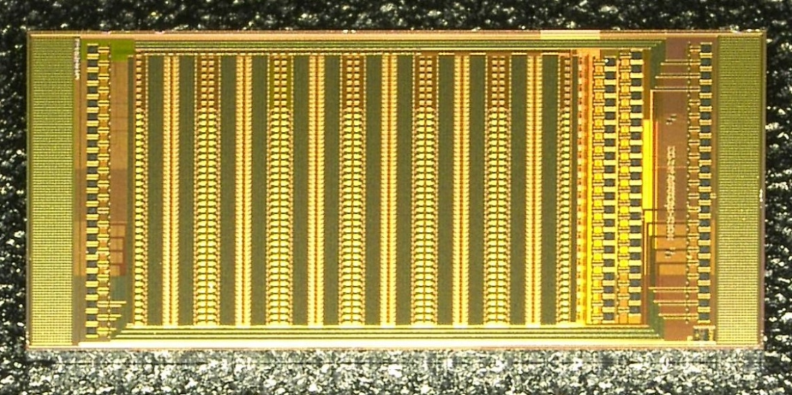
CCPD detector (HV2FEI4)
Size: 50 µm x 250 µm
The digital outputs of three pixels are multiplexed to one pixel readout cell
Different logic 1 levels
+
Size: 33 µm x 125 µm
CCPD Pixels
2
2
3
3
1
1

Slide 15
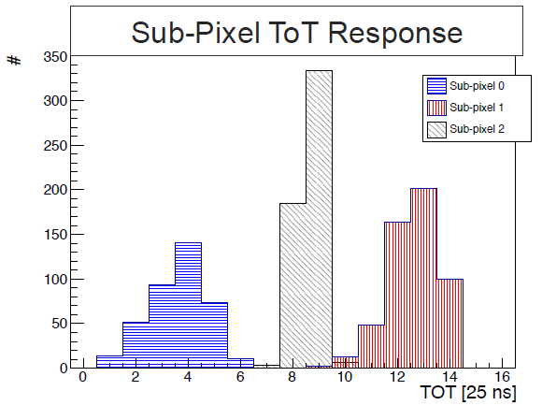
HV2FEI4
“Sub-pixel resolution” by measuring of time over threshold (measurement: Malte Backhaus)
CCPD Pixels
2
2
3
3
1
1

Slide 16
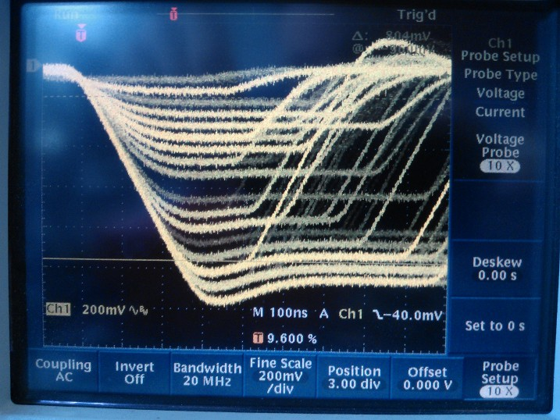
HV2FEI4: segmented strip measurements
Analog encoding of pixels positions in the case of the segmented strip readout
Fe55
Absorber
Amp
Oscilloscope
Th1
Monitor
Chip

Slide 17
HV2FEI4: neutron irradiation 10¹⁵ n_{eq}/cm₂
No evidence of signal decrease after 10¹⁵ n_{eq}/cm₂

Slide 18
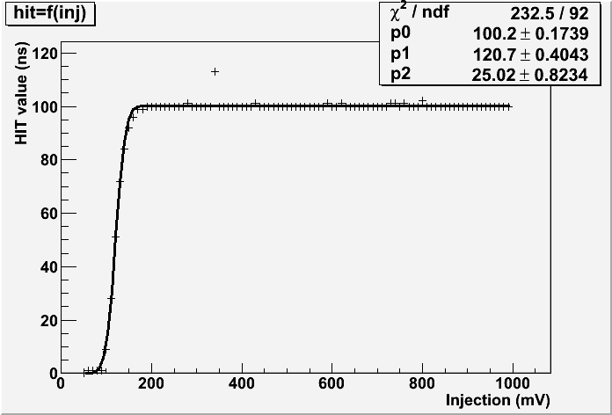
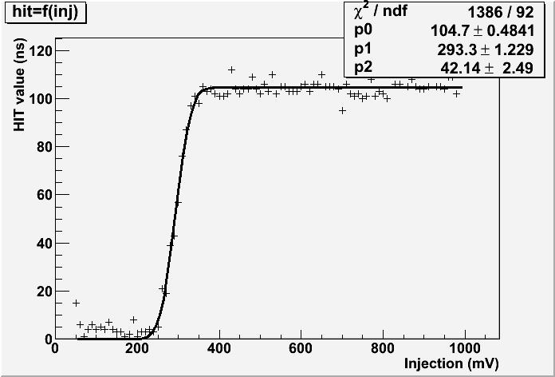
HV2FEI4: x-ray irradiation to 862 Mrad
A detector has been irradiated to 862 Mrad with x-rays. (chips on during the irradiation, 2 hours of annealing at 70C after each 100Mrad)
862 Mrad
90e
150e

Slide 19
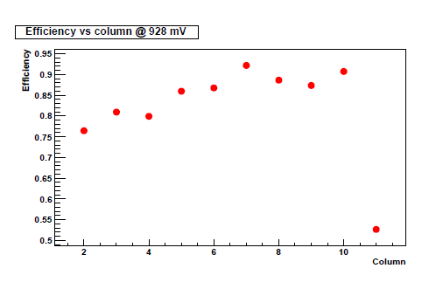

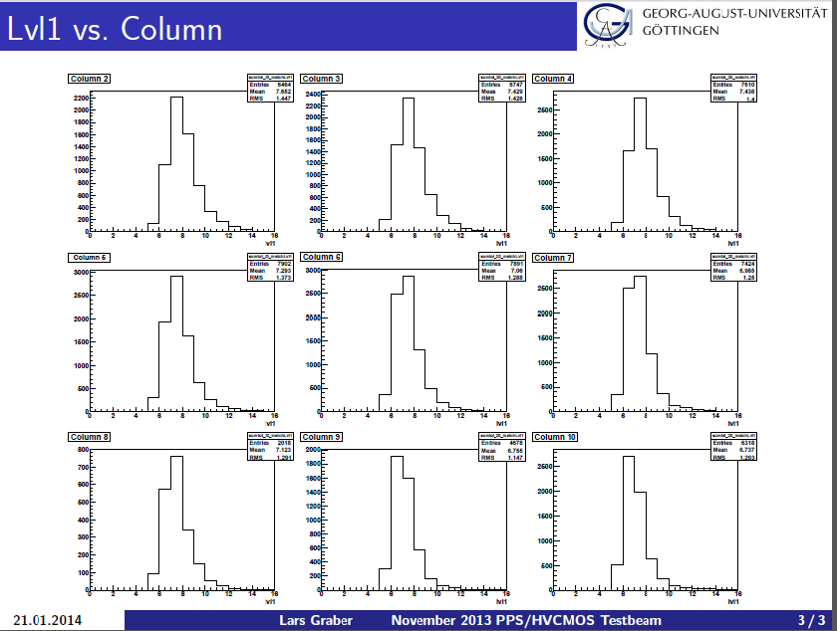
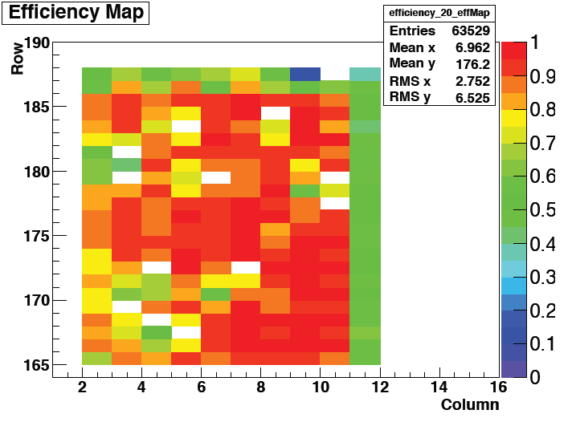
HV2FEI4: test beam
Test beam DESY, analysis: Lars Graber, et al.
Threshold tune not optimal
(changed in the new version)

Slide 20
Further steps
We need to improve time walk
We need to improve SNR of CCPDs for ATLAS, especially after irradiation
Three strategies:
1) optimize present design
2) invent more clever electronics
3) improve the detector structure and technology

Slide 21
Detector structure improvements

Slide 22
Isolated PMOS
Detector structure improvements:
Isolated PMOS
Eliminates PMOS to sensor crosstalk, allows more freedom when pixel electronics is designed
Improvement:
NMOS
PMOS
NMOS
PMOS
3.3V
Deep p-well
Shallow n-well
Deep n-well

Slide 23
High resistive substrates
Detector structure improvements:
High resistive substrates
Uniformly doped substrate 20 Ω cm
Signal 1800e (50%-50% drift-diffusion)
Uniformly doped substrate 80 Ω cm
Signal: ~ 2700e-4500e (estimation)
Particle
Particle
Deep-n-well
Deep-n-well
Primary signal
100%-Signal collection: drift
Primary signal
100%-Signal collection: drift
+-
+-
+-
Depleted 12 µm
+-
+-
+-
Depleted 24µm
(@ equal bias voltage)
Depleted 48µm
(@ equal field, doubled bias voltage)
+-
+-
+-
+-
+-
+-
+-
+-
Secondary signal
Partial signal collection: diffusion
+-
+-
+-
12 um
+-
+-
+-
+-
+-
Signal loss: recombination
+-
+-
+-
+-
+-
Signal loss
+-

Slide 24
High resistive substrates
Detector structure improvements:
High resistive substrates
These improvements are possible within AMS- and LFoundry processes
Uniformly doped substrate 20 Ω cm
Signal 1800e (50%-50% drift-diffusion)
Uniformly doped substrate 80 Ω cm
Signal: ~ 2700e-4500e (estimation)
Particle
Particle
Deep-n-well
Deep-n-well
Primary signal
100%-Signal collection: drift
Primary signal
100%-Signal collection: drift
+-
+-
+-
Depleted 12 µm
+-
+-
+-
Depleted 24µm
(@ equal bias voltage)
Depleted 48µm
(@ equal field, doubled bias voltage)
+-
+-
+-
+-
+-
+-
+-
+-
Secondary signal
Partial signal collection: diffusion
+-
+-
+-
12 um
+-
+-
+-
+-
+-
Signal loss: recombination
+-
+-
+-
+-
+-
Signal loss
+-

Slide 25
AMS TSV process

Slide 26
TSV – bask side RDL
AMS offers through silicon vias and wafer bonding (so far only for H35, from end of 2015 for H18 as well)
Backside redistribution layer and backside pads are possible
TSV pitch 260 µm
Very important for the module construction
Bump
Read out Chip
CMOS Side
M4
M3
M1
Transistor
nwell
Sensor
Backside RDL
VIAT_TSV
Wire bond pad
(PAD_TSV)
RDL
(MET4_TSV)
Wire bond

Slide 27
Pixel detectors
…
Capacitive signal transmission
Capacitive signal transmission
Wire bonds for sensor chip
Wire bond for sensor bias
CMOS pixel sensor
several reticles
(e.g. 4 x 2 cm)
CMOS pixel sensor
several reticles
(e.g. 4 x 2 cm)
Pixel sensor
(diode based)
(e.g. 8 x 2cm)
Wire bonds for RO chips
Wire bonds for RO chips
Wire bonds for RO chips
Readout chip
Readout chip
TSVs
Readout chip
PCB
Wire bonds for sensor chip
CMOS pixel sensor
CMOS pixel sensor with backside contacts
Pixel sensor
Readout chips
Readout chips
Backside contact
PCB
PCB
PCB
Detector as it is done now:
Diode based pixel sensor bump-bonded to readout ASICs
Present development:
CMOS pixel sensor capacitively coupled to readout ASICs
With TSVs
CMOS pixel sensor with backside contacts
capacitively coupled to readout ASICs

Slide 28
Summary
Collaborations have been formed with the goals to develop HVCMOS sensors for ATLAS- and Mu3e experiments, as well for CLIC
The Mu3e prototype detector (technology AMS 0.18 µm H18) (design Heidelberg) is a fully monolithic sensor with untriggered time-stamp based readout
Detection efficiency of >99% has been measured in a beam test, time resolution (time walk) is ~ 70 ns.
The ATLAS prototypes in AMS 0.18 µm (H18) (design HD) and GF 0.13 µm (design CPPM, HD) technologies are capacitively coupled smart sensors that can be readout using FE-I4 chip
Irradiations and test beam measurements have been performed on the H18 chip
The H18-chip is operational after 880 MRad and 10¹⁶ n_{eq}/cm²
A test beam measurement has been performed with the test-setups which are still not optimized and in development stage – the threshold uniformity was poor
The uniradiated H18-detector had a detection efficiency of >90% in the regions with lower threshold

Slide 29
Summary
We need to improve the time walk and the detection efficiency
Three approaches:
1) Optimization of the present design
2) Use of low-pass filter and the time-walk compensation circuit
3) Detector structure improvements (isolated PMOS) and the use of substrates of higher resistivity
Chip producers AMS and LFoundry allow such “extra features” within their processes
AMS additionally offers through silicon vias and wafer bonding (so far only for H35, from end of 2015 also for H18 process)
We are also investigating the use of HVCMOS sensors (segmented strips) for the ATLAS strip layers
Constant delay lossy multiplexing can be used – every hit is transmitted to one of n outputs with a constant delay of ~60 ns.
Hit loss occurs only if there are more than n simultaneous hits within one bunch crossing

Slide 30
Segmented strip detector with lossy constant-delay-multiplexing
A
B
C
D
Output 1
Output 2

Slide 31
Segmented strip detector with lossy constant-delay-multiplexing
A
B
C
D
Output 1
Output 2

Slide 32
Segmented strip detector with lossy constant-delay-multiplexing
0
A
1
B
2
C
D
Output 1
Output 2

Slide 33
Segmented strip detector with lossy constant-delay-multiplexing
0
A
1
B
2
C
D
Output 1
A
Output 2
B

Slide 34
Segmented strip detector with lossy constant-delay-multiplexing
A
B
C
D
Output 1
Output 2

Slide 35
Segmented strip detector with lossy constant-delay-multiplexing
A
B
C
D
Output 1
Output 2

Slide 36
Segmented strip detector with lossy constant-delay-multiplexing
0
A
B
0
C
1
D
Output 1
Output 2

Slide 37
Segmented strip detector with lossy constant-delay-multiplexing
0
A
B
0
C
1
D
Output 1
C
Output 2

Slide 38
Segmented strip detector with lossy constant-delay-multiplexing
A
B
C
D
Output 1
Output 2

Slide 39
Segmented strip detector with lossy constant-delay-multiplexing
A
B
C
D
Output 1
Output 2

Slide 40
Segmented strip detector with lossy constant-delay-multiplexing
0
A
1
B
C
D
2
Output 1
Output 2

Slide 41
Segmented strip detector with lossy constant-delay-multiplexing
0
A
1
B
C
D
2
Output 1
A
Output 2
D

Slide 42
Segmented strip detector with lossy constant-delay-multiplexing
A
B
C
D
Output 1
Output 2

Slide 43
Time Walk Compensation

Slide 44
Time Walk Compensation
The idea: Adding of low-pass filter decreases the noise without increasing the power consumption
=> Better SNR, lower threshold
However: a slow output signal leads to a time-walk
Time walk is caused 1) by the fluctuations of the input signal and 2) by the low and signal-dependent response speed of the electronics
Can we compensate for time walk, without decreasing the shaping time constants?
Tsha
Th
Sig
TW
Tsha
Cdet
Iamp

Slide 45
Time Walk Compensation
Imagine a comparator which has the output zero-to-one transition speed, that depends on the input signal “overdrive”
High amplitude signal – faster threshold crossing but slower 0-1 transition
Low amplitude signal – slower threshold crossing but faster 0-1 transition
Result: the threshold-crossing- and the transition time skews compensate each other
Second comparator generates time-walk free signal
Slow down
Higher amplitude
2
Slow down
Lower amplitude

Slide 46
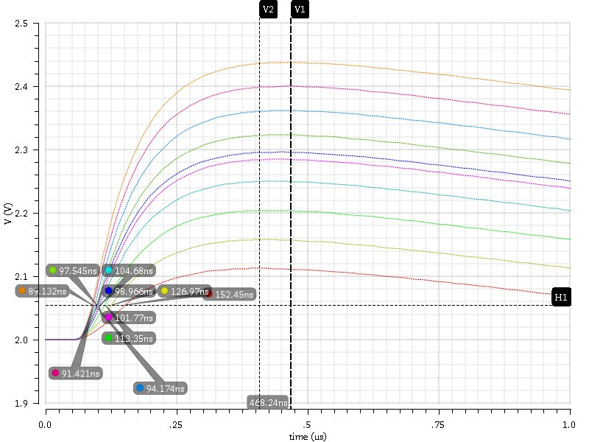
Time Walk Compensation – AMS 350 nm
Noise=8.8mV, Thr=55mV, Bias current=10µA, Pixel size = 50x250µm, Ifoll=10, amplifier power 200mW/cm²
Max 3600e:468ns
3600e
Shaper Output
TW 62ns
TW 62ns
Max 900e:408ns
900e

Slide 47
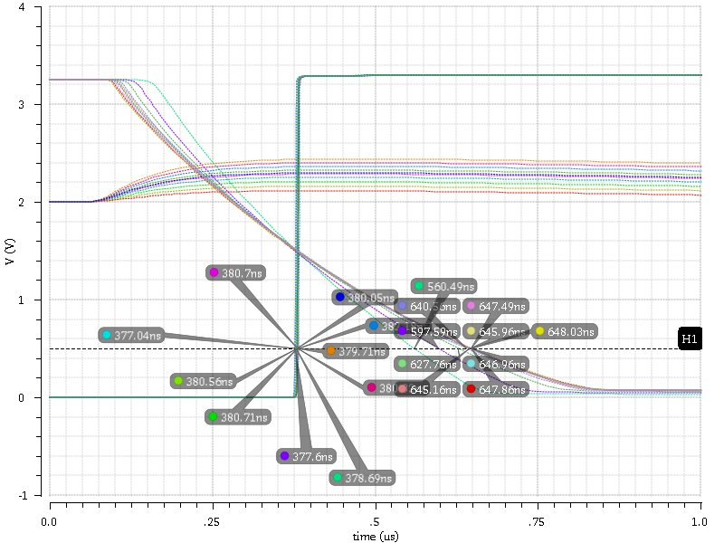
Time Walk Compensation – AMS 350 nm
Noise=8.8mV, Thr=55mV, Bias current=10µA, Pixel size = 50x250µm, Ifoll=10, amplifier power 200mW/cm²
3600e
900e
Comparator Output
TW 4ns

Slide 48
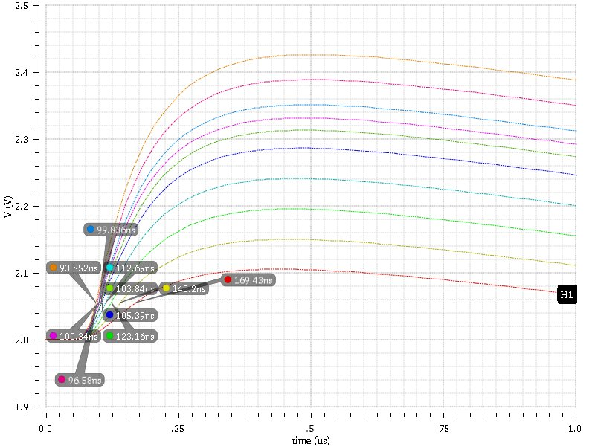
Time Walk Compensation
Noise=8.0mV, Thr=55mV, Bias current=10µA, Pixel size = 50x500µm, Ifoll=7, amplifier power 100mW/cm²
3600e
Shaper Output
TW 75ns
900e

Slide 49
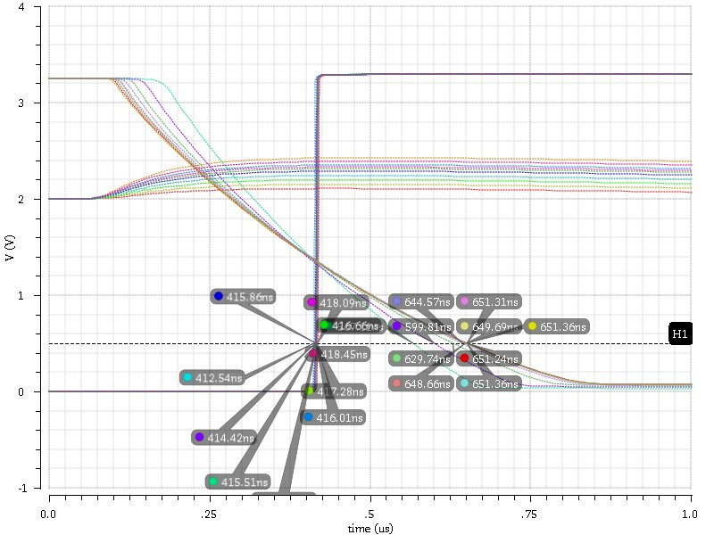
Time Walk Compensation
Noise=8.0mV, Thr=55mV, Bias current=10µA, Pixel size = 50x500µm, Ifoll=7, amplifier power 100mW/cm²
3600e
900e
Comparator Output
TW 5ns

Slide 50
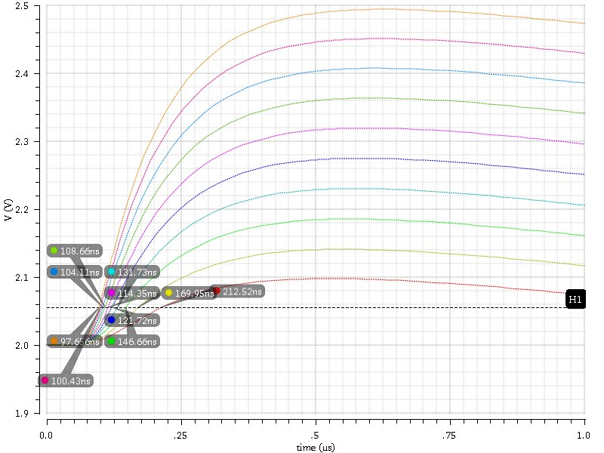
Time Walk Compensation
Noise=7.9mV, Thr=55mV, Bias current=5µA, Pixel size = 50x500µm, Ifoll=5, amplifier power 50mW/cm²
3600e
Shaper Output
TW 116ns
900e

Slide 51
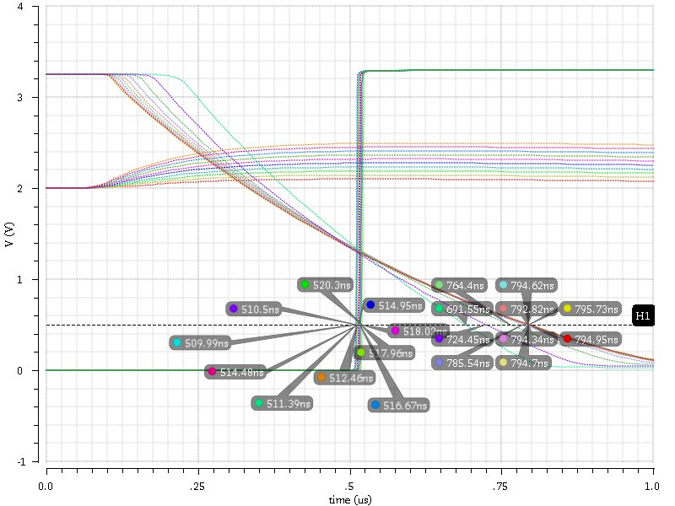
Time Walk Compensation
Noise=7.9mV, Thr=55mV, Bias current=5µA, Pixel size = 50x500µm, Ifoll=5, amplifier power 50mW/cm²
3600e
900e
Comparator Output
TW 8ns

