Slide 1

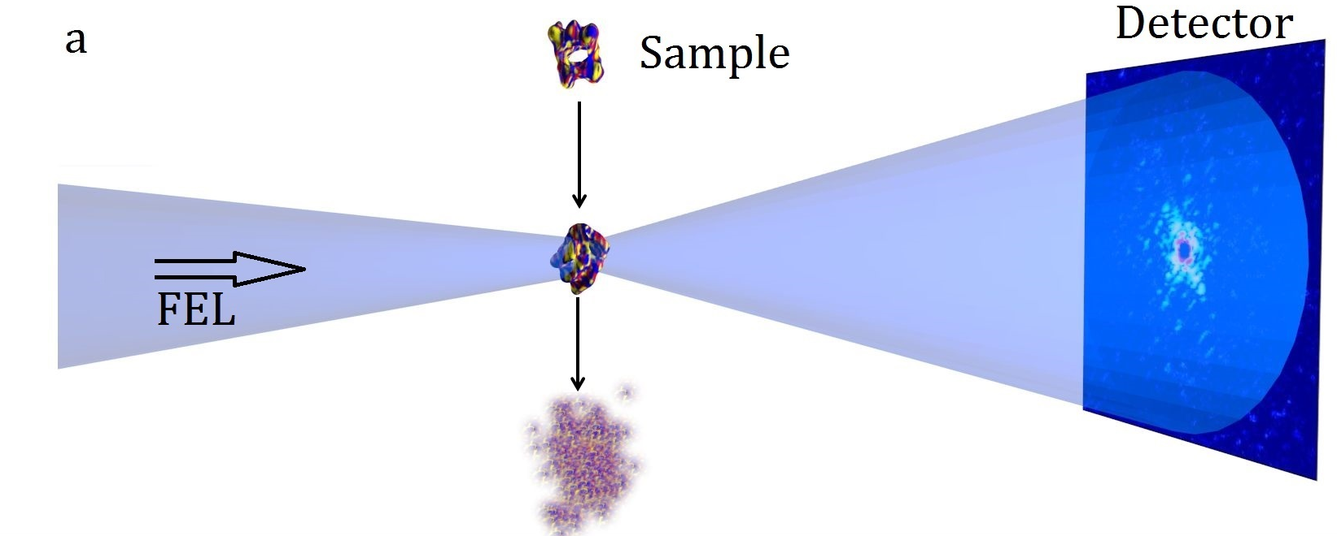
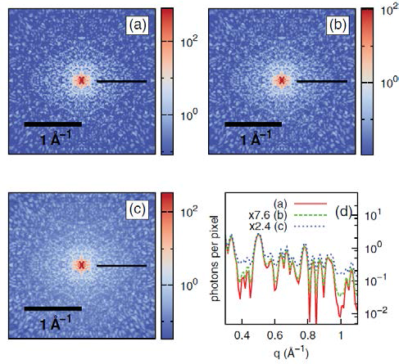
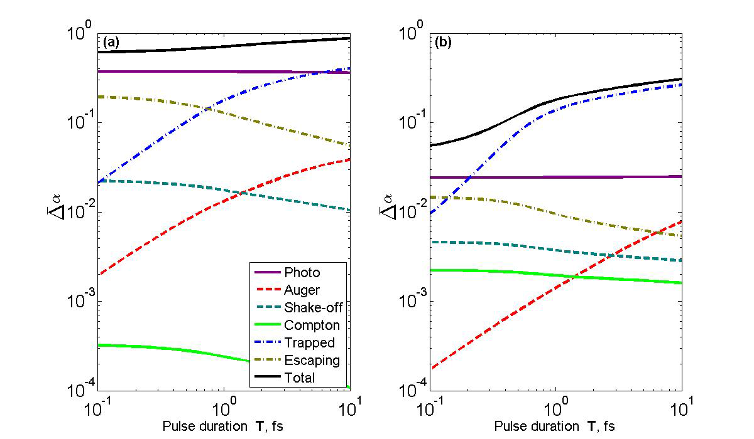
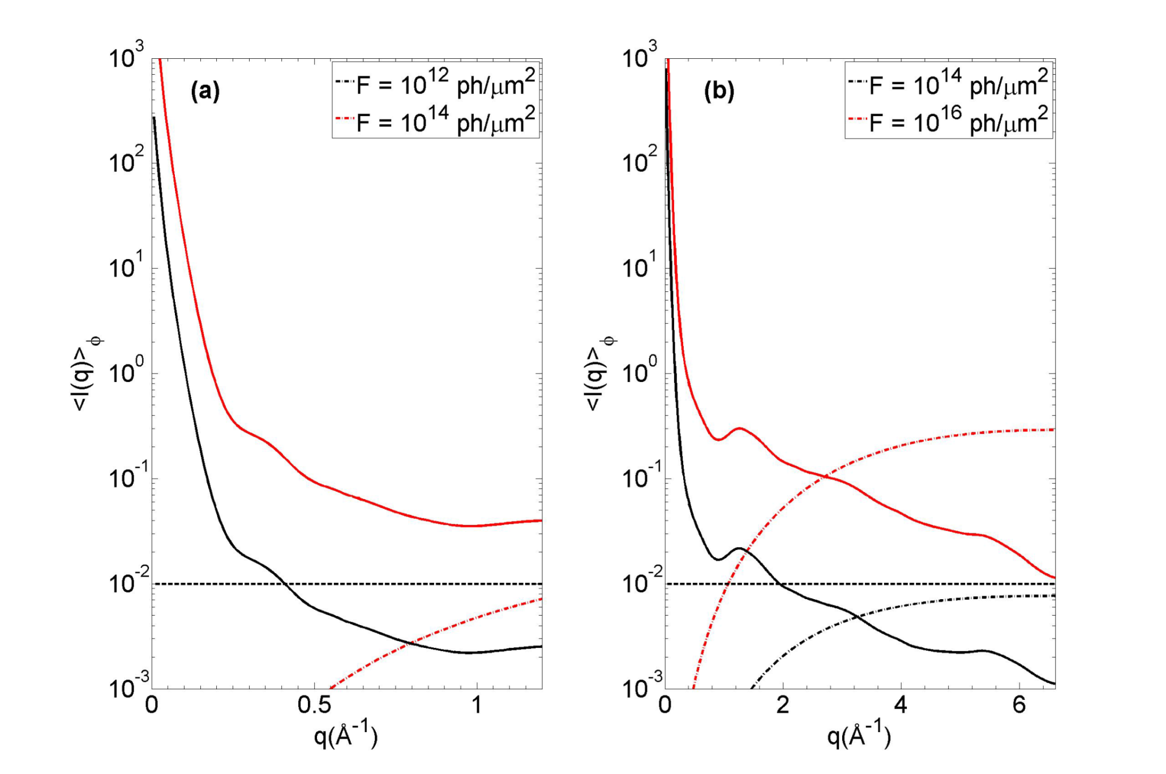
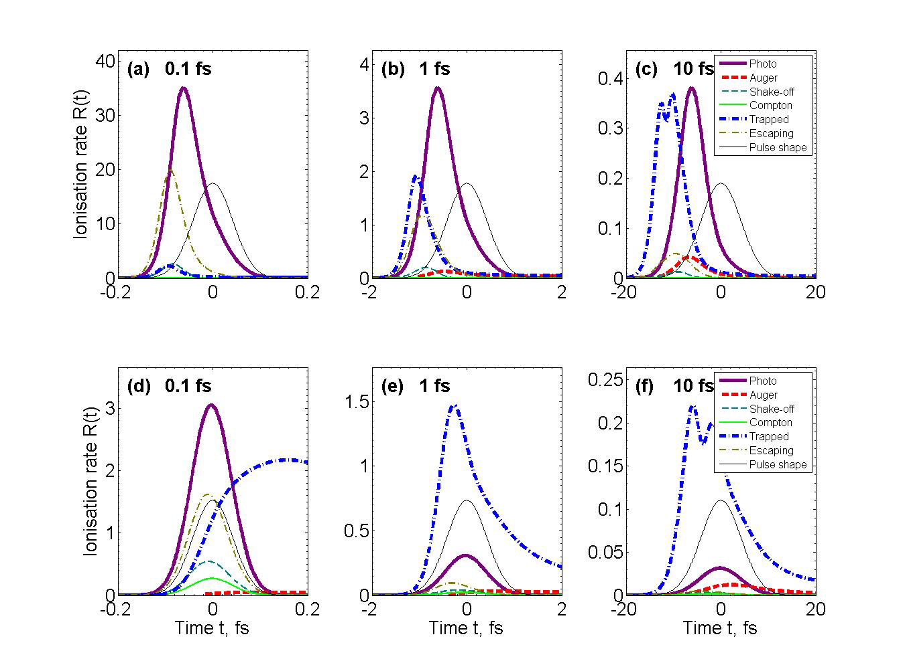
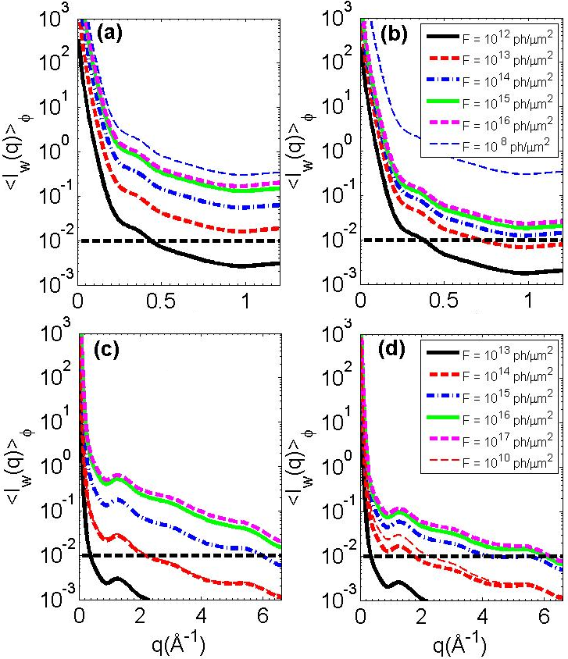
Electronic damage for short high-power x-ray pulses: its effect on single-particle x-ray imaging for 100 as - 10 fs pulse durations.
O. Gorobtsov^{1,2}, U. Lorenz³, N. Kabachnik^{4,5}, I. A. Vartanyants^{1,6}
1. DESY, Hamburg, Germany 2. Kurchatov Institute, Moscow, Russia 3. University of Potsdam, Potsdam, Germany 4. Skobeltsyn Institute of Nuclear Physics, Moscow, Russia 5. European XFEL, Hamburg, Germany 6. MEPhI, Moscow, Russia
Single-particle diffraction imaging experiments at XFELs have a great potential for the structure determination of reproducible biological specimens that cannot be crystallized. In these experiments, samples are exposed to intense x-ray pulses to obtain single-shot diffraction patterns. The high intensity induces electronic dynamics on the femtosecond time scale in the system, which can reduce the contrast of the obtained diffraction patterns [1]. By going to shorter pulse durations, electronic damage can be partially avoided [2].
A. Experiment scheme and diffraction patterns
A.2
Diffraction patterns
Diffraction patterns are affected by the electronic damage to the particle during pulse propagation.
Shown: averaged two-dimensional diffraction patterns of the Adenovirus shell for a 5-fs x-ray pulse and 3.1-keV photon energy. (a) No electronic damage, fluence of 10¹⁴ ph/μm². [(b) and (c)] Ionized sample, 10¹⁴ ph/μm² (b) and 10¹⁶ ph/μm² (c). (d) Intensity profiles along the black lines. From Ref. [1]
A.1
Experiment geometry
Diffraction pattern from a sample in random orientation is measured by a single FEL pulse.
After the pulse propagation the particle explodes due to Coulomb forces between ions.
B. Different processes and Compton scattering
B.1
Total contribution of different processes
B.3
Compton background
Different ionization channels exist.
Their importance (average ionization degree) changes with pulse duration. Photon energies 3.1 keV (a) and 12.4 keV (b). The fluence is 10¹⁴ photons/µm² in both cases. Ref. [2].
Compton background from inelastic atomic scattering contributes to the problem. Angular averaged scattered signal (solid lines) and the Compton scattering signal (dashed lines) for photon energies of 3.1 keV (a) and 12.4 keV (b). 1 fs pulse. The horizontal dashed black line corresponds to the requirement of 10⁻² photons per resolution element. [2].
B.2.
Time evolution of the electronic damage
C. Effect of electronic damage on the signal
Average ionization rates during the pulse for photon energies of 3.1 keV (a-c) and 12.4 keV (d-f). The pulse durations are 0.1 fs (a,d), 1 fs (b,e), and 10 fs (c,f). The pulse fluence is 10¹⁴ ph/µm² in all cases. The dashed line shows the pulse shape. Ref. [2].
C.1
Scattered signal
Angular averaged scattered signal stops growing with the fluence at certain power. Here it is shown for photon energies of 3.1 keV (a-b) and 12.4 keV (c-d) and different fluences. Pulse durations are 0.1 fs (a,c) and 10 fs (b,d). Ref. [2].
Summary
References
The simulation of ionization dynamics for different pulse parameters and quantification of the contribution of single mechanisms were performed. For sufficiently short pulses (~1 fs already), it is possible to outrun the ionization from the trapped electron gas, and thus reduce the electronic damage considerably. We also notice that Compton scattering introduces a noticeable background for higher photon energies.
[1] U. Lorenz, N. M. Kabachnik, E. Weckert, I. A. Vartanyants, Phys. Rev. E 86, 051911 (2012).
[2] O. Gorobtsov, U. Lorenz, N. M. Kabachnik, E. Weckert, I. A. Vartanyants, in preparation

