Slide 1

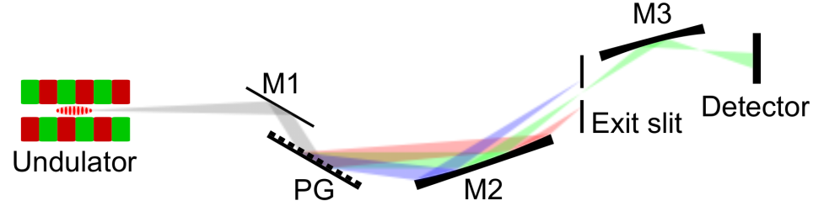
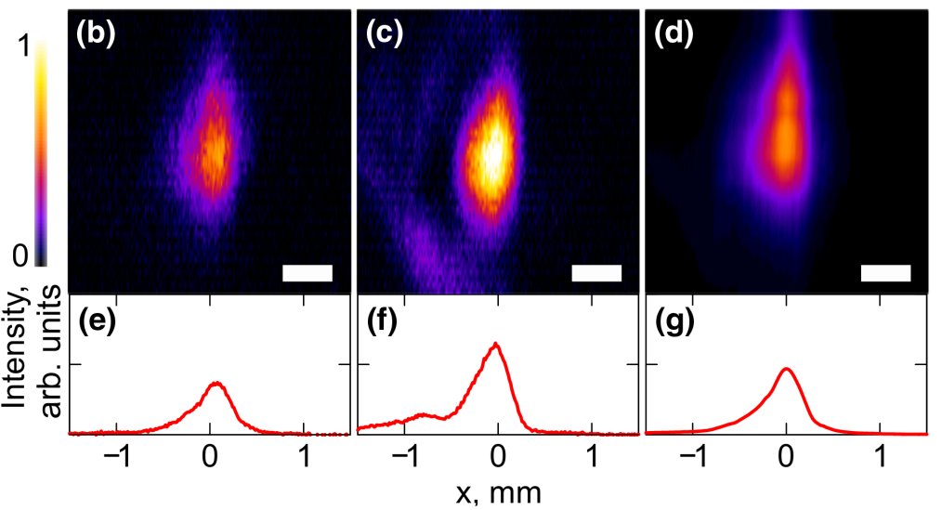
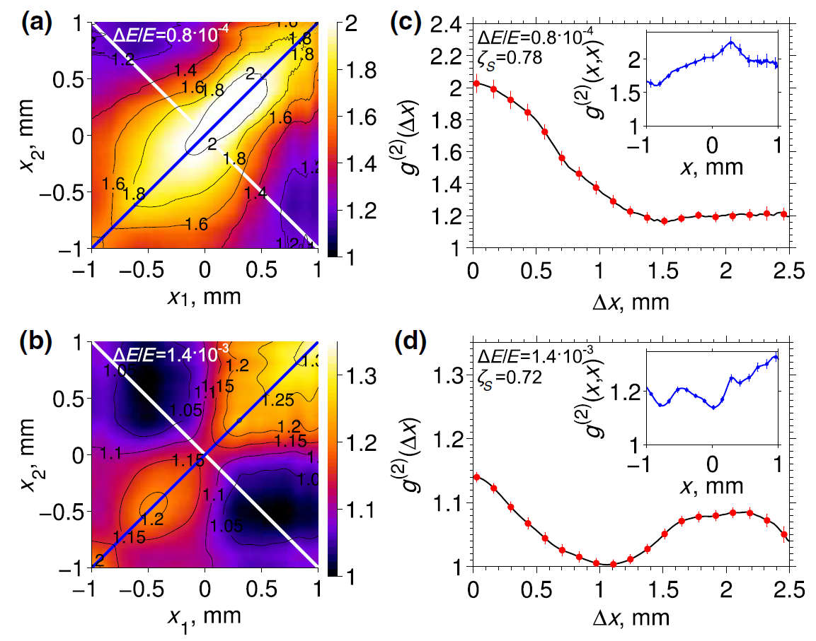
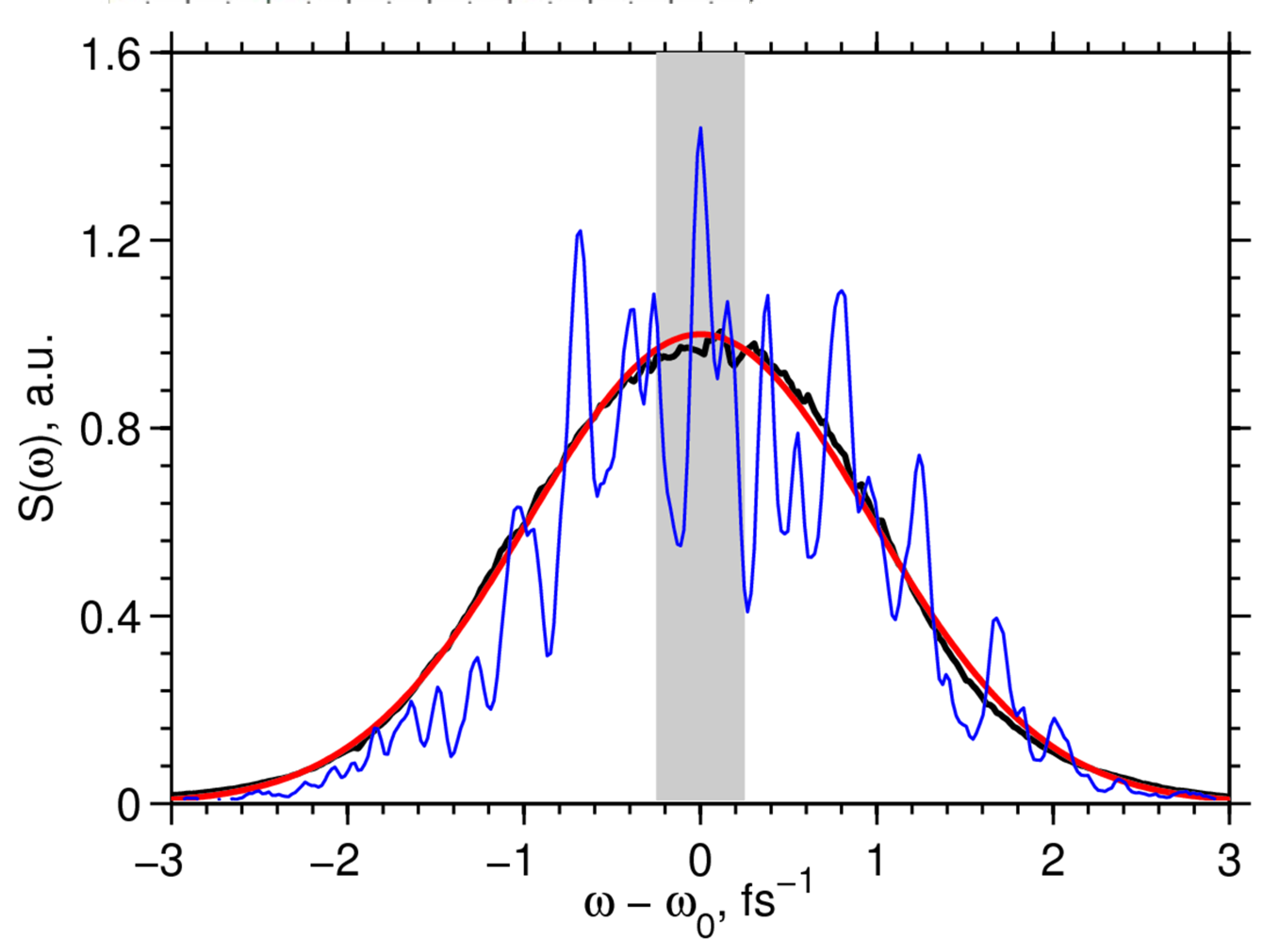
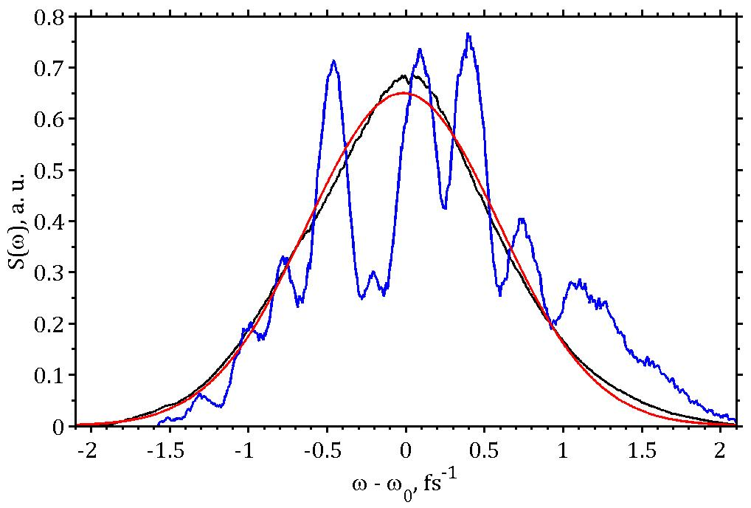
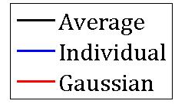
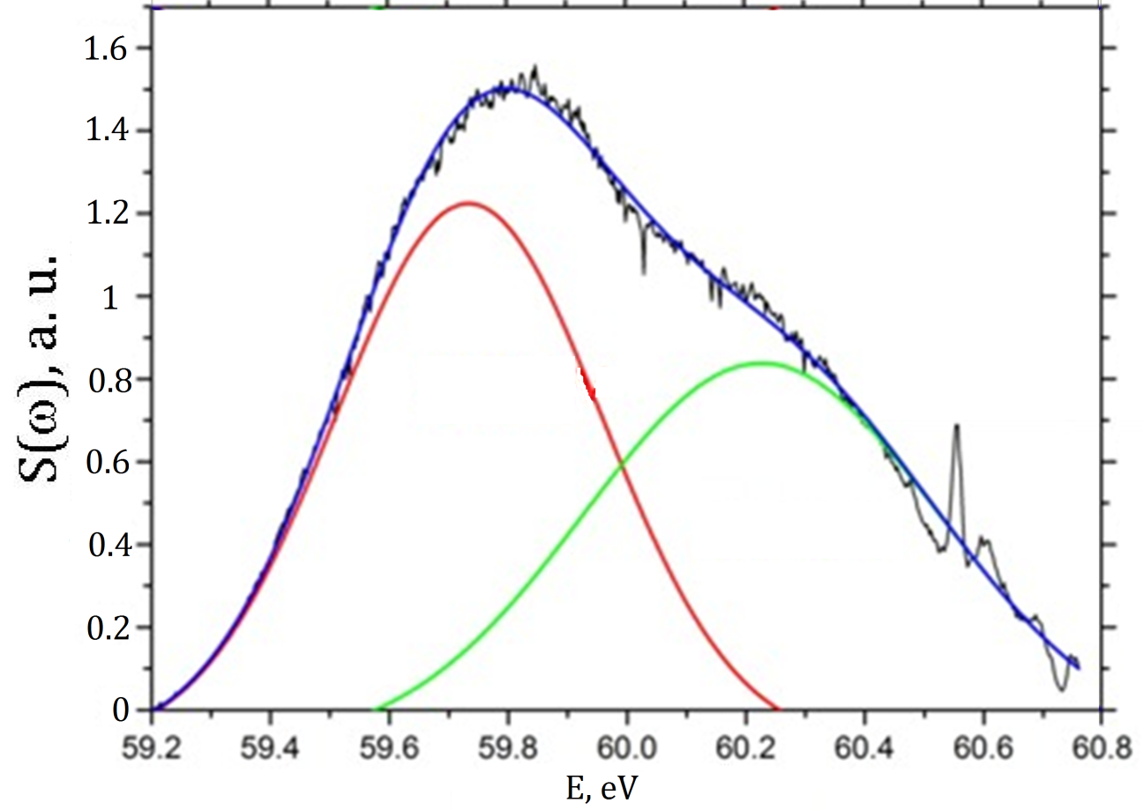
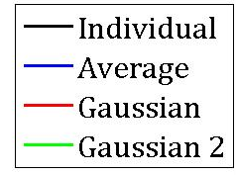
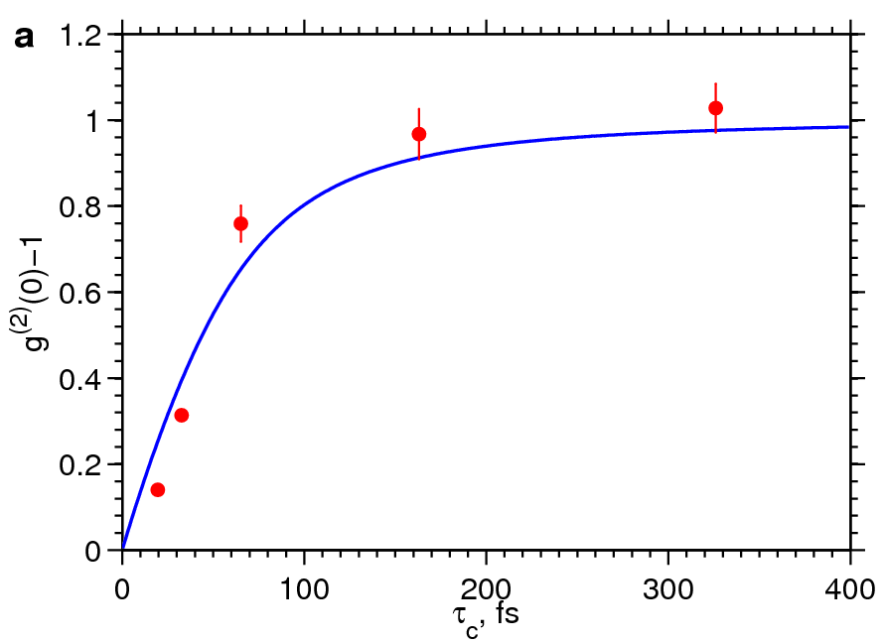
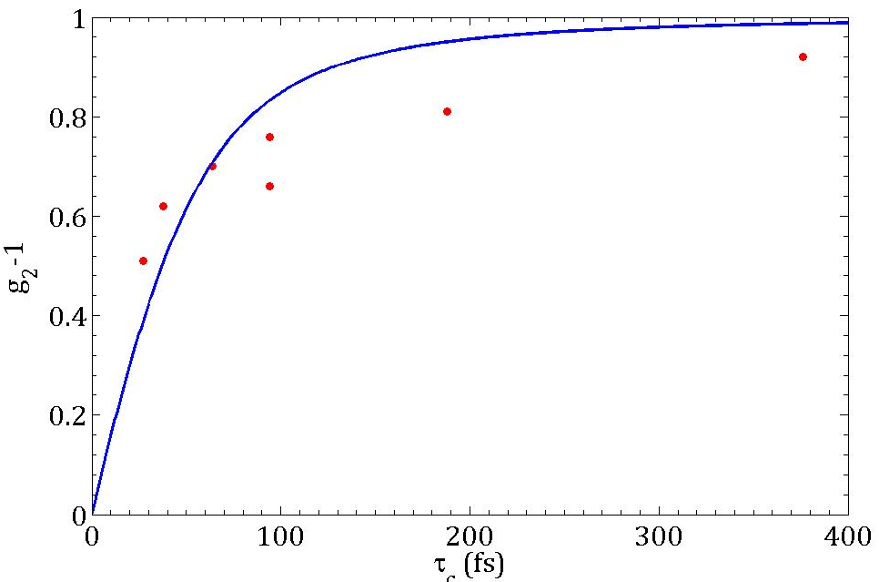
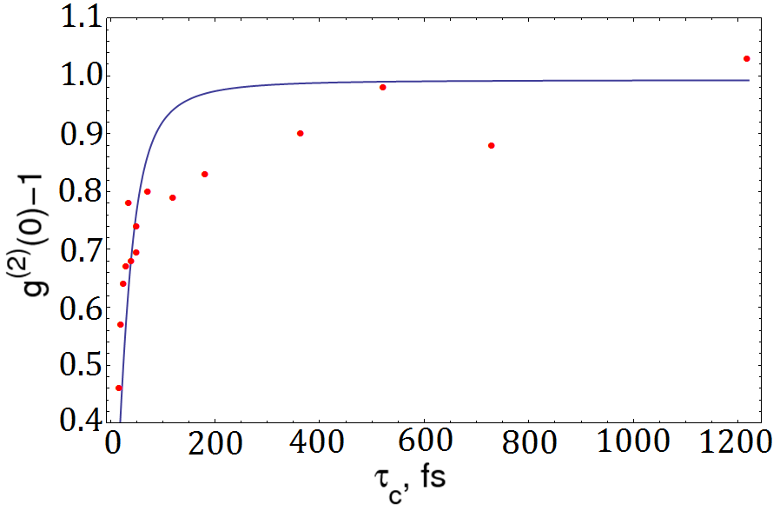
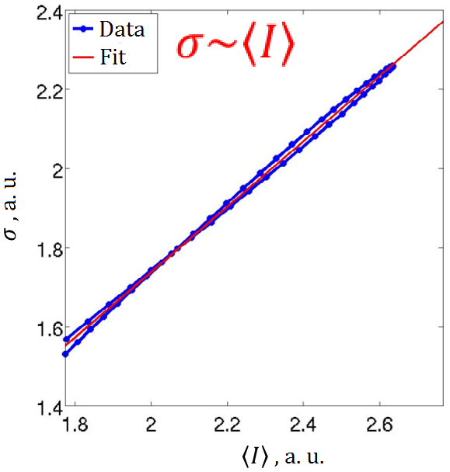
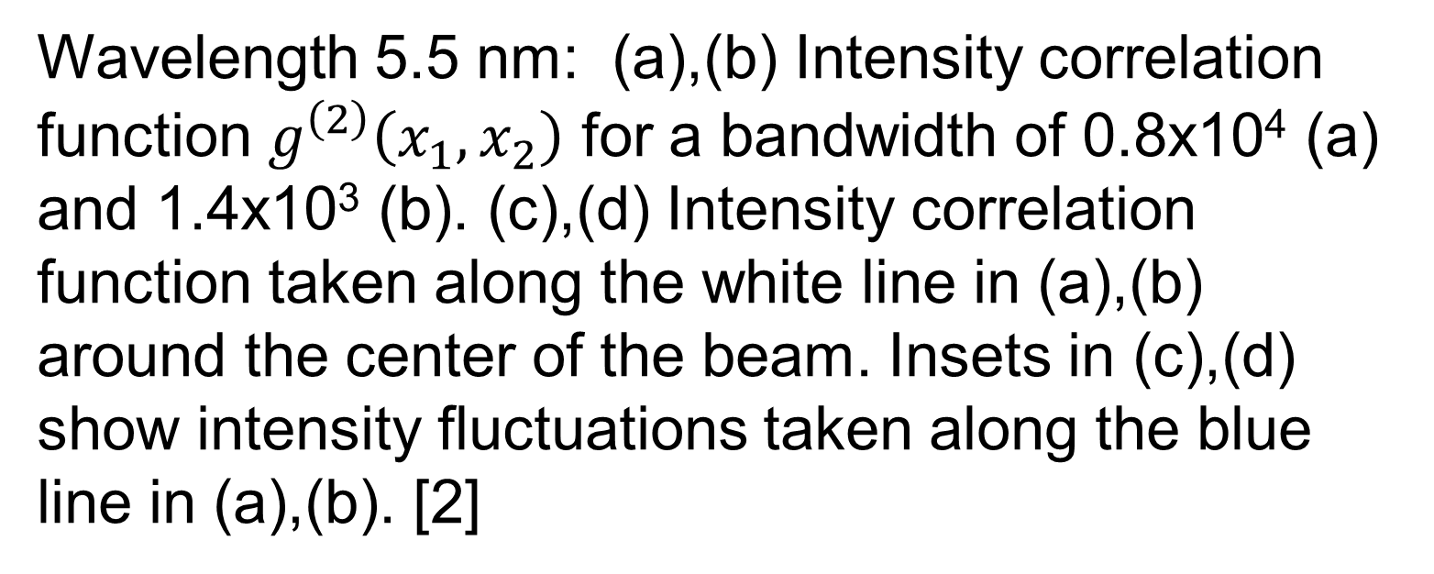


Hanbury Brown and Twiss interferometry at FEL FLASH.
O. Y. Gorobtsov^{1,2}, A. Singer³, U. Lorenz⁴, F. Hieke⁶, G. Mercurio⁶, N. Gerasimova⁵, F. Sorgenfry, S. Lazarev¹, R. Kurta⁵, I. Zaluzhnyy^{1,7}, D. Dzhigaev^{1,7}, A. Shabalin¹, O. M. Yefanov⁶, E. Weckert¹, W. Wurth⁶, I.A. Vartanyants^{1,7}
1. DESY, Hamburg, Germany 2. National Research Center ‘Kurchatov Institute’, Moscow, Russia 3. University of California-San Diego, California, USA 4. University of Potsdam, Potsdam, Germany 5. XFEL, Hamburg, Germany 6. CFEL, Hamburg, Germany 7. MEPhI, Moscow, Russia
Hanbury Brown and Twiss demonstrated that statistical properties of a light source can be retrieved from measurements of intensity correlations [1]. Originally designed to determine star sizes, it has since been used for different applications, including studies of FEL sources [2]. Here we show results of extensive measurements performed at FLASH FEL at different wavelengths and accelerator conditions.
Theory
Experiment
1.
Correlation functions
1.
Experiment setup and parameters
- The second order correlation function is defined as
$$g^{\left(2\right)}\left(r_{1},r_{2}\right)=\frac{\left\langle I(r_{1})∙I(r_{2})\right\rangle }{\left\langle I(r_{1})\right\rangle \left\langle I(r_{2})\right\rangle }.$$
- For stationary chaotic sources [3l]
$$g^{\left(2\right)}\left(r_{1},r_{2}\right)={1+\frac{τ_{c}}{T}\left|γ(r_{1},r_{2})\right|}^{2}.$$
$τ_{c}$ - coherence time;
$T$ – pulse duration;
$γ(r_{1},r_{2})$ – complex degree of coherence.
FELs based on SASE principles obey Gaussian statistics in linear and deep non-linear regimes [4].
Wavelengths 5.5 nm, 13.4 nm, 20.8 nm
Bunch charges 0.6 nC, 0.06 nC and 0.2&0.5 nC respectively
Monochromator to modify bandwidth (coherence time)
2D detector to measure high order correlation functions at different separations simultaneously
Wavelength 5.5 nm, ΔE/E = 0.8∙10⁻⁴:
(b), (c) – typical pulses, (d) – average over 20000 pulses. (e) - (g) – their projections.
Features and Analysis
1.
Intensity correlation analysis
2.
Spectra and modes
(a)
(b)
(c)
Typical spectra for different wavelengths and bunch charges.
Spectra of a single pulse, averaged and gaussian fit for (a) 5.5 nm wavelength, 0.6 nC bunch charge (b) 13.4 nm, 0.06 nC (c) 20.8 nm, 0.5 nC.
- The latter case corresponds to high bunch charge regime, which leads to a greater number of modes than expected and double peak.
Wavelength 5.5 nm: (a),(b) Intensity correlation function $g^{\left(2\right)}\left(x_{1},x_{2}\right)$ for a bandwidth of 0.8x10⁴ (a) and 1.4x10³ (b). (c),(d) Intensity correlation
function taken along the white line in (a),(b) around the center of the beam. Insets in (c),(d) show intensity fluctuations taken along the blue line in (a),(b). [2]
3.
Degree of coherence and pulse duration
In cases with high beam intensity fluctuations, it can be better to obtain contrast using relationship
$σ^{2}/{\left\langle I\right\rangle }^{2}=g^{\left(2\right)}−1$;
Where $σ$ is intensity dispersion.
λ=5.5 nm
λ=13.4 nm
λ=20.8 nm
T≈50 fs
T ≈ 20 fs
T ≈ 70 fs
Contrast as a function of coherence time for different wavelengths.
Pulse durations: (a) T ≈ 50 fs; (b) T ≈ 20 fs; (c) T ≈ 70 fs. (0.2 nC charge).
Summary
References
In summary, we conclude that change in wavelength produces changes in FEL spectrum statistical properties that confirm to theory. For all wavelengths, high contrast (close to 1) can be reached. Bunch charge can also affect FEL behavior significantly, leading to double-peak spectrum with excessive number of modes in one observed case.
[1] – Hanbury Brown and Twiss, Nature 177, 27 (1956)
[2] – Singer et. al., Physical Review Letters 111 (2013)
[3] – Mandel and Wolf, Optical Coherence and Quantum Optics
[4] – Saldin, Schneidmiller and Yurkov, The Physics of Free Electron Lasers
Contact e-mail: oleg.gorobtsov@desy.de

