Slide 1
Experiments on thermal cycling
Measurements on selected cavities of the
European XFEL production
Thanks to the following groups and colleagues for support, help and work on this topic:
All colleagues involved in cavity preparation, cavity handling and cavity transport.
J. Eschke and the Cryogenic Team,
The AMTF Team and my colleagues from FLA-ILC for RF tests / support
MHF-SL and MPY for general support
Ricarda Laasch
Hamburg, 25th March 2014

Slide 2
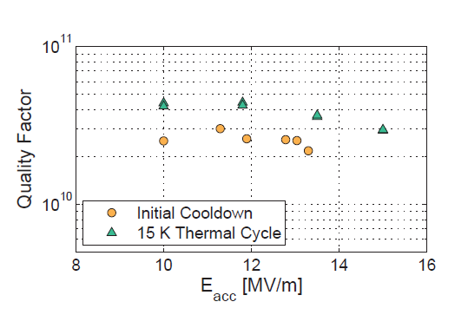
Role of thermal cycling of cavities
Paper by N. Valles et al., Cornell University
Different cool down velocities in vertical tests and module tests show change of the quality factor
Rise of quality factor Q₀ between 5% and 15%
Thermal cycling as additional ‚method‘ to standard cavity treatment?
Quality factor in HTC-2 of the prototype cavity at 1.6K before and after thermal cycle. (Error bars 20%)
Proceedings of IPAC2013, Cornell ERL Main Linac 7-Cell cavity performance in horizontal test cryomodule qualifications, N. Valles et al.

Slide 3
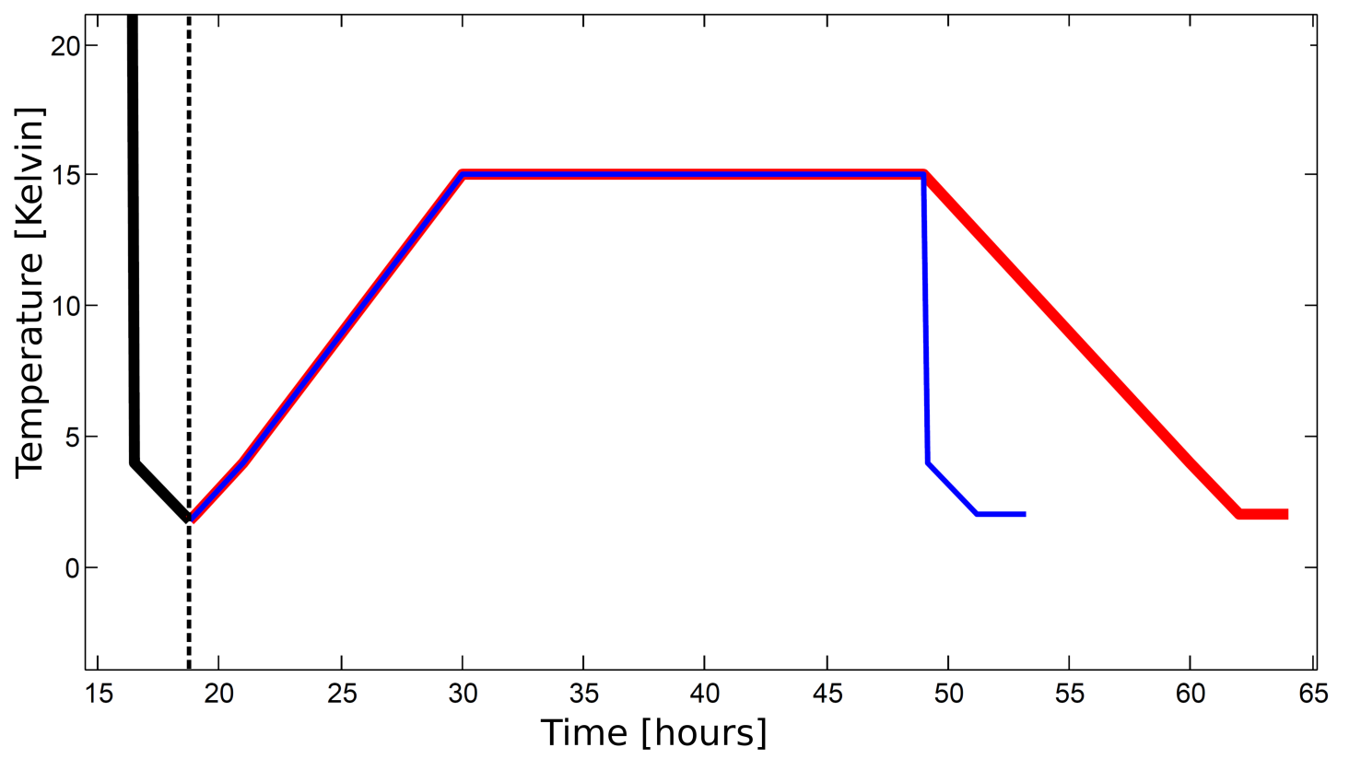
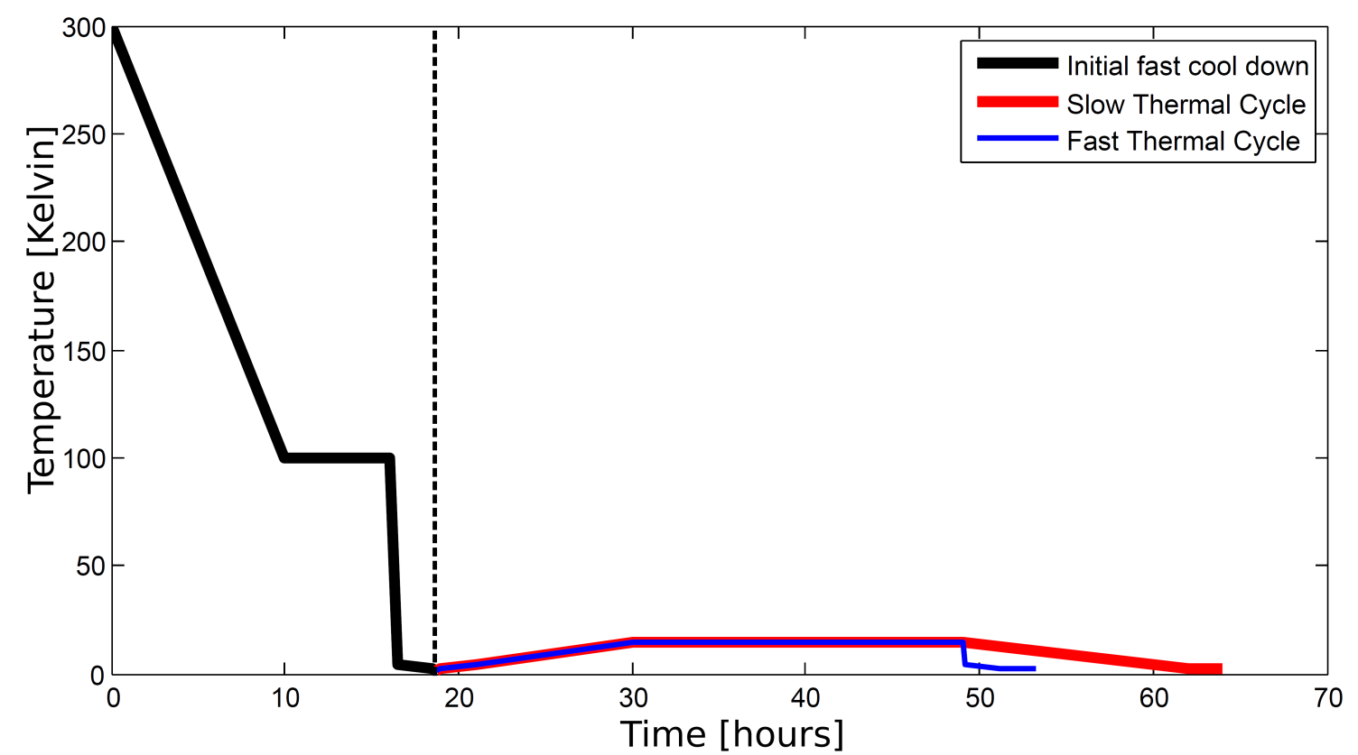
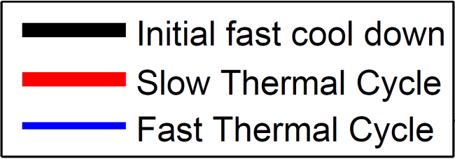
Cool downs and thermal cycles
Initial fast cool down (DESY standard):
From 300K slow to 100K
At 100K for 6h (Q-disease)
From 100K fast to 4K (~30min)
Pumping to 2K (~ 2h)
Pumping to 1.8K (~ 20min)
Slow cool down
thermal cycle
Fast cool down
thermal cycle
Initial fast cool down
Thermal cycling

Slide 4
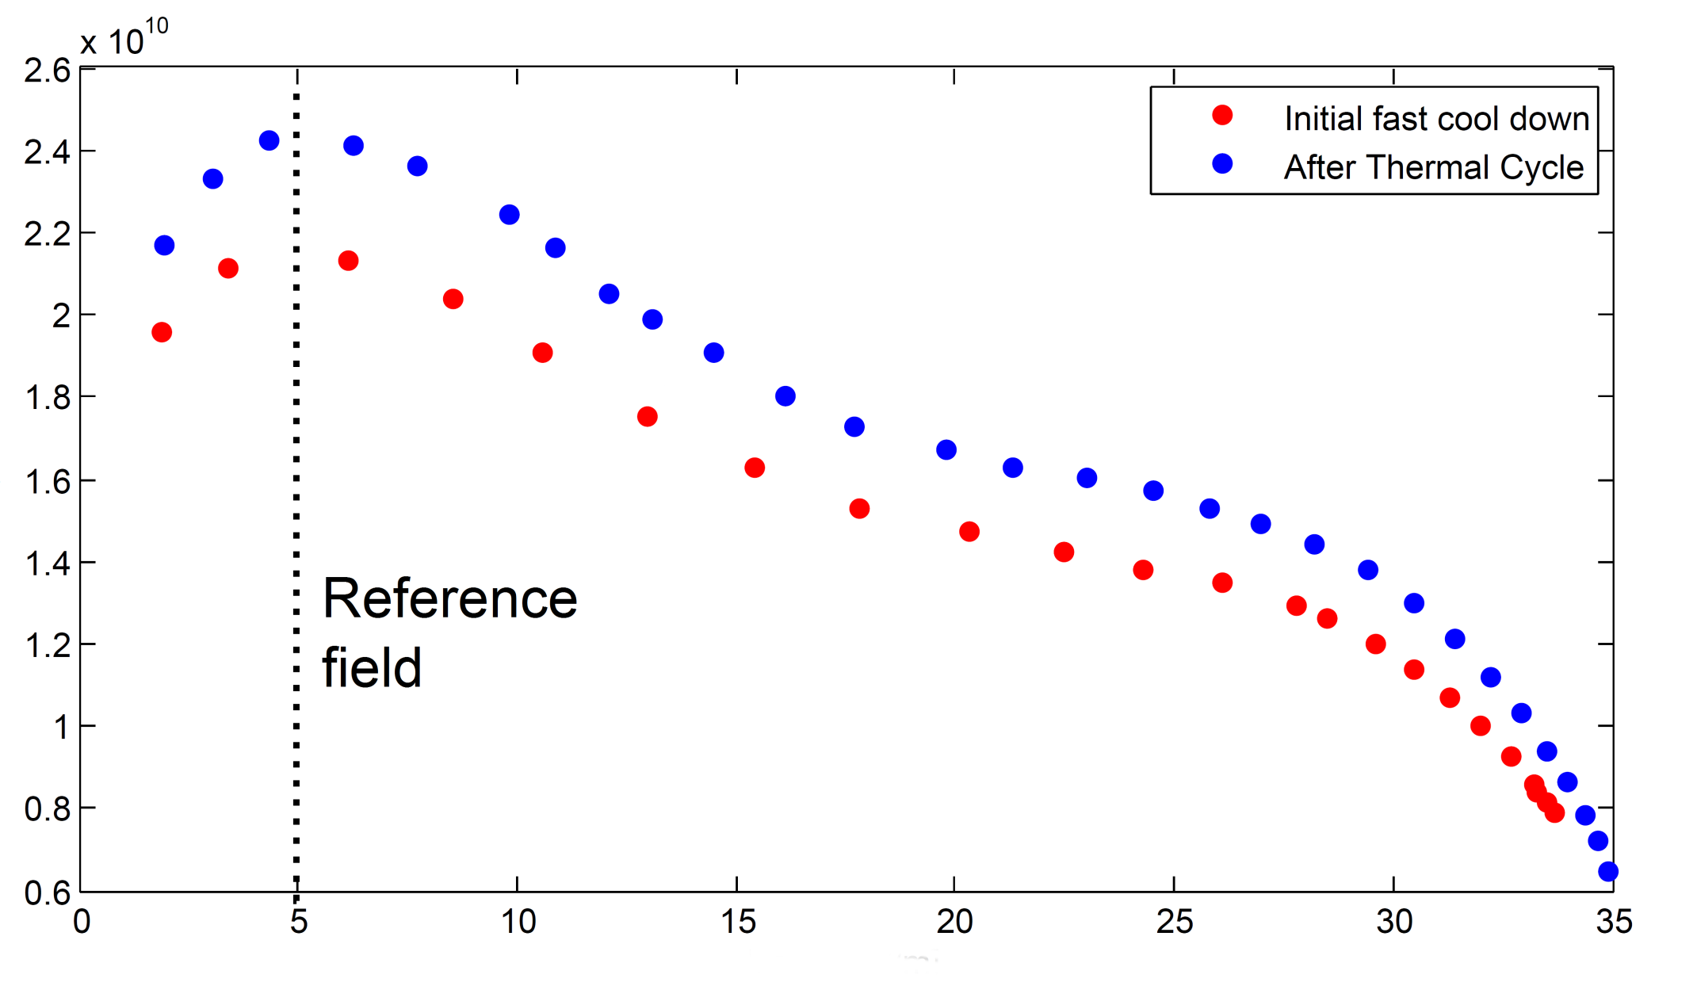
Example: CAV00551 Q(E) curve
Q₀
Eacc [MV/m]

Slide 5
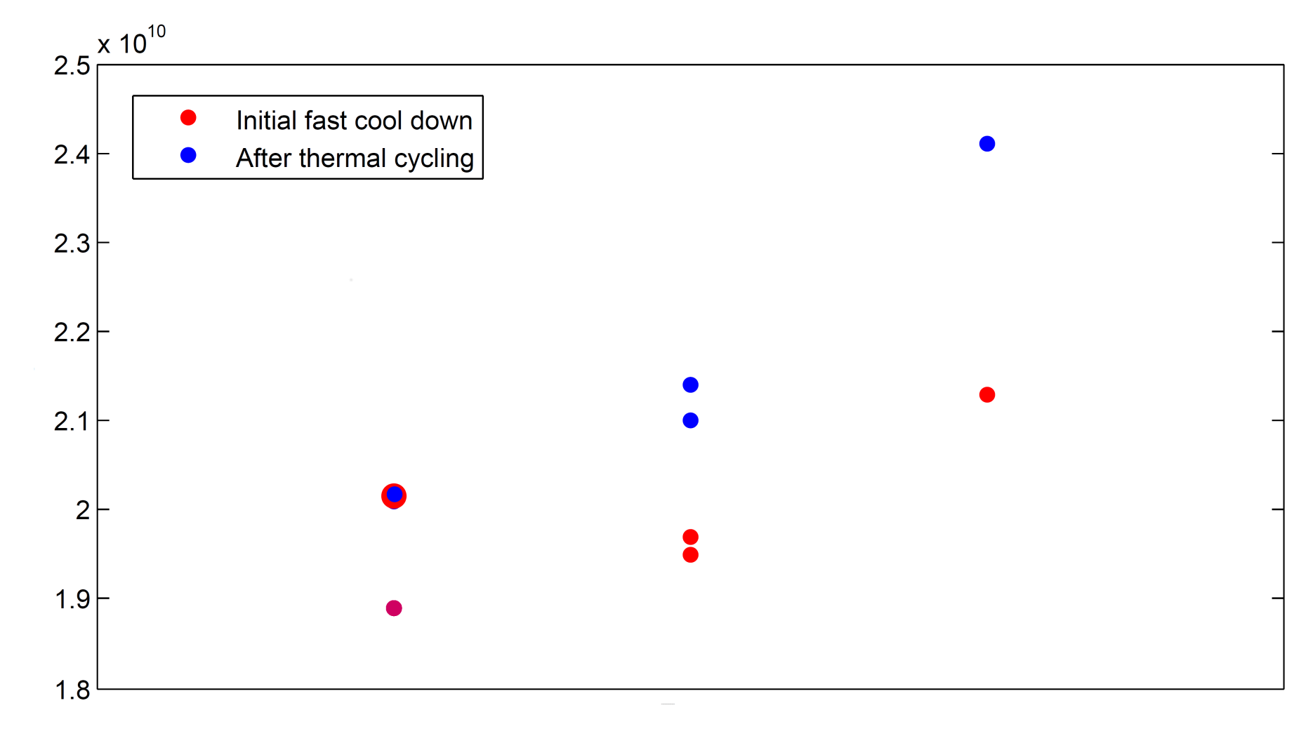
Comparison of different cavities
All values at 5MV/m
Typically 10% rise
Q₀
Q₀ drop after 1st power rise
After TC Q₀ rise
CAV00064
CAV00071
CAV00551
CAV00551 slow cycle
CAV00071 slow cycle, no He-vessel
CAV00064 fast cycle, but Q₀ drop in-between two power rises in initial measurement

Slide 6
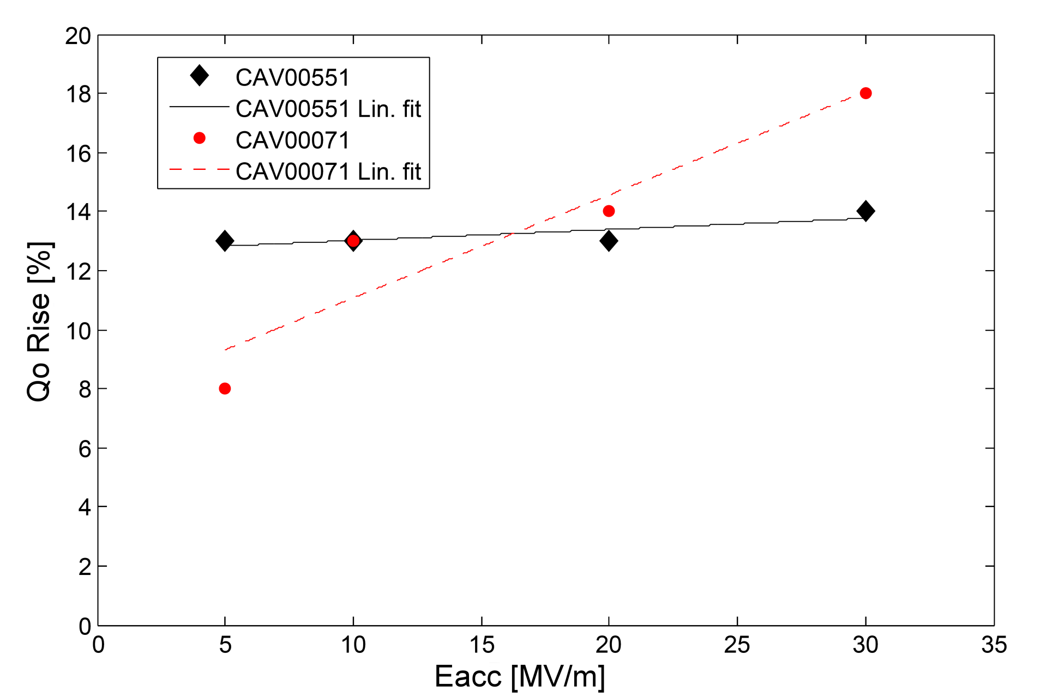
Q₀ rise depending on accelerating field
CAV00551 with He-vessel, CAV00071 without He-vessel

Slide 7
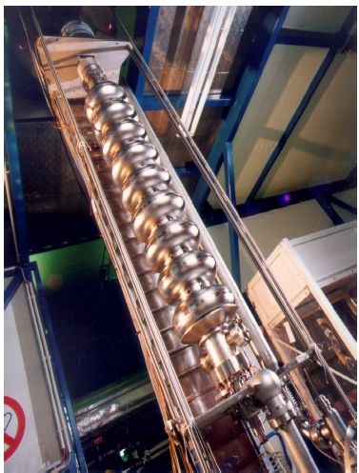
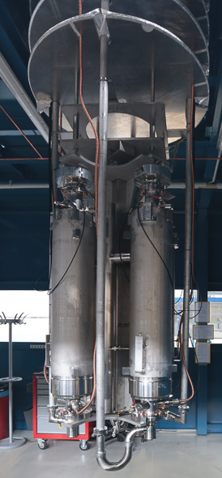
Cavity with He-vessel and cavity without He-vessel
Cavity with He-vessel in insert
Cavity without He-vessel in insert
Insert materiales:
Holding plates:
Stainless steel
Connecting rod:
Titanium
Thanks to D. Reschke
Photo: D. Noelle

Slide 8
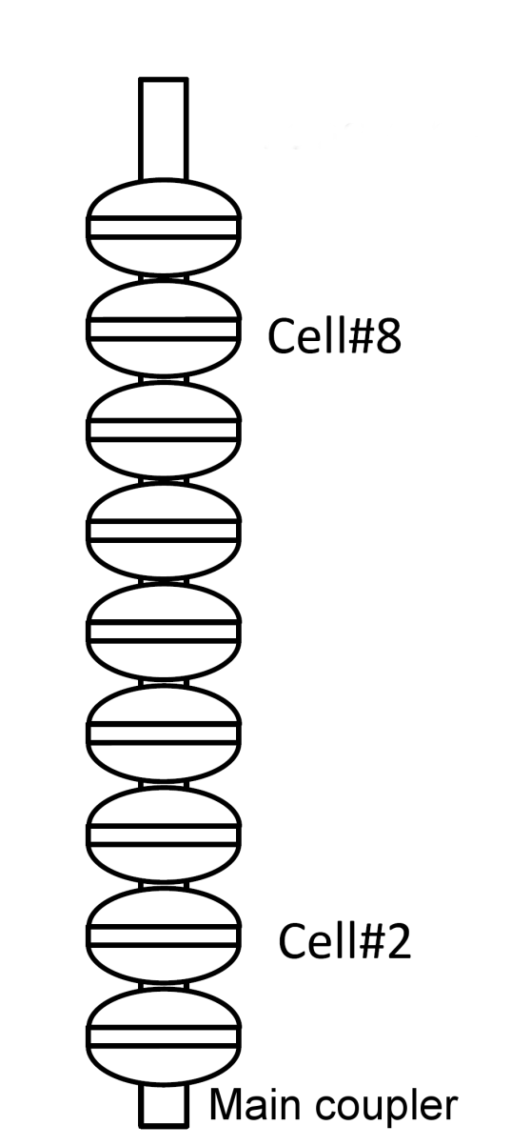
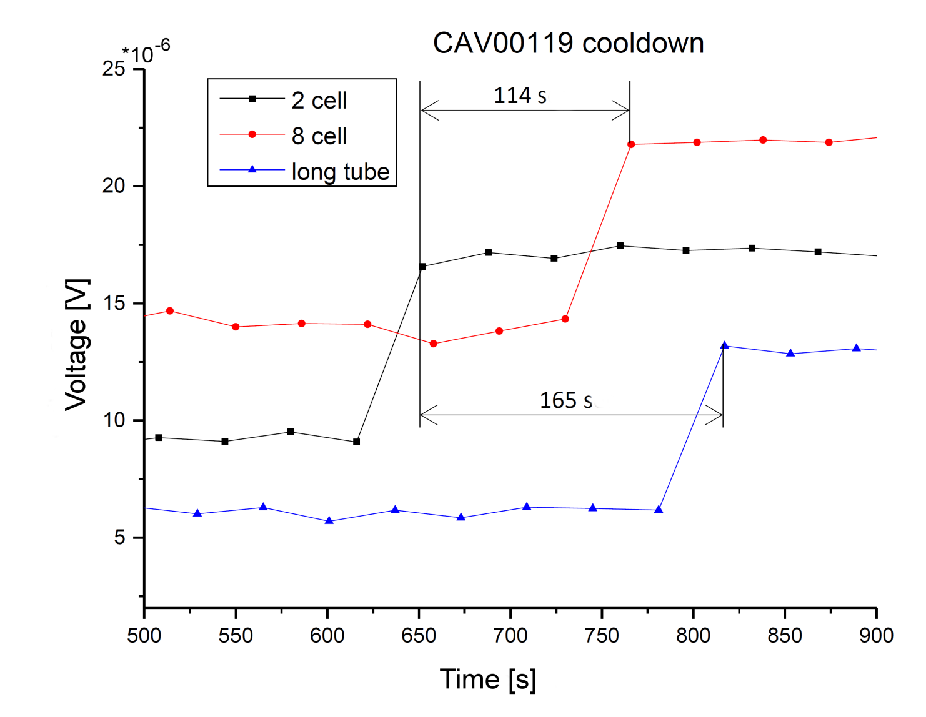
Temperature difference in cool down
Measurementduring standard fast cool down
Eddy current measurement with coils to determine transition from NC to SC state
Critical temperature reached at different point in time

Slide 9
Summary and Outlook
Q₀ rise after thermal cycling (~10%)
Possible field dependency for cavities without
He-vessel
Further measurements are planned
Explore the role of the current induced by the metal-metal junction
Explore cooldown rates
Combining measurement with an Eddy Current System

